Slide 1
Welcome to the Inclusion College!
Find your name plate at your assigned table!

Slide 2
Inclusion College Lead Facilitator
Daphney Rose Bitanga
Director Diversity, Equity and Inclusion

Slide 3
Introductory Reflection
Why is this position important to you?
Why is this role important to your chapter specifically?
What is the one thing you hope to take away from our time together this weekend?

Slide 4
Learning Outcomes
Discover the impact of personal identity in fostering diversity, equity and inclusion, and understand how their unique perspective contributes to creating a more inclusive sisterhood.
Cultivate key skills that empower them to design and lead inclusive, engaging and collaborative programming, events and experiences that resonate with all members.
Deepen their understanding of Pi Beta Phi’s Commitment to Diversity, Equity, and Inclusion, and explore actionable ways their chapter’s operations can align with and strengthen this vision.
Develop effective strategies to evaluate chapter inclusion efforts, using meaningful data to drive initiatives and create valuable collaboration opportunities that enhance member satisfaction and belonging.

Slide 5
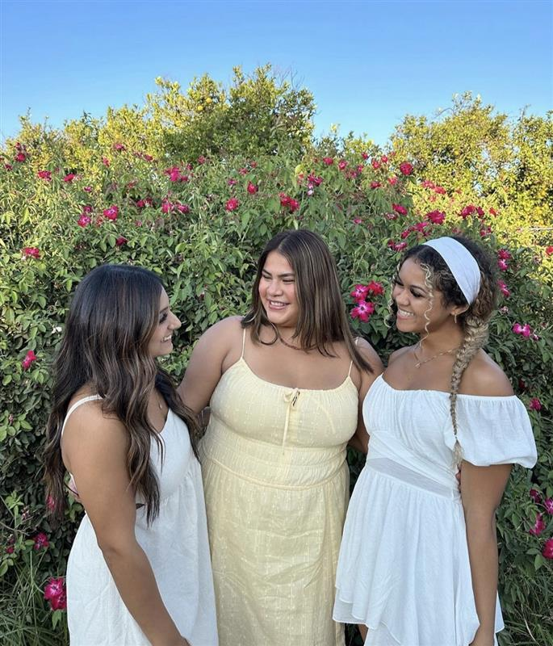
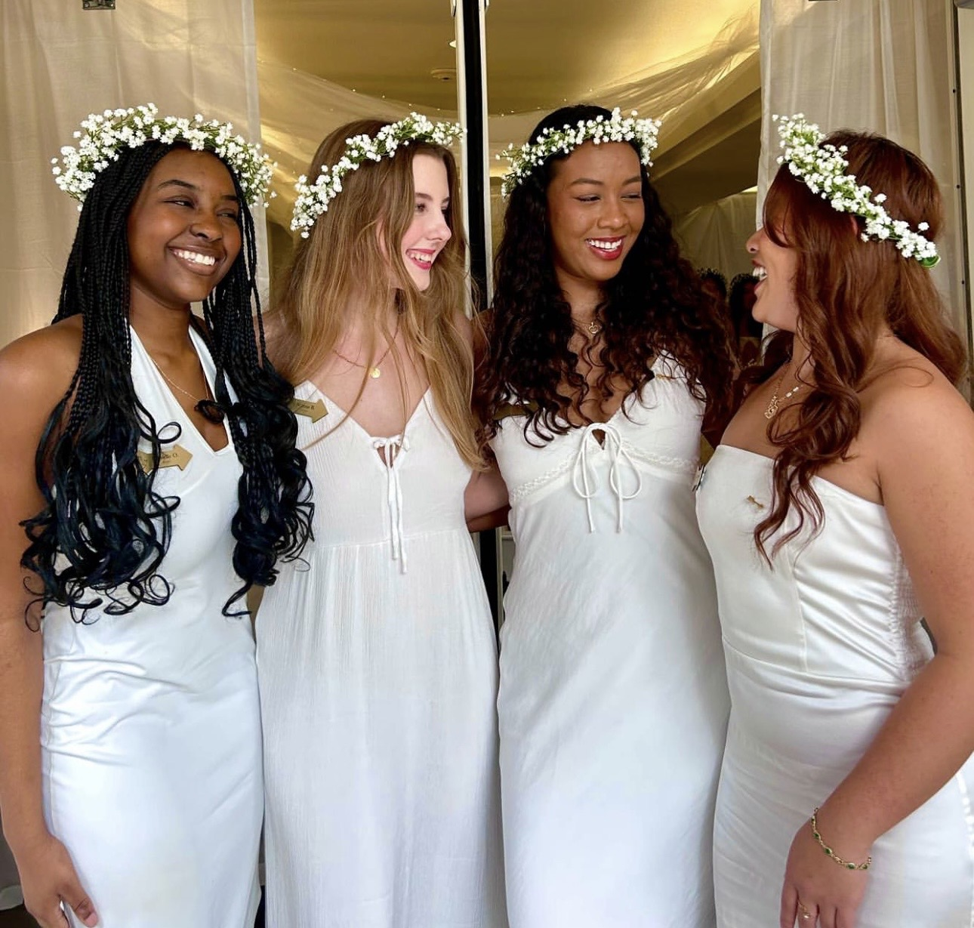
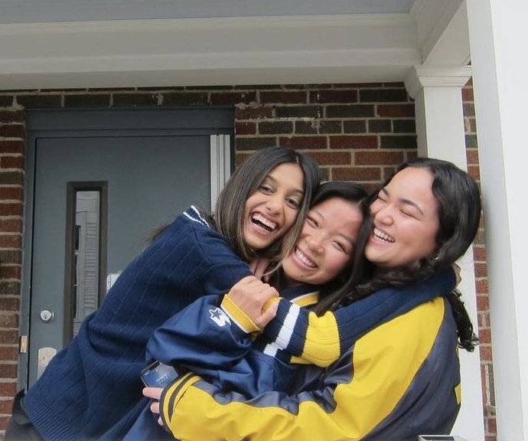
Tonight
Tomorrow
Sunday

Slide 6
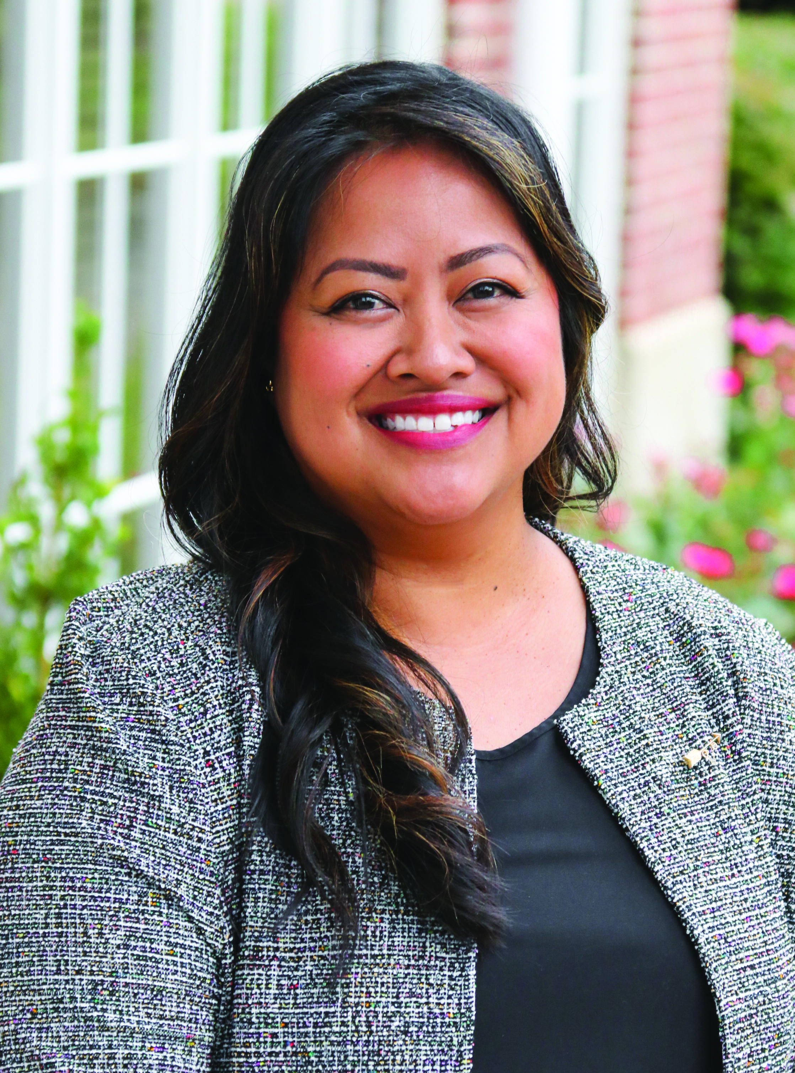
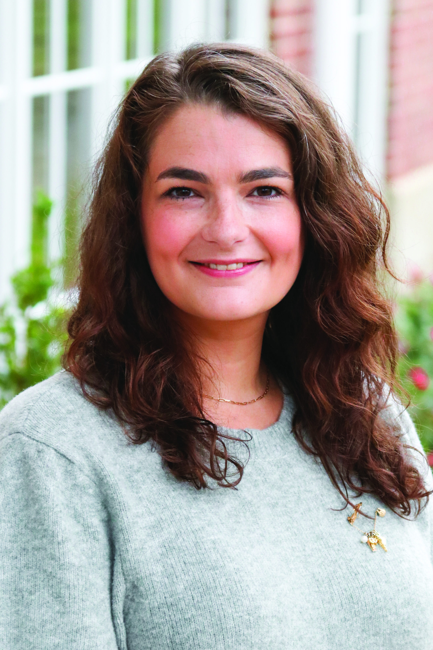
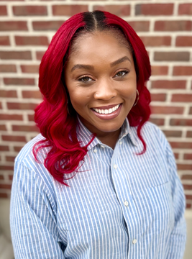
Meet Your Facilitators
Daphney Rose Bitanga, California Eta
Director Diversity, Equity Inclusion
Marisa Stribling,
Oregon Alpha
Collegiate Region 7 Director
Teresia Greer Williams, Delta Sigma Theta Sorority, Inc.
HQ Education and Inclusion Director

Slide 7
Introduction Activity
At your table, take a few minutes to introduce yourselves by sharing your name, chapter, hometown, year in school and major!
Decide on a name for your table!!

Slide 8
Seven Things in Common

Slide 9
Table Name Reveal!

Slide 10
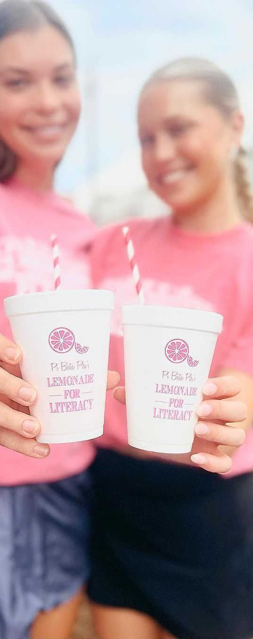
Saying Yes to Pi Phi
Why do you say yes to Pi Phi?
Who helps you say yes to Pi Phi?
How do you encourage others to say yes to Pi Phi?

Slide 11
Thanks for an amazing first night!
Don’t forget if you signed up for the Affinity Group Meet Ups, those meet ups will be happening tomorrow morning!

Slide 13
Welcome to the Inclusion College!
Day Two

Slide 14

Shared Commitments
Lessons Leave, Stories Stay.
Embrace Openness and Honor Varying Perspectives
Assume Positive Intent
What other commitments should we consider? ​
Let's take 3-5 minutes to discuss any additional ground rules we should add to this list.

Slide 15

I AM…
I AM...
I AM…
I AM...
I AM…
I AM…

Slide 16
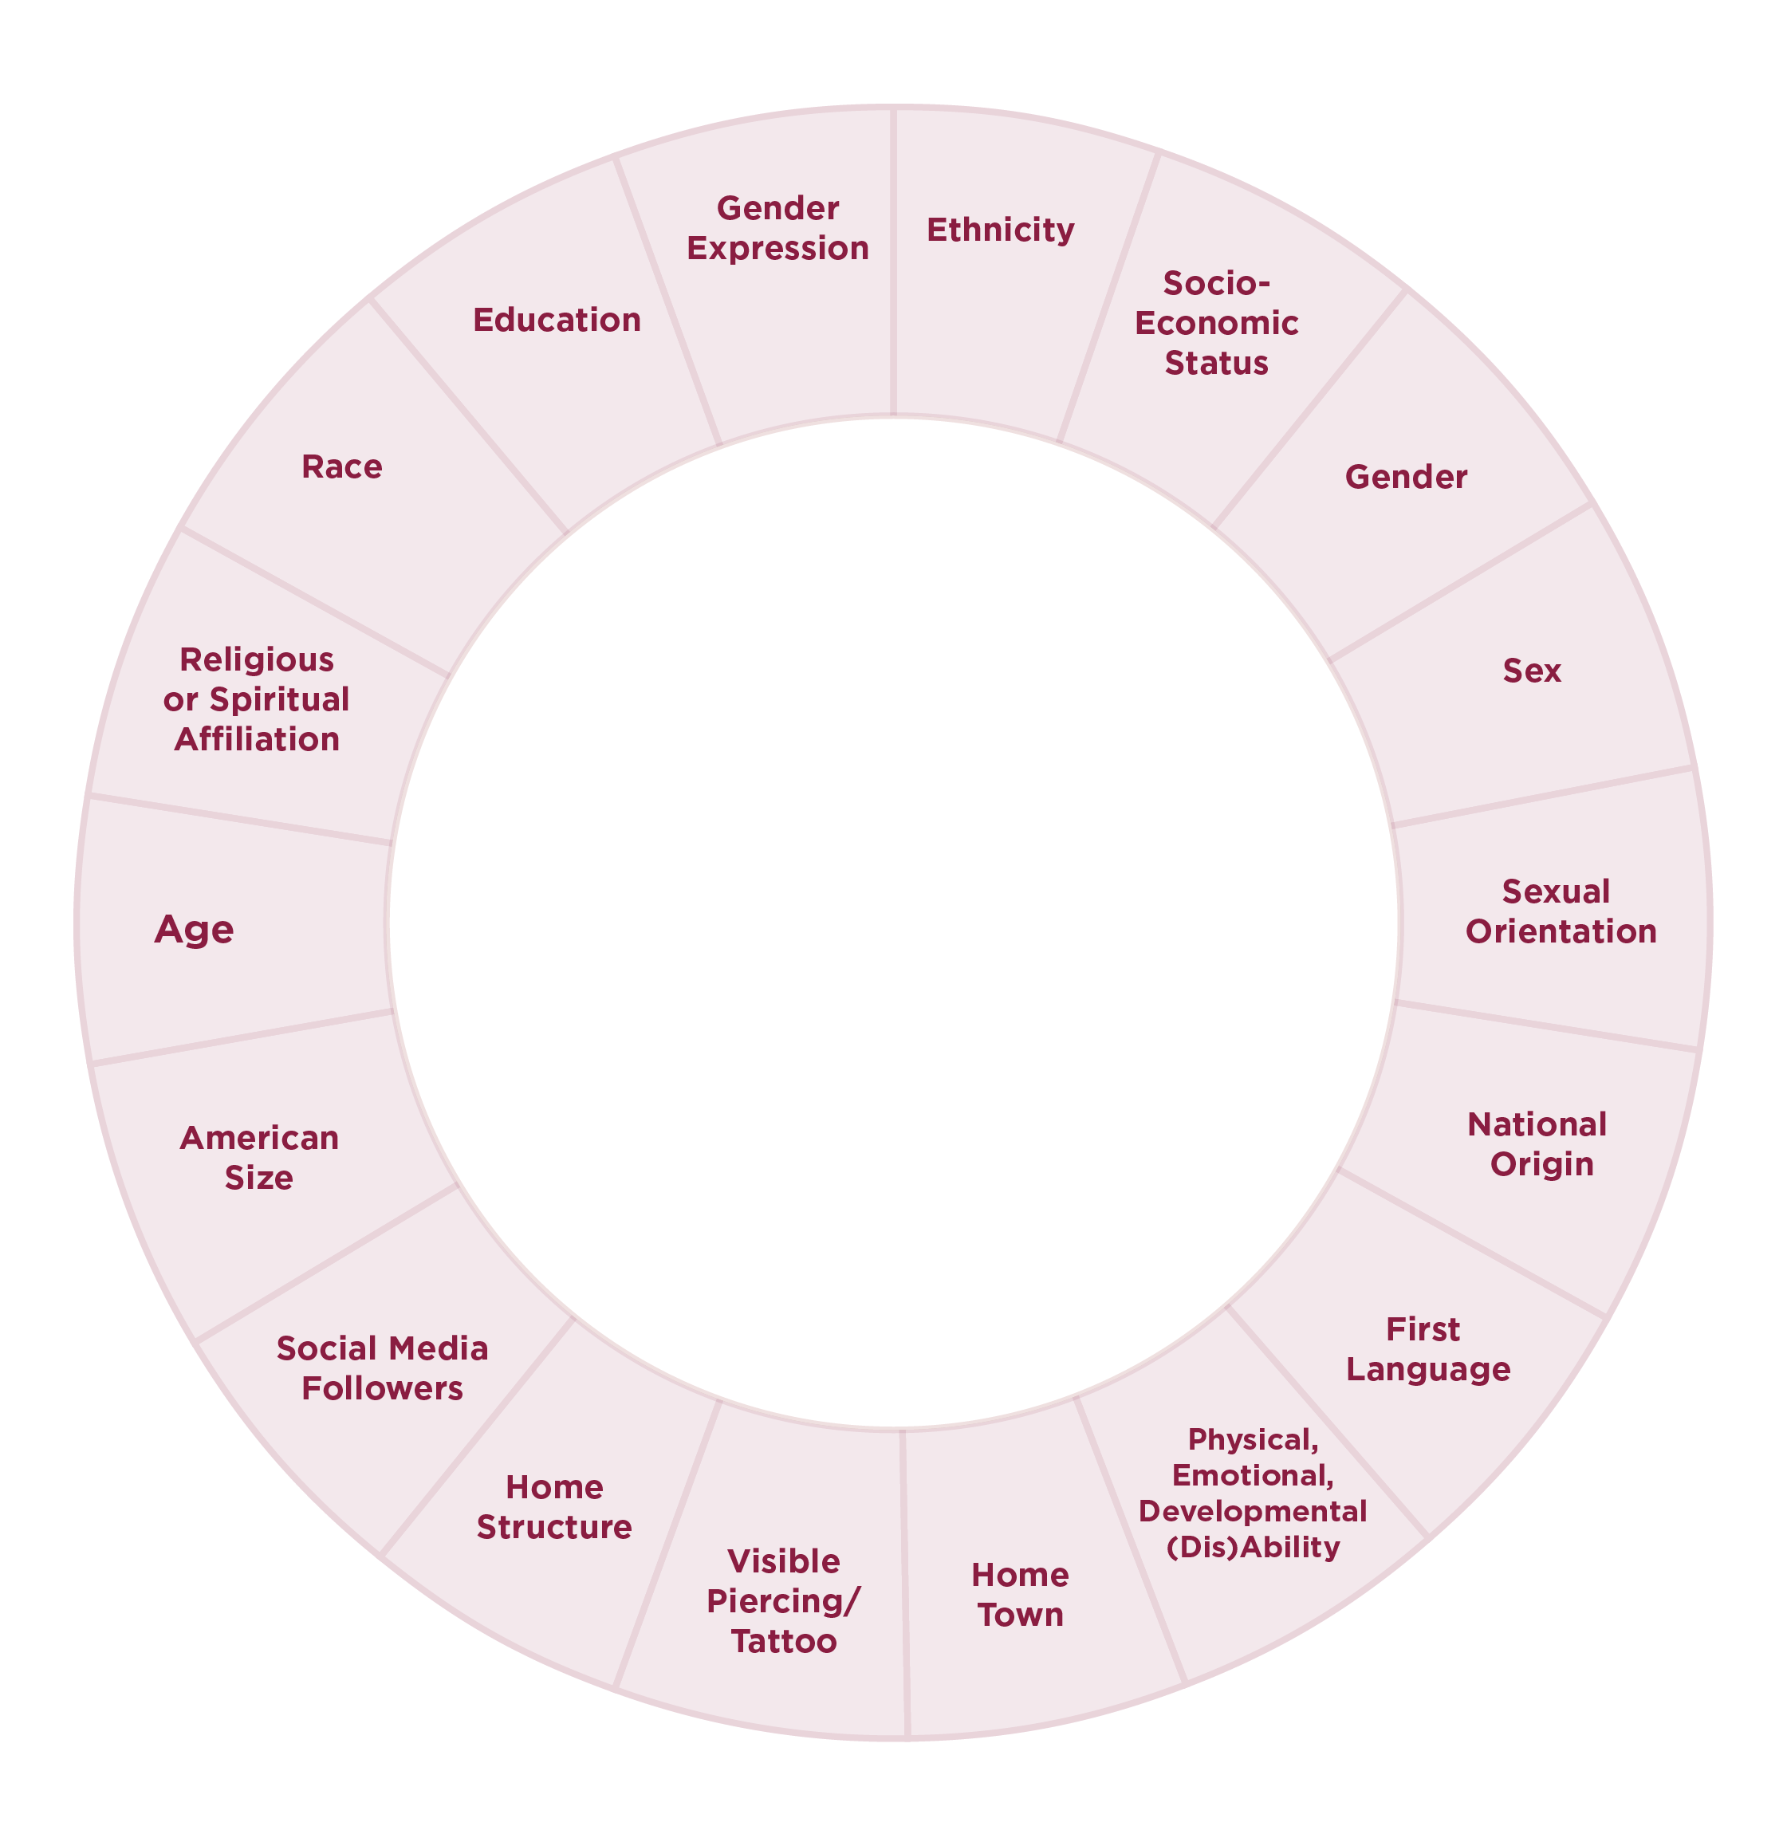
Social Identity
Involves the ways in which one characterizes oneself, the affinities one has with other people, the ways one has learned to behave in stereotyped social settings, the things one values in oneself and in the world, and the norms that one recognizes or accepts governing everyday behavior
Pi Beta Phi Inclusive Language Guide

Slide 17

Social Identity Pair and Share
Review the Social Identity Wheel:
Share identities on the wheel that are more important when describing yourself
Share one challenge you have personally face in understanding your own identity or another person’s identity.

Slide 18
Understanding Pi Beta Phi’s
Commitment to Diversity, Equity and Inclusion

Slide 19
Quick Group Poll
Raise your hand if you are brand new in this role
Raise your hand if you served in the DCI or VPI role last year
Raise your hand if you served in another chapter leadership team position last year
Raise your hand if this is your first leadership role in Pi Phi
Raise your hand if this is your first leadership role in college

Slide 20
As true friends, we honor the uniqueness of each sister. We empower one another through meaningful relationships grounded in empathy. We promise an inclusive sisterhood where every member feels welcome, is supported and knows they belong.
As the first fraternity for women, we own our role and responsibility in the fraternal movement. We recognize our power and privilege as college-educated women to work for an equitable society. We commit to developing the servant leaders our diverse world needs.

Slide 21
Pi Phi DEI Resources

Slide 22
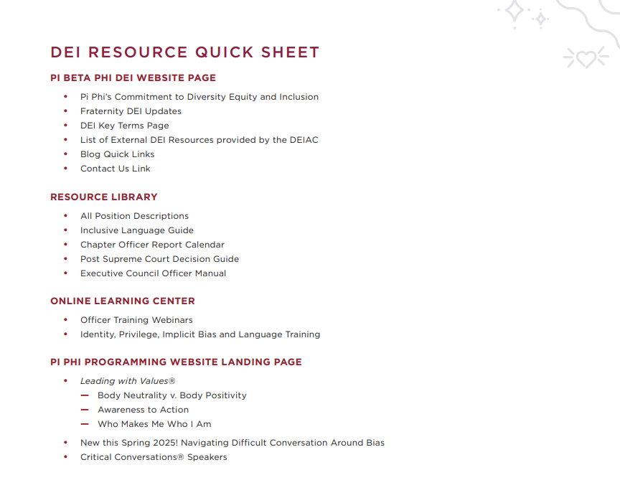
Resources Review and Discussion

Slide 24
Aligning Your Role and Chapter with PBP Commitment

Slide 25
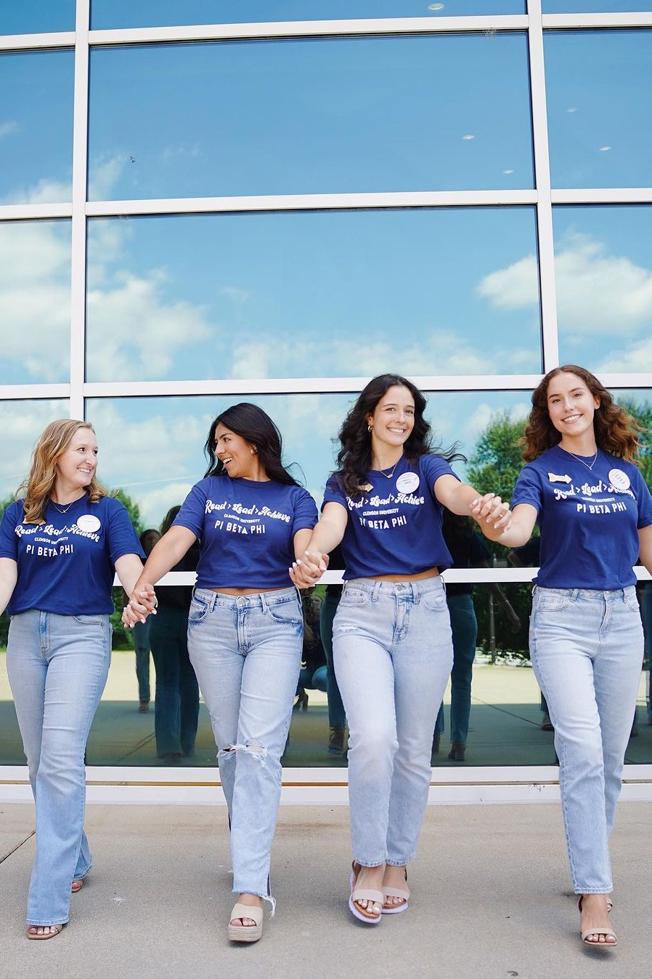
Activity
As a table you will have 5-7 minutes to decide the following about the group of pictures:
Pair each picture up and describe those pairings. What attributes/characteristics make them a good pair?
What knowledge and skills should the person possess to utilize the objects in each pair of pictures?

Slide 26
VP Inclusion Position Description,
Responsibilities, Knowledge and Skills

Slide 27
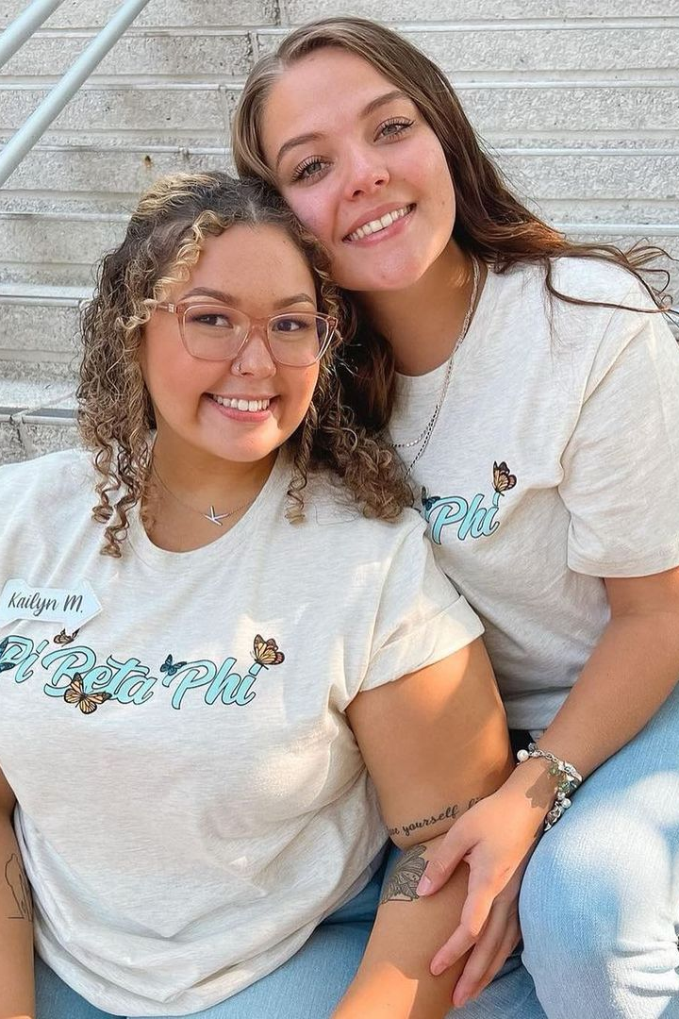
Ranking Our Needed Skills
SKILLS | RANK YOUR CONFIDENCE IN EACH SKILL 1-5 (1 LEAST SKILLED, 5 MOST SKILLED)

Slide 28
Tips
Keep a positive attitude — progress doesn’t happen overnight. Stay positive and know that you are doing the best you can as you continue to grow.
Use resources provided by Pi Phi, your institution and DEI experts and thought leaders.
Ask for feedback from your CP, Executive Council, DCI, Committee members and AAC. Receiving feedback can be frightening at times. However, getting timely feedback can help you continue to sharpen your skills as a leader.
.

Slide 29
Tips
4. Don’t be afraid to delegate tasks to your team members. This encourages creativity and opens your eyes to new ways to approach problems and tasks.
5. Plan, Plan, Plan. There will be times that you will need to be reactive, however the more you can plan and be proactive in your role, the more in control you will feel.
6. Never think you know enough. We are lifelong learners and there is always something to learn. Be okay with not always knowing the answers and be open to learning a lot in this role.

Slide 30
Monthly Chapter Evaluation

Slide 31
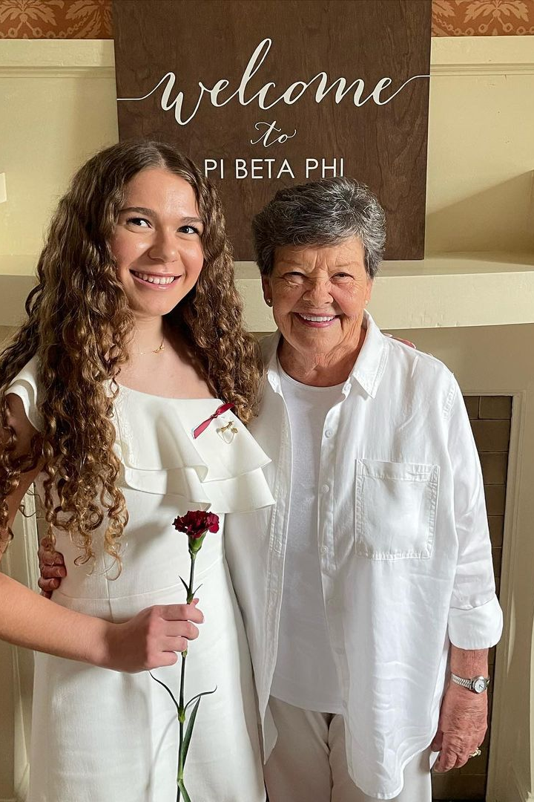
Monthly Chapter Evaluation
Each month, Vice Presidents will report their specific team's accomplishments from the previous month utilizing the prompts within the template. These accomplishments should be in alignment with the standards listed in the MCE standards document for your position.
Completing this report should take no longer than 15 minutes for each person on your Executive Council. Keep it simple but meaningful!

Slide 33
Meeting Ritual Update
College Weekend 2025

Slide 34
The Origin of Our Meeting Ritual
Historical Significance:
Meeting Ritual adopted in 1893, 26 years after our founding.
Emma Harper Turner determined we need a uniformed opening and closing to our meetings.
Purpose:
Connect all members in shared, unifying practice of saying meeting Ritual.
Modern Challenges:
Not consistently used across chapters.
Some members feel disconnected or face challenges in practicing it.
Misalignment with the beliefs or feelings of members.
Our Commitment:
Pi Beta Phi is focused on empowering one another and creating a sisterhood where our members feel seen, understood, supported, and valued.

Slide 35
Evolving Meeting Ritual
Informed Decision
Result of a two-year process of feedback, research, and dialogue.
Preserving Tradition
Evolution honors our traditions.
Aims to ensure every sister feels connected, welcomed, and valued.
Purpose Remains Unchanged
Sets a unified tone for conducting Fraternity business.

Slide 36
The Journey to Evolve
The 7 Guardrails for Ritual Evolution:
The Creed (phrases beginning with "Whatsoever") remains unchanged and used in the closing
Removes references to Christ, God, and Trinity
Infers core values without explicitly listing them.
Maintains tone, cadence, and elevated language.
Remains simple, short, and memorable.
Aligns with Ritual's original purpose.
Preserves historical significance.

Slide 37
Reflect on what it means to live our Pi Phi values

Slide 38
What if this was how I felt?

Slide 39
What this Means for You
Pi Phi is sharing with alumnae clubs, members at large in phased communication plan
Current Ritual remains in use until Fall 2025.
Does not impact Initiation
Meeting Ritual Evolution Guide to follow.

Slide 40

Quotes from members this week...
"A tradition is just a tradition because it carries on. Soon, this new Ritual will be our tradition" - Chapter Officer
"While it's hard to personally let go of a long-standing tradition because its near and dear to my heart, it's worth it to make those that feel conflicted more included." - Chapter President
"I may need help in supporting our members who do identify as Christian or Catholic as this continues to roll out." - Chapter President
"I just attended the meeting Ritual zoom and wanted to say thank you for all the work Grand Council and HQ have put into this. Beyond the fact that I'm personally excited to see these changes that seem well thought out – I really appreciate how this is being announced and that the Fraternity is giving members a chance to feel heard and take time to process." - AAC Chair
"Our chapter has been using a meeting Ritual they have written, which they love. My biggest concern is getting them to adapt the new meeting Ritual." - AAC Chair
"I welcome these changes, and I appreciate the way this has been handled by the Fraternity. We learned from past experience, and we are sensitive to those afraid of change. Pi Phi is growing!" – Foundation volunteer and past Fraternity Officer
"A tradition is just a tradition because it carries on. Soon, this new Ritual will be our tradition" - Chapter Officer
"While it's hard to personally let go of a long-standing tradition because its near and dear to my heart, it's worth it to make those that feel conflicted more included." - Chapter President
"I may need help in supporting our members who do identify as Christian or Catholic as this continues to roll out." - Chapter President
"I just attended the meeting Ritual zoom and wanted to say thank you for all the work Grand Council and HQ have put into this. Beyond the fact that I'm personally excited to see these changes that seem well thought out – I really appreciate how this is being announced and that the Fraternity is giving members a chance to feel heard and take time to process." - AAC Chair
"Our chapter has been using a meeting Ritual they have written, which they love. My biggest concern is getting them to adapt the new meeting Ritual." - AAC Chair
"I welcome these changes, and I appreciate the way this has been handled by the Fraternity. We learned from past experience, and we are sensitive to those afraid of change. Pi Phi is growing!" – Foundation volunteer and past Fraternity Officer
"A tradition is just a tradition because it carries on. Soon, this new Ritual will be our tradition" - Chapter Officer
"While it's hard to personally let go of a long-standing tradition because its near and dear to my heart, it's worth it to make those that feel conflicted more included." - Chapter President
"I may need help in supporting our members who do identify as Christian or Catholic as this continues to roll out." - Chapter President
"I just attended the meeting Ritual zoom and wanted to say thank you for all the work Grand Council and HQ have put into this. Beyond the fact that I'm personally excited to see these changes that seem well thought out – I really appreciate how this is being announced and that the Fraternity is giving members a chance to feel heard and take time to process." - AAC Chair
"Our chapter has been using a meeting Ritual they have written, which they love. My biggest concern is getting them to adapt the new meeting Ritual." - AAC Chair
"I welcome these changes, and I appreciate the way this has been handled by the Fraternity. We learned from past experience, and we are sensitive to those afraid of change. Pi Phi is growing!" – Foundation volunteer and past Fraternity Officer

Slide 41
Meeting Ritual Update
College Weekend 2025

Slide 42
Quick Reflection

Slide 43
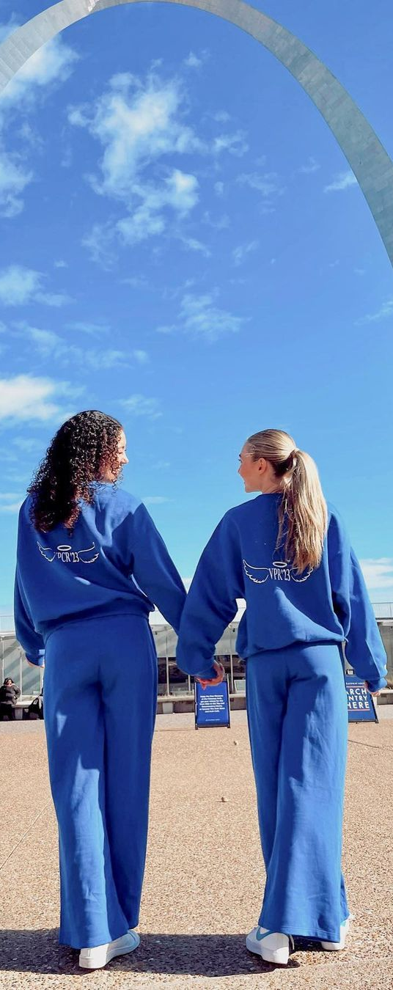
Agree or Disagree
My Chapter could benefit from more diversity, equity and inclusion-based education.
Members of my chapter are nervous about speaking about DEI topics.
Learning and celebrating different cultural holidays would be well received in my chapter.
Weekly talking points at chapter is a good way for me to communicate about this topic with the members of my chapter.
I feel pressure to know everything about topics that could be considered inclusion or equity issues in the world.
I have a clear grasp on what my chapter needs to increase our skills and knowledge to be equitable and inclusive.

Slide 44
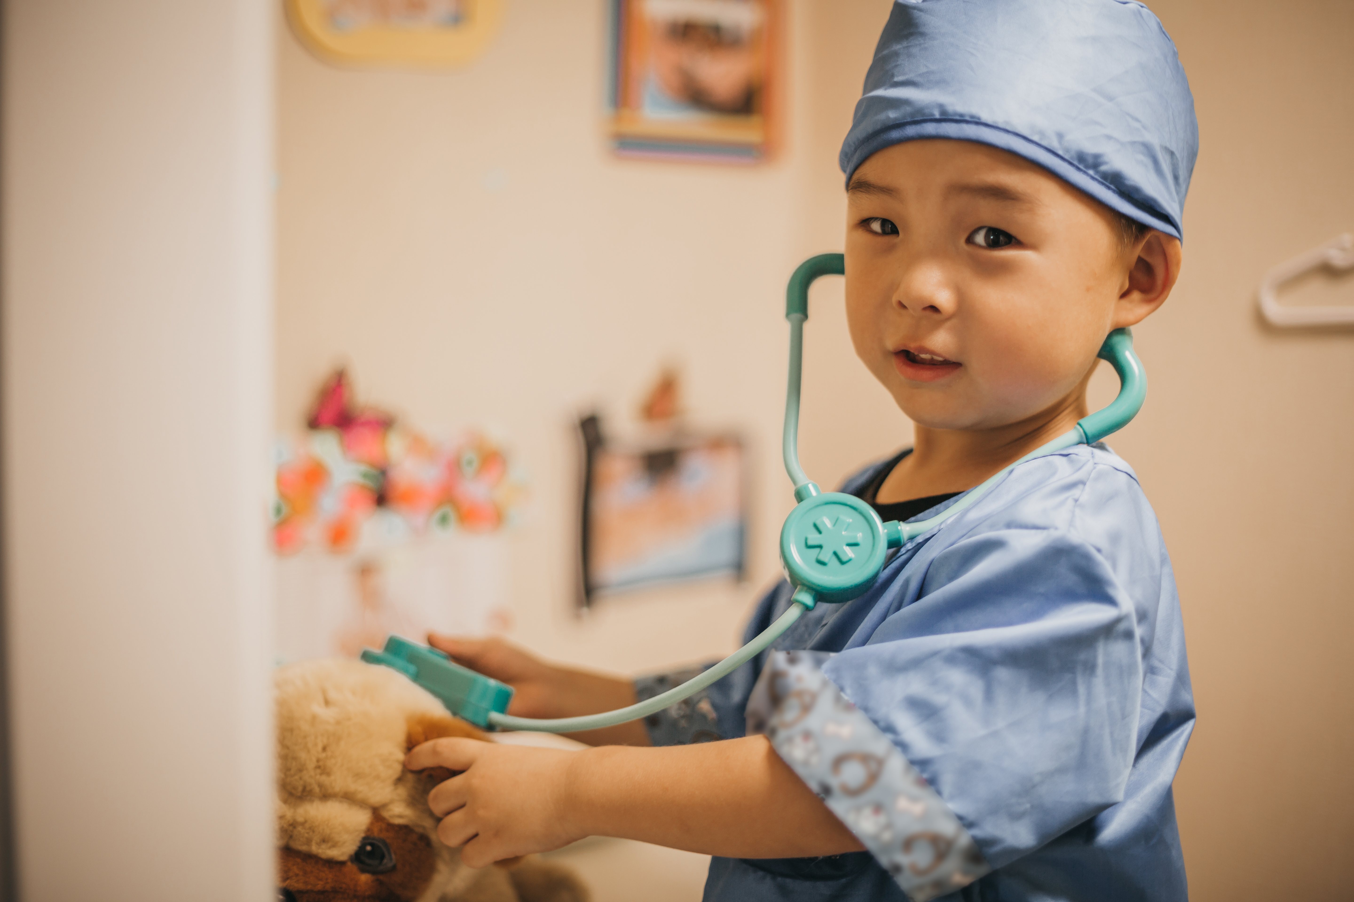

Slide 45
Table Discussion
What information would help you make decisions for your chapter?
How to best gather that information?

Slide 46
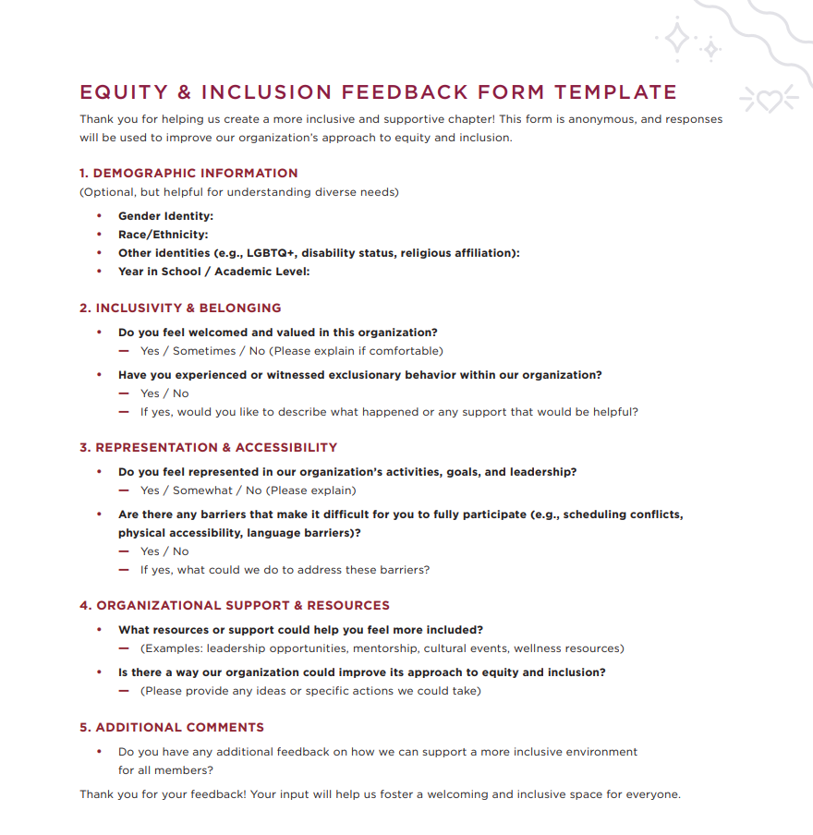

Slide 47
Annual Member Evaluation
Work with your VPME to consider the best way to use this data to understand your member’s experiences and hoped-for expectations for programming that you can consider offering later in the semester or school year.

Slide 48
Working together with your AAC Inclusion, DCI and other members of CLT

Slide 49
TACOS 4 LIFE

Slide 50
Processing Questions
What stood out?
Using your chapter and campus as an example, how would you approach this scenario?
What role could your DCI play in supporting this approach? If you don’t have a DCI, what CLT member could you ask to assist?
What communication methods would you use to communicate with your DCI or CLT member?
How would you follow up with your DCI to ensure tasks are completed? How could your AAC help support you both?
What other strategies could you utilize to maximize effectiveness?

Slide 51
Collaborative Partnership Ideas to Consider
Working with VPO on Bylaw Review
Collaborating with VPME on Sisterhood Event Themes
Facilitating discussions for Recruitment Spirit Week with VPR
Meeting regularly with VPCR to discuss Social Media Content
Contributing to budgeting or housing conversations with VPFH
Collaborating with appropriate VP to ensure events are accessible

Slide 52
Q &A Break

Slide 53
The Reality of DEI Advocacy

Slide 54
Free Write Exercise

Slide 55
Goal Setting, Planning and Building Your Inclusion Toolkit

Slide 56
What are the Top 3 DEI opportunities for your chapter?
What is my commitment to tackling these chapter opportunities during my term?

Slide 57
5-Minute Mental Break

Slide 58
Building Your Inclusion Toolkit

Slide 59
Final Track Q & A

Slide 60
Group A
Group B

Slide 61
Question 1. What is your full name? What does your name mean to you?
Question 2. Share with your partner a little bit about what family means to you? Who is in your family or who do you consider family?
Group B move 2 partners to your right.
Question 3. What is a time where you felt most confident in yourself?
Question 4. What was the first time you noticed you were different than others?
Question 5. Talk about a time where you realized you felt true belonging? What contributed to that feeling?
Group A move 1 partner to your right.
Question 6. What social identity do you hold closest to you? Why?
Question 7. What do you do to bring joy into your life?
Question 8. What do you feel you will uniquely bring to your role as VPI?

Slide 62
Remember that Equity and Inclusion work is not what you do FOR others, it is what you do WITH others.

Slide 63


































































