Slide 2
Welcome to
College Weekend 2025!
Risk Management College

Slide 3
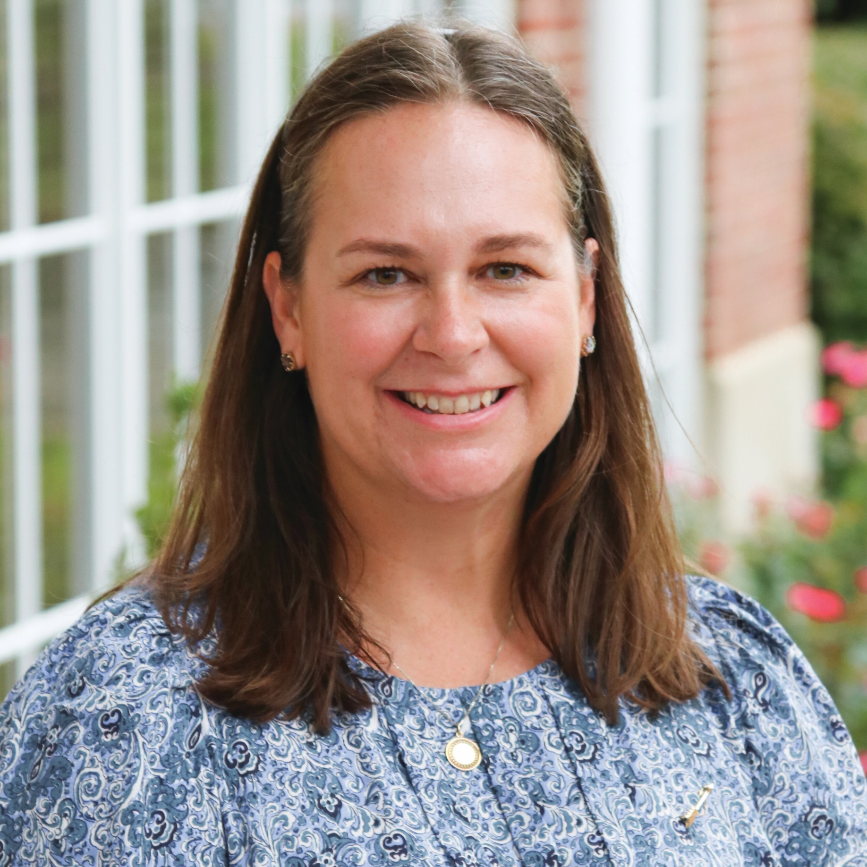
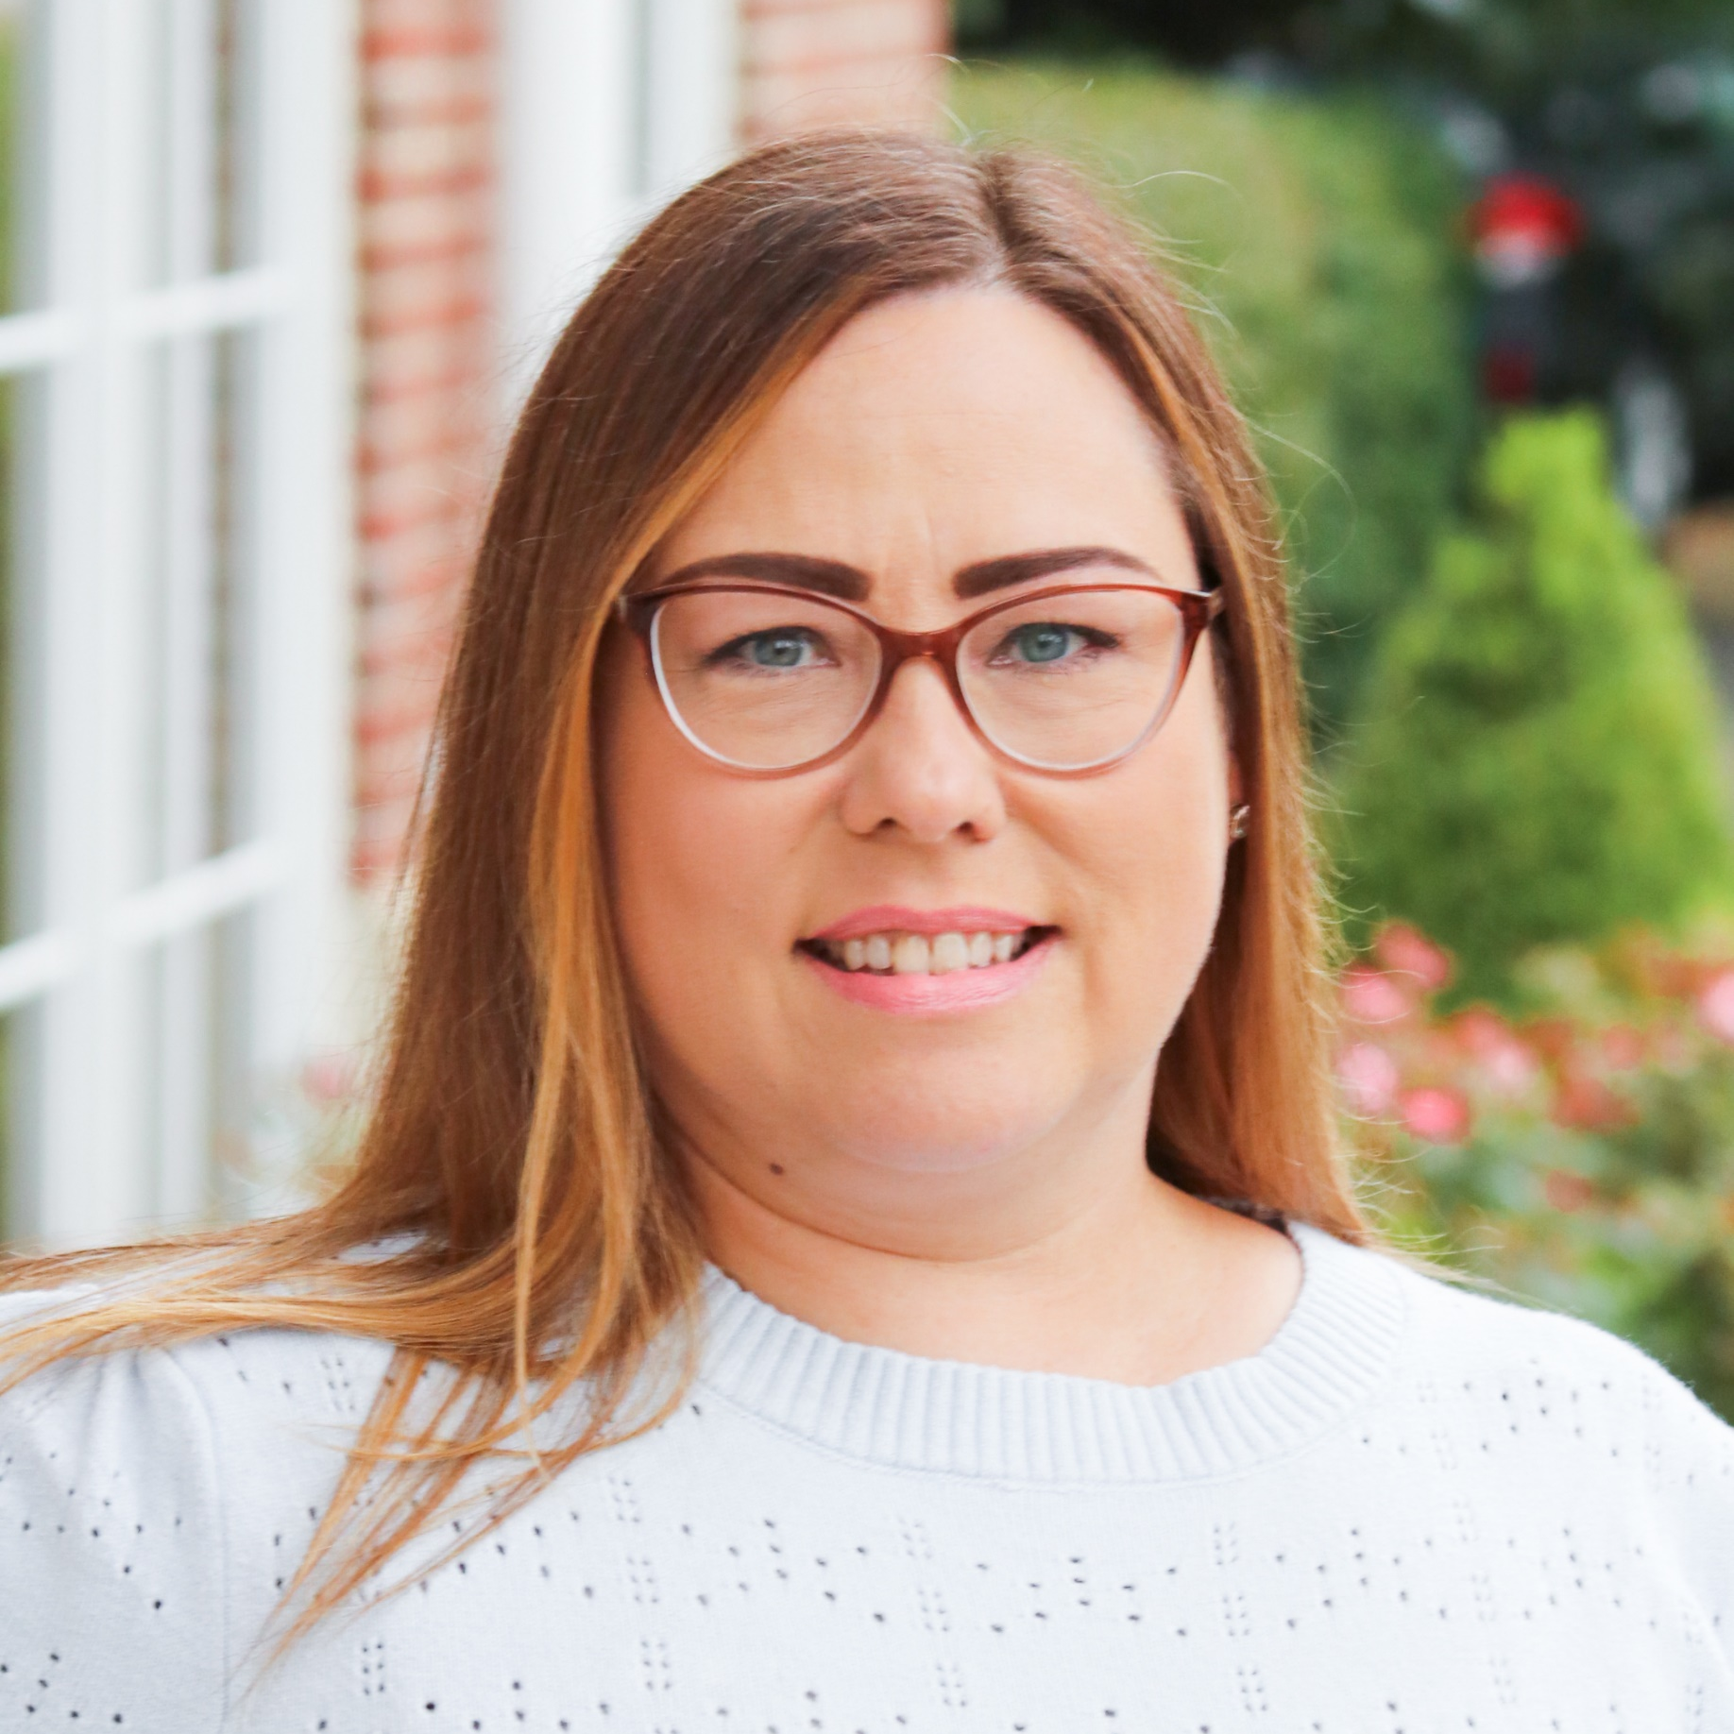
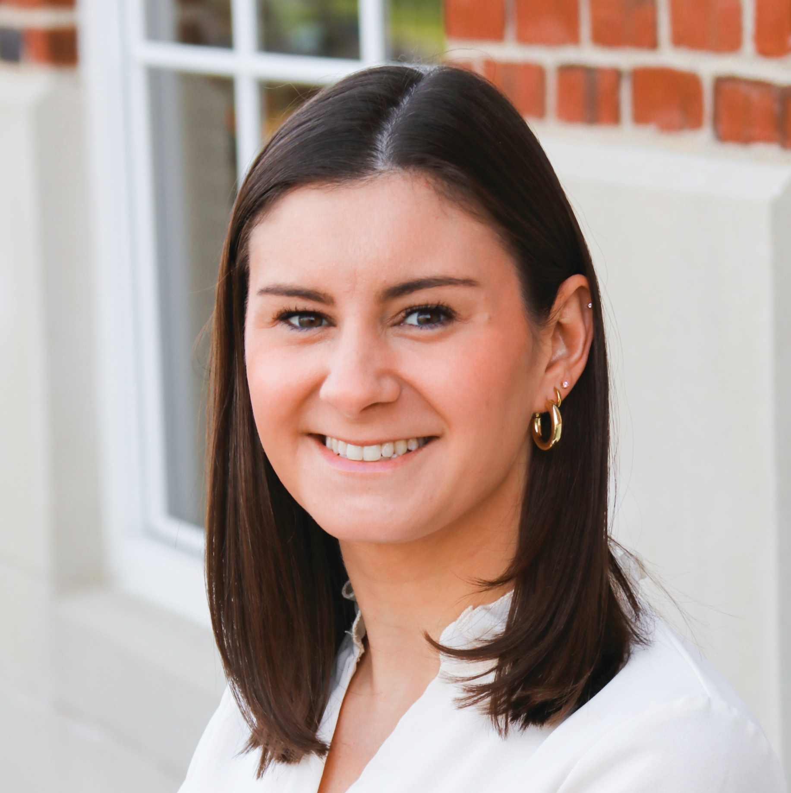
Your Facilitators
Jennifer Mandeville
Virginia Theta
Director Risk Management
Alison Pilgrim
South Dakota Alpha
Collegiate Regional Director
Emilia DeMarco
Headquarters Assistant Director of Chapter Services

Slide 4
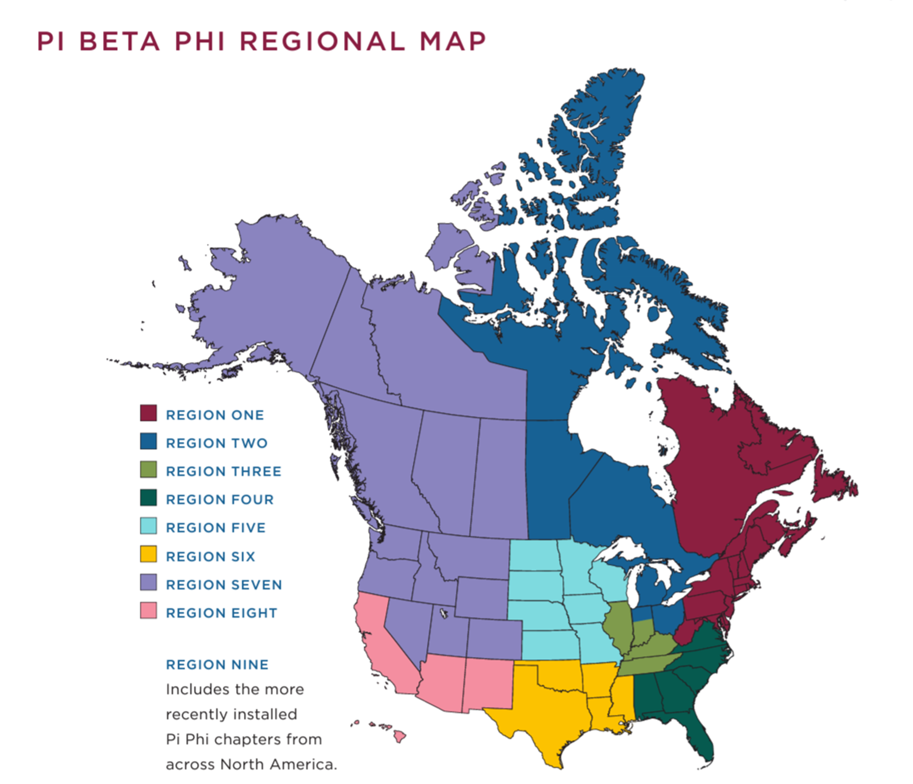
What You Need to Know
REGION ONE
REGION TWO
REGION THREE
REGION FOUR
REGION FIVE
REGION SIX
REGION SEVEN
REGION EIGHT
REGION NINE
Includes the more recently installed Pi Phi chapters from across North America.

Slide 5
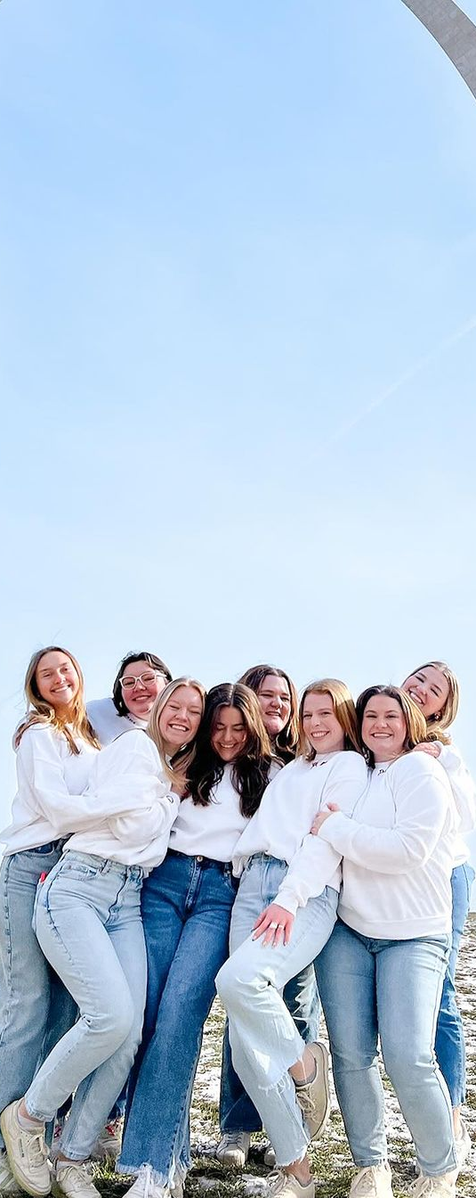
Stand up if you’re most looking forward to…
Identifying and developing best practices in event planning, policy education and member accountability that actively and effectively create a safe and inclusive environment for all members of your chapter.
Defining and creating context for Pi Beta Phi policies and procedures.
Articulating Pi Beta Phi’s event planning process and identifying events that require Regional Team approval.
Identifying areas of opportunity for comprehensive policy and prevention education within your chapter.
Gaining knowledge and comfort in using Pi Beta Phi's member accountability process to help members engage in our value of Personal and Intellectual Growth.

Slide 6
Your Role as VPRM
Why did I want to be a leader in my chapter?
Why did I accept the VPRM role?
Why is my position important?
How will I work with my Directors to relay the information I learn this weekend? How will I take good notes for them?
What other goals or learning objectives do I have for myself this weekend?

Slide 7
The Why Behind
Pi Phi Policies

Slide 8

The Why Behind Pi Phi Policies
Colleges & Universities
Laws
National Panhellenic Conference (NPC)
MJ Insurance
Housing facilities
Member safety and satisfaction

Slide 9
The Why Behind Pi Phi Policies – Case Studies
External | Pi Phi | Member Expectations
Laws (local, state/provincial, federal) NPC Unanimous Agreements Campus policies College Panhellenic Council policies | Constitution & Statutes Policy & Position Statements Event Planning and Management Guide Membership Status Guide Other manuals and guides Housing contracts Chapter’s local bylaws Monthly Chapter Evaluation | Member Obligations Pi Beta Phi’s core values Fraternity Ritual Constitution & Statutes Member Conduct Policy & Position Statement Campus Student Code of Conduct

Slide 10
Policies in Conflict
Some of these policies may conflict with one another.
Pi Phi expects chapters to follow the more conservative policy.
Examples:
    Marijuana is legal in Canada and many states in the U.S., but you still cannot smoke in Pi Phi facilities or at Pi Phi events.
    Your campus may allow alcohol in facilities for students of legal drinking age, but Pi Phi does not allow alcohol in our facilities.

Slide 11
Good morning! Please find your seat.
Chapter | Table Number |  | Chapter | Table Number |  | Chapter | Table Number |  | Chapter | Table Number
AL Beta | 6 |  | FL Beta | 4 |  | KY Beta | 13 |  | OK Beta | 4
AR Alpha | 3 |  | FL Epsilon | 2 |  | LA Alpha | 8 |  | ON Gamma | 7
AZ Alpha | 11 |  | FL Eta | 8 |  | LA Beta | 3 |  | OR Alpha | 8
AZ Beta | 13 |  | GA Alpha | 6 |  | MI Alpha | 5 |  | SC Alpha | 11
AZ Gamma | 10 |  | IA Beta | 7 |  | MI Beta | 12 |  | SC Beta | 3
CA Beta | 12 |  | IA Gamma | 4 |  | MI Gamma | 1 |  | TN Delta | 2
CA Delta | 9 |  | IA Zeta | 8 |  | MO Alpha | 4 |  | TN Gamma | 4
CA Epsilon | 3 |  | ID Alpha | 5 |  | MO Gamma | 7 |  | TX Alpha | 3
CA Eta | 10 |  | IL Kappa | 9 |  | MS Alpha | 10 |  | TX Beta | 12
CA Kappa | 4 |  | IL Theta | 7 |  | MS Beta | 6 |  | TX Delta | 11
CA Mu | 2 |  | IL Zeta | 10 |  | MS Gamma | 11 |  | TX Epsilon | 2
CA Omicron | 9 |  | IN Alpha | 7 |  | MT Alpha | 2 |  | TX Eta | 13
CA Zeta | 6 |  | IN Beta | 12 |  | NE Gamma | 1 |  | TX Gamma | 1
CO Alpha | 11 |  | IN Delta | 1 |  | NV Alpha | 10 |  | TX Zeta | 6
CO Delta | 8 |  | IN Gamma | 5 |  | NY Eta | 9 |  | UT Alpha | 12
CT Alpha | 9 |  | KS Alpha | 13 |  | OH Theta | 5 |  | VT Beta | 2
CT Gamma | 7 |  | KS Beta | 12 |  | OH Zeta | 1 |  | WA Alpha | 5
D.C. Alpha | 5 |  | KY Alpha | 10 |  | OK Alpha | 11 |  | WI Alpha | 13
DE Alpha | 9

Slide 12
Event Planning
Planning a great Pi Phi event

Slide 13
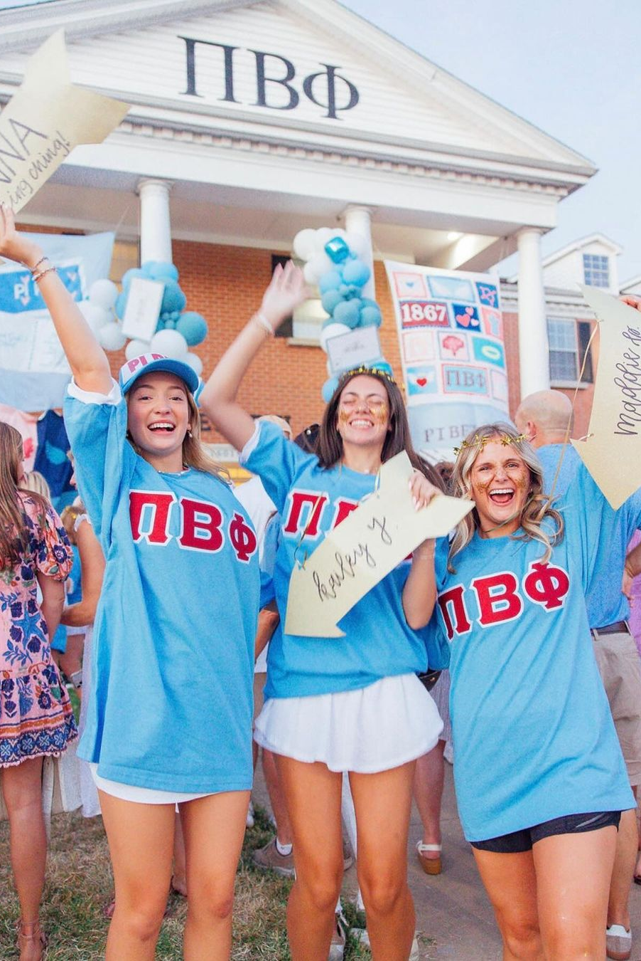
Chapter Social Events and Activities
What counts as a chapter social event?
What policies do we need to follow?
Where can we host our events?
Who can we host events with?
When are we able to host events?
What is our drug and alcohol policy?

Slide 14
Event Planning: True or False
The Director Social Events assumes the ultimate responsibility for all social events.
True

Slide 15
Event Planning: True or False
The Director Service and Philanthropy completes all the event planning tasks for philanthropy events.​
True

Slide 16
Event Planning: True or False
The Director Social Events oversees recruitment event planning tasks.​
False

Slide 17
Event Planning: True or False
The Vice President Community Relations plans Parent/Family Weekend events.​
True

Slide 18
Event Planning: True or False
The Director Social Events reviews event contracts
and signs them.​
False

Slide 19
Event Planning: True or False
The Director Social Events does not help the Vice President Member Experience with planning sisterhood events.​
False

Slide 20
Event Planning: True or False
The Vice President Risk Management reviews event contracts and signs them.​
False

Slide 21
Event Planning: True or False
There are different rules and policies for mixers and socials than for formals and semi-formals.​
False

Slide 22
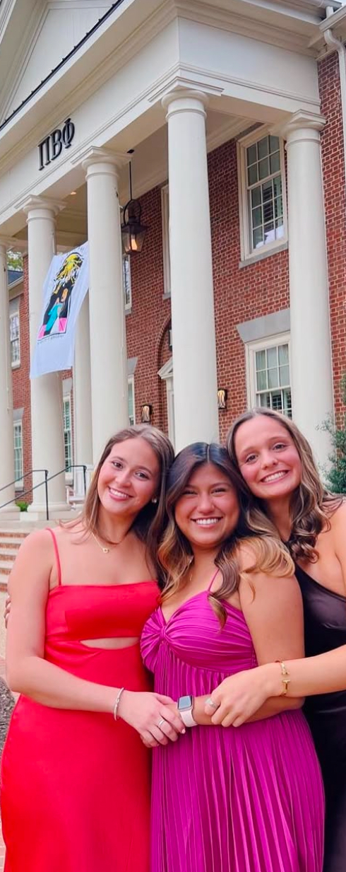
VPRM Position Description - Events
Support the Director Social Events in planning events according to Pi Phi’s policies and handles elevated event planning needs before, during and after events.
Direct chapter requests for exceptions to Pi Beta Phi policies to the regional Risk Management Specialist or other applicable Fraternity officer.
Coordinate the efforts of all officers to ensure members are aware and educated on Fraternity and campus/community policies and local, state and provincial and federal laws.

Slide 23
VPRM Position Description - Events
Support the Director Social Events in planning events according to Pi Phi’s policies and handles elevated event planning needs before, during and after events.
    Providing training for other leaders who are planning events
    Reviewing all Risk Management (RM) plans before a social event
    Reviewing campus registration forms
    Reminding Director Social Events (DSE) to complete Event Information Forms (EIFs)
    Helping with event monitor selection
    Being fully present for check-in/check-out and confronting members, if needed
    Interfacing with venue staff and vendors

Slide 24
VPRM Position Description - Events
Direct chapter requests for exceptions to Pi Beta Phi policies to the regional Risk Management Specialist or other applicable Fraternity officer.
    Working with DSE to develop a BYOB request
    Working with the Director Lifelong Membership (DLM) to plan for a seniors-only experience, with approval from the Regional Team
    Identify high-risk events and support the creation of a robust risk management plan

Slide 25
VPRM Position Description - Events
Coordinate the efforts of all officers to ensure members are aware and educated on Fraternity and campus/community policies and local, state and provincial and federal laws.
    Looking for opportunities to assist with developing risk management plans when listening to updates in Chapter Leadership Team (CLT) meetings
    Intervening when you see members doing something unsafe or unacceptable
    Support your Director Policy and Prevention Education (DPPE) in delivering relevant policy education topics to the chapter

Slide 26

DSE Position Description - Events
Holds full responsibility for socials, mixers, formals, etc.​
Serves as the chapter's event planning expert​
Organizes all transportation, vendors, venues, etc.​
Selects and trains event monitors​
Educates chapter on expectations, policies, automatic consequences and laws prior to social events​
Coordinates all aspects of the event—before, during and after

Slide 27
Event Planning Activity
Red Card​
One event planning responsibility you have as VPRM that you need to learn ​more about or needs improvement in your chapter​.
​
Yellow Card​
One event planning responsibility you think your Director Social Events might need additional support with.
​
Green Card​
One event planning responsibility you feel your directors have covered ​and you’re extremely confident about​.

Slide 28

High-Risk Events
A high-risk event is an event that brings a greater risk to our individual members, event attendees and Pi Beta Phi due to the more physical and/or dangerous nature of the activities.

Slide 29
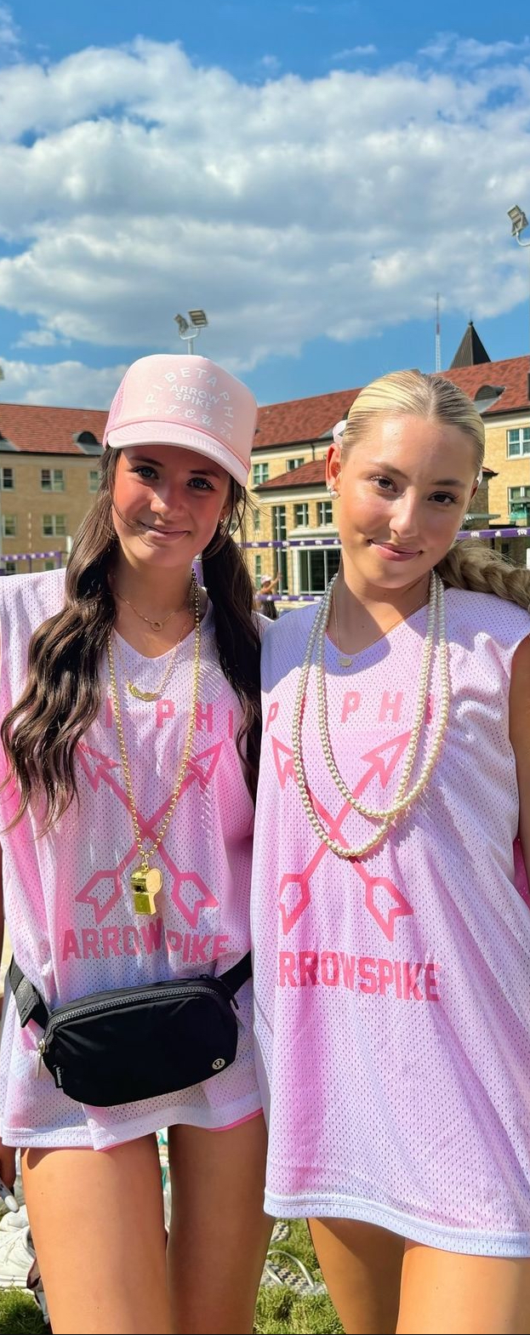
High-Risk Events
Animal-related events​
Athletic or competitive events ​
Ropes courses ​
Hayrides ​
Mud/color/zombie runs ​
Rock climbing/climbing walls ​
Skeet shooting/axe throwing/events with weapons
Paintball ​
Trampoline events
Slip-and-slides ​
Haunted attractions ​
Mazes ​
Bounce houses/inflatables ​
Dunk tanks ​
Hamster balls ​
Events on or near water, including pools
Bonfires ​
Community-facing events with more than 500 attendees

Slide 30
High-Risk Event Tools
High-risk Event Plan
Emergency Action Plan
Waivers, including post-event waiver management
Having the event alcohol-free
Purchasing a special event policy through MJ Insurance

Slide 31
High-Risk Event Approval
Approved by Alumnae Advisory Committee (AAC) counterpart of the responsible chapter officer
Approved by the appropriate Regional Specialist
Approved by Director Risk Management, Grand Council and/or
MJ Insurance, if necessary

Slide 32

Event Planning and Management Guide (EPMG)
Pi Phi Event Planning Policies​
Social and Chapter Event Guidelines​
    Co-hosted events, high-risk events, venue locations, themes, food and ​non-alcoholic beverages​
Event Attendees (Members and guests)​
Contracts and Insurance​
Alcohol Service at Pi Phi Events​
    Third-party bartenders, BYOB​
Transportation​
Security and Event Monitors​
Event Management​
Event Planning Timeline​
Event Budget Information​
Event Information Form
The EPMG was updated as of January 2025. Make sure you’ve downloaded the most recent version from the Resource Library in BetaBase!

Slide 33
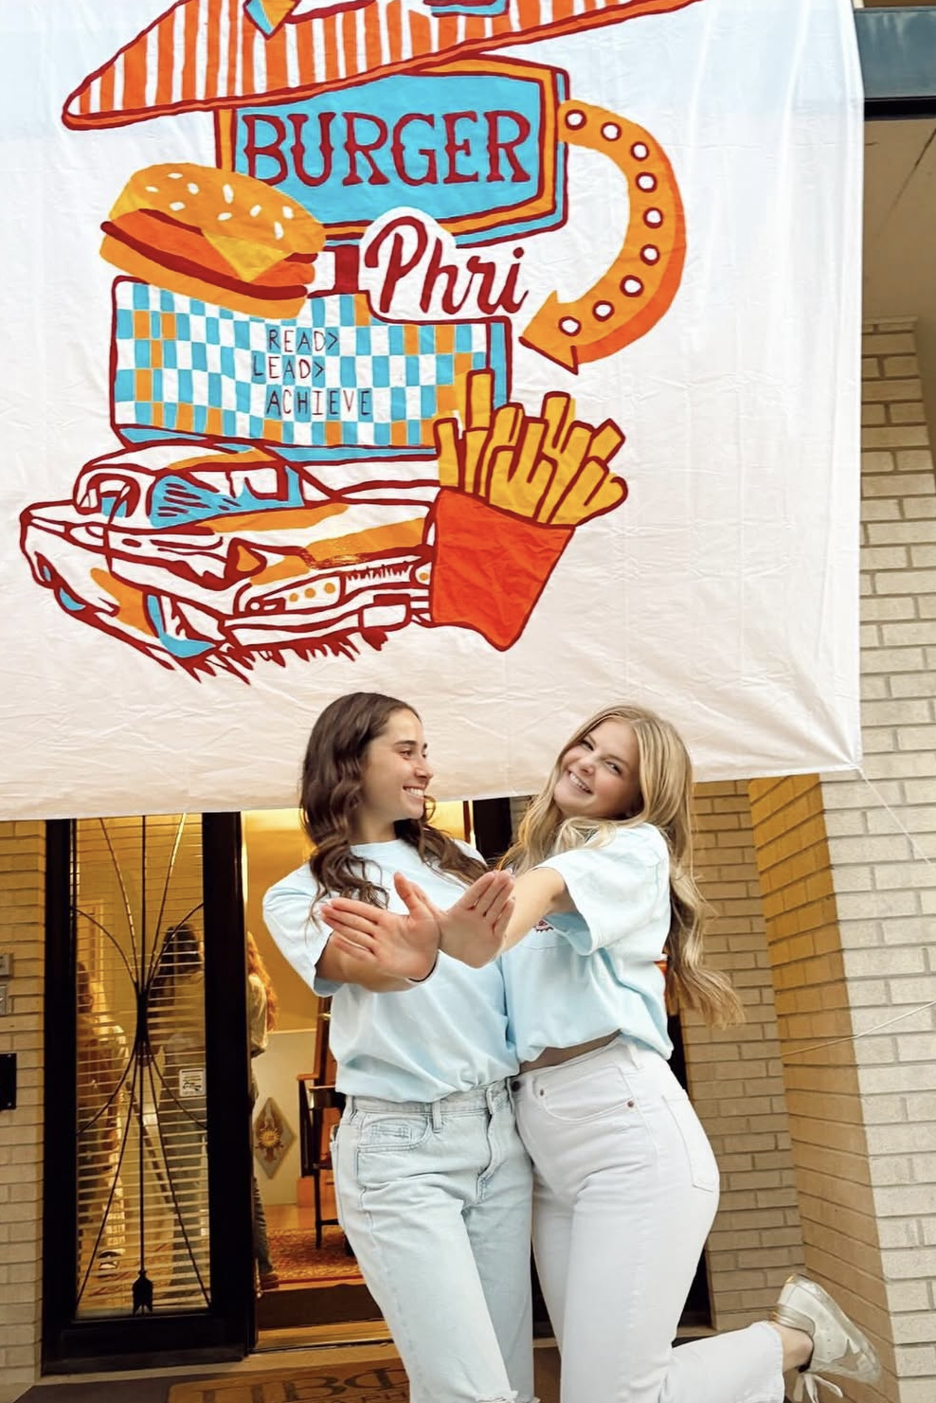
Event Themes and Apparel
Original designs​
No copyright infringement​
No reference to drugs, alcohol, violence, death or cultures and ethnicities​
May not include sponsors who are in the alcoholic beverage trade​
Association or use of college logos, if not licensed through Affinity​
Ensuring the type of apparel is inclusive and comfortable for all members​
Groups of members (i.e., seniors) should not make their own apparel

Slide 34

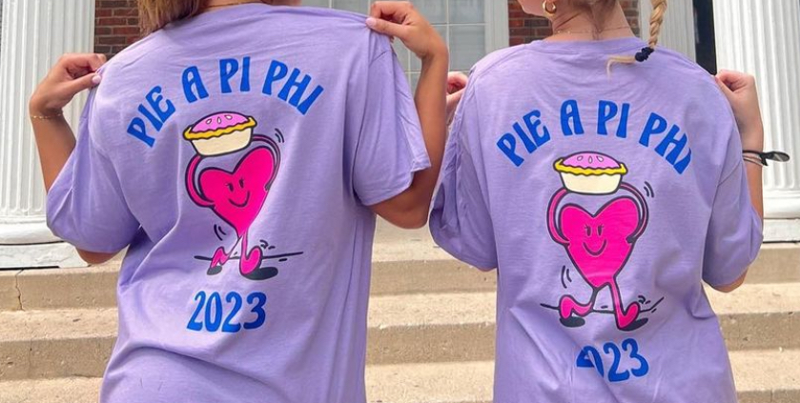

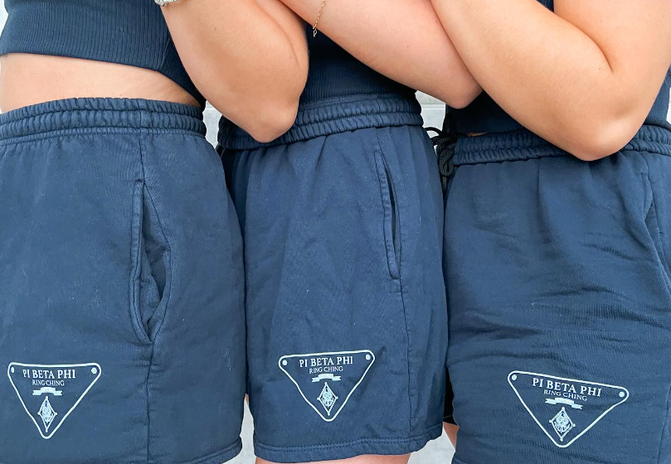

Event Themes and Apparel
No!
Yes!

Slide 35
Event Monitors

Slide 36
Event Monitors
An “event monitor” is a sober, alcohol and drug-free volunteer Pi Beta Phi member who helps to manage the event. While it is every member’s responsibility to discourage and prevent risky behaviors at events, event monitors are specifically designated and trained to be a resource for each event.
The Event Monitor Training PowerPoint can be used as a tool to support you in educating and training your event monitors. You can find this PowerPoint in the Resource Library.

Slide 37
Event Monitors
There must be one event monitor for every 20 attendees at all events with alcohol. Event monitors should also be selected for dry mixers and social events. If your campus or governing council requires more or less event monitors, the chapter must follow the more restrictive policy.
When selecting event monitors, use the following guidelines:
    Equal representation from each class (senior, junior, sophomore, initiated first-year students)
    Combination of Executive Council (at least one legal-age officer) and volunteers
    No New Members
    Should never be a consequence through the accountability process

Slide 38
Event Monitors
An "event monitor" is a sober (alcohol and drug free) volunteer Pi Beta Phi member who helps to manage your event​​.
Event monitors are the key to having a safe event.

Slide 39
Event Monitors
How do you identify event monitors?
A
mount
B
est selection
C
onfident and committed

Slide 40

Event Monitors: Amount
Arrange for one event monitor for every 20 attendees at your event
ratio of 1:20​
Attendees = members and their guests​
If your campus/community has a stricter guideline, follow the more restrictive policy

Slide 41
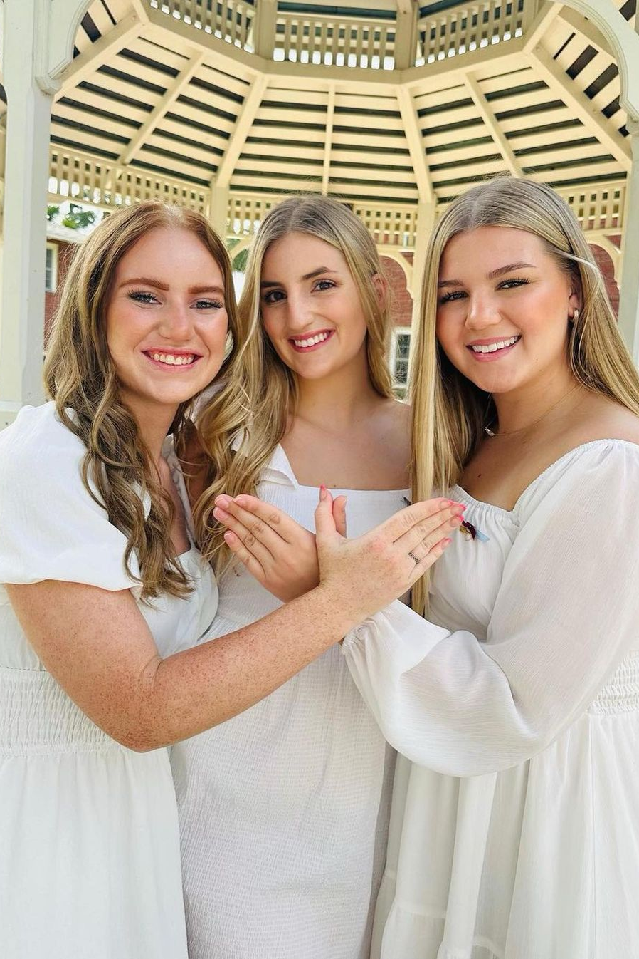
Event Monitors: Best Selection
Equal representation from each class, but not New Members.
Some volunteers and some Executive Council members, not just one group or the other
    Members must volunteer, they cannot be assigned​
No one who is fulfilling a consequence

Slide 42
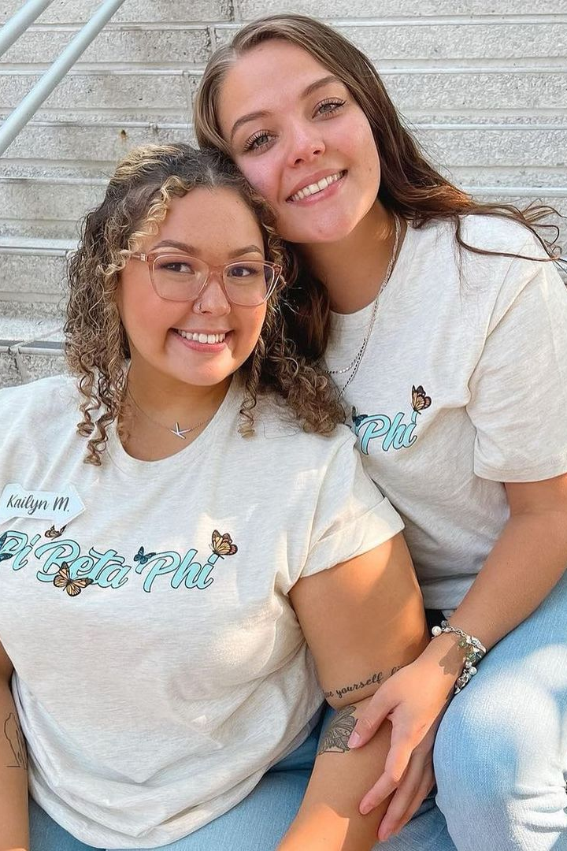
Event Monitors: Confident and
Committed
Must be sober (alcohol and drug free) before, during and after the event​
Willing to ensure the well-being of their sisters takes priority over the social experience​
Confident in their ability to confront behaviors​
Committed to fulfilling the responsibilities as trained

Slide 43

Event Monitor Training
Prior to each event, gather event monitors for training and discuss responsibilities.
Identify each event monitor’s role.
  Critical pre-event roles include helping Exec with check-in or keeping an eye out for members who are not in the best shape to attend the event.
  Critical transportation roles include ensuring the appropriate transportation plan is being followed (if a walking plan, everyone is staying with the group) or ensuring no one is showing signs of distress.
  The goal of check-in is to ensure anyone who has pre-gamed or may have already had too much to drink is not allowed to enter the event.
There is a premade Event Monitor Training PowerPoint in the Resource Library on BetaBase!

Slide 44
We have some big news to share….

Slide 45
There are no more “alternative” transportation options, and AAC can approve transportation plans for chapter events.

Slide 46
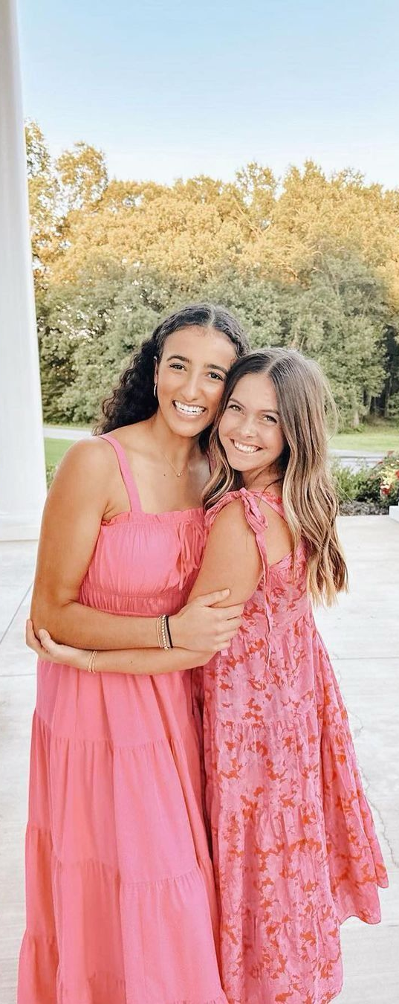
Transportation Plans
Pi Phi no longer has “alternative” transportation options, just our approved transportation options
Approved transportation options include:
  Commercial transportation (busses, vans, limos, trollies, etc.)
  Walking plans for events with or without alcohol in the immediate local/campus community
  Driving/carpool plans for member-only events without alcohol within 30 miles/50 km of campus​
  Rideshare plans such as Uber, Lyft, taxis, etc., for events with or without alcohol
  Public transportation for events with or without alcohol, where applicable and if appropriate for the event location

Slide 47
Transportation Plans
AAC now has the autonomy to approve transportation plans, with Risk Management Specialist approval no longer required.
Your Risk Management Specialist is there as a resource to talk through different options.
The Alternative Transportation Request form has now been integrated directly into the Event Information Form (EIF).

Slide 48
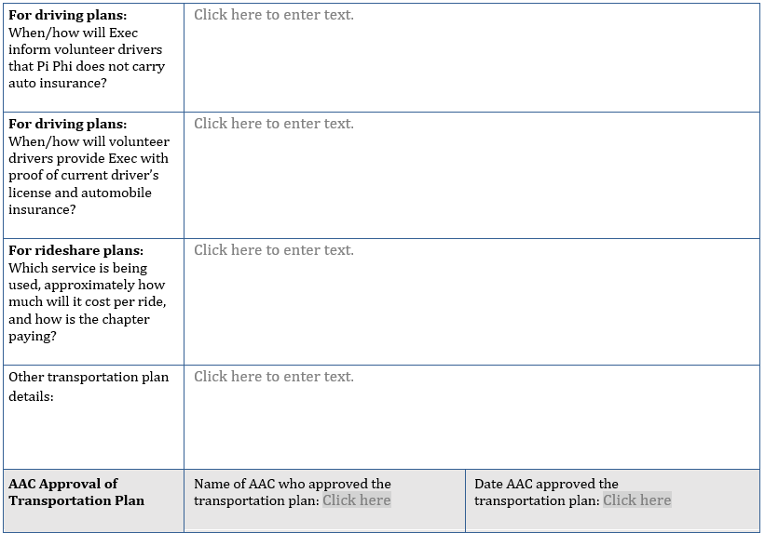
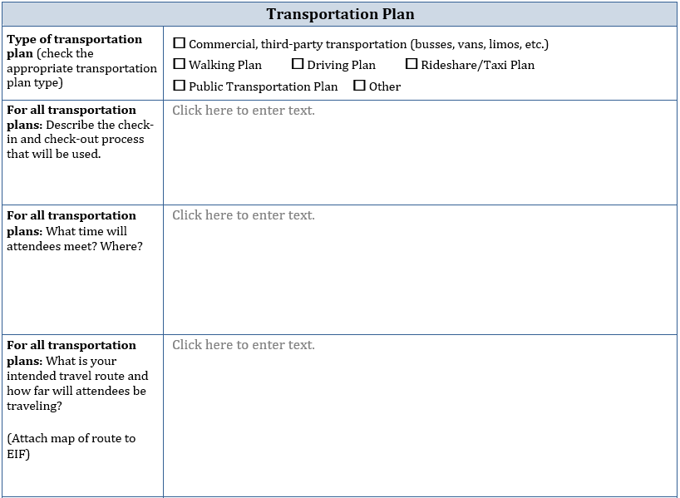
Transportation Plans in the EIF

Slide 49
Transportation Plan Guidance in the EPMG
Rideshare Plans
Rideshare options, such as taxis, Uber, Lyft, etc., may be used for events with or without alcohol that are less than 5 miles from the chapter facility or campus address (for chapters without facilities).
Organizing the Rideshare
    There must be a list of passengers for each car.
    We encourage there be a member of Exec in each car, if possible.
    All cars leave the house or other designated starting point at the same time. Cars should not leave until all participating members are accounted for.
    The chapter should arrange for payment (using chapter funds) in advance. A possible option is obtaining a group code for the event.
    No members will leave early unless sent home by Exec and accompanied by an event monitor.
    No car will leave until all passengers are accounted for.
    Riders will ride in the same groups as they arrived.
    Cars will return to the house or other designated end point and check out, to assure all members have returned safely. Record must be kept of all check-outs.

Slide 50
Contracts & Insurance
Key highlights
    Can be a confusing aspect of event planning​
    One of the highest areas of liability for Pi Beta Phi​
    Applies to event planning for all events, not just social events​
    Requires advances and diligent planning

Slide 51

Contract Basics
Agreement of services and responsibilities of both parties​
Should be written and signed by both parties​
Complete with accurate dates, times and costs​
Could include insurance language that will need to be reviewed further​
Contract should be made in the chapter's name, not a specific officer​
Must be approved by AAC and can be signed only by the Chapter President​
An approval for one event does not mean it will automatically be approved for the next event
Contract Pro Tips
Alcohol vendor contracts should state that alcohol service ends 1 hour before the end of the event
Security/venue contracts should state the number of security guards being provided

Slide 52
Contract Review Process
CP and DSE/VPRM
AAC
Risk Management Specialist
MJ Insurance, if necessary
Chapter President signs contract

Slide 53
Certificate of Insurance (COI)
Represents the insurance coverage the vendor or co-sponsor has purchased for their operations​
Shows (1) that the vendor has insurance coverage and (2) how much insurance coverage the vendor has​
We must obtain COIs from: ​
  All vendors (Venue, photographer, photo booth, caterer, ​bus company, bartenders/alcohol vendor, DJ/band, etc.)
  All co-sponsors (likely another Greek group or organization on your campus)

Slide 54
Certificate of Insurance (COI)
Must include:
    Name of insured or policyholder
    Insurance company name
    Dates of coverage
    Amount of coverage purchased by the insured
    Your chapter name listed as the certificate holder

Slide 55
Insurance Minimums
General Liability: $1 million​
Liquor Liability: $1 million​
Automobile Liability: $1 million​
Workers’ Compensation/Employers Liability: $100,000 per accident/$500,000 per policy/$100,000 per employee
    Workers’ compensation insurance is not typically required for vendors using independent contractors.
    If you have questions about a vendor’s workers’ compensation coverage, reach out to your regional Risk Management Specialist.

Slide 56
Co-Sponsored Events with Fraternities
We will need a Certificate of Insurance from the fraternity.
If you cannot get the COI directly from the chapter, reach out to your
Risk Management Specialist who can assist.

Slide 57
Member Accountability in
Pi Beta Phi

Slide 58
Stand up if…
Member accountability is
viewed as a positive process in
your chapter.

Slide 59
Stand up if…
Member accountability is
viewed as a negative process in
your chapter.

Slide 60
Stand up if…
Member accountability happens
less than it should in your chapter.

Slide 61
Stand up if…
You know the approaches in
Pi Phi’s member accountability process.

Slide 62
Stand up if…
Your chapter members know
the steps in Pi Phi’s member accountability process.

Slide 63
Stand up if…
In your chapter, AAC members are always present for accountability meetings.

Slide 64
Stand up if…
Member accountability doesn’t always feel like you’re expressing Sincere Friendship.

Slide 65
Stand up if…
Members in your chapter see member accountability as a punishment.

Slide 66
Stand up if…
Your Member Conduct Committee struggles to hold members accountable consistently.

Slide 67

Member Accountability
Pi Phi is a private member organization, and membership is a mutual choice.
Every initiated member and New Member agree to accept the ideals and standards of the Fraternity at the time of pledging, and annually by signing the Member Obligations.
The chapter and Fraternity have the right to expect modification of a member’s personal behavior if it is in conflict with Fraternity policies, guidelines and standards.
Our accountability process is rooted in our values of Respect, Sincere Friendship and Personal and Intellectual Growth.

Slide 68
Member Accountability
Through holding our members accountable we:
  Keep each other safe
  Care enough about each other to point out mistakes so we can learn
  Protect the reputation and “brand” of our sisterhood
  Serve as good stewards of our chapter’s assets
  Help our sisters become the best versions of themselves

Slide 69
Obstacles to Member Accountability
A lack of respect for the Member Conduct Committee (MCC) and its function​
A lack of belief that anything will happen​
A distaste for “ratting sisters out”​
An attitude of, “no one can tell me what to do, everyone on campus ​is doing it, you’re not the boss of me”​
An attitude of, “it’s enough to say I’m sorry”​
An attitude of, “what I did was no big deal, I know others who have ​done the same thing without being referred for accountability”

Slide 70

Critical Conversations® Webisode: Social Media
CRITICAL CONVERSATIONS
SOCIAL MEDIA

Slide 71
Automatic Consequences (ACs)

Slide 72
Automatic Consequences (ACs)
The purpose of automatic consequences is to address common, low-level accountability issues​.
Examples of accountability issues could include:​
    Social media violations​
    Failing to complete housing chores​
    Social event policy violations
    Excess alcohol use​
    Missing a chapter meeting​
These are outlined in your chapter bylaws in the Risk Management section.​

Slide 73
Issuing an Automatic Consequence
Invite the member to meet with MCC (or others on behalf of MCC).
Review the behavior and remind the member of Pi Phi’s expectation around this behavior and that their actions don’t align​.
Inform and explain the AC to the member​.
Document the discussion.
Follow-up with an email to the member so there is no confusion.

Slide 74
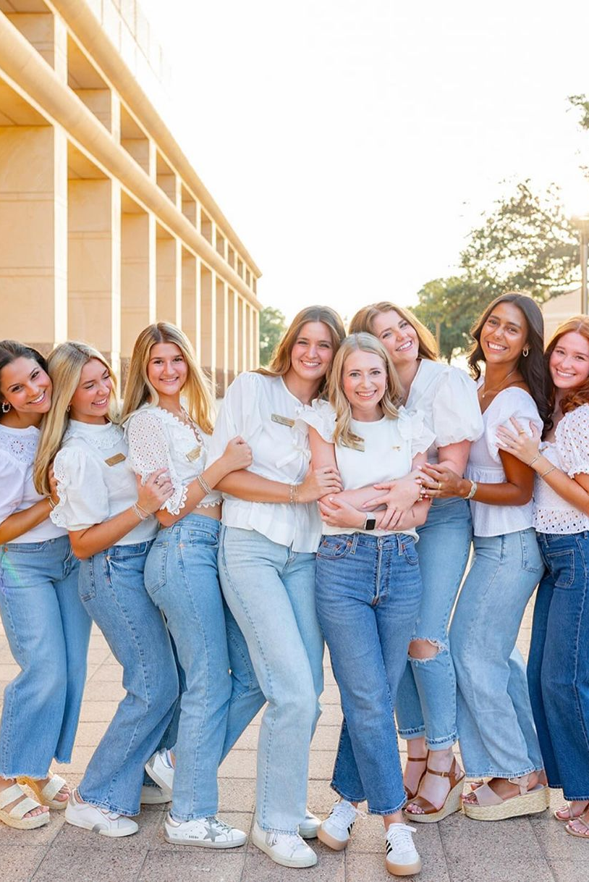
ACs should:
Provide learning and reflection opportunities for members
Align with the policy or value that was not followed
Be specific, non-discretionary and easy for MCC to issue
ACs should not:
Restate Pi Phi’s accountability process
Try to cover every “what if” situation
Have tiers or levels

Slide 75
Writing an Automatic Consequence
Consequences should:​
  Address the behavior and be appropriate to the offense​
  Be specific and measurable​
  Designate who will be monitoring and documenting compliance​
  Allow the member to demonstrate personal and intellectual growth​
  Have a reasonable time limit

Slide 76
Writing an Automatic Consequence
Consequences cannot:​
  Require community service or philanthropy
  Require a member to serve as an event monitor
  Require a member to give a presentation to the chapter
  Dismiss a member or put them on general probation
  Remove a chapter leader from their position

Slide 77
AC Pro Tips
MCC should review ACs annually to ensure they are still relevant and applicable to the chapter.
ACs live in your chapter bylaws, so you must collaborate with your Vice President Operations (VPO) to make any changes during the bylaws review period.
MCC should provide consistent education on ACs to both initiated and New Members.
ACs are automatic and cannot be modified in any way.
Any ACs related to Academic Probation or Academic Supervision should be removed.

Slide 78
#1 Rewrite this Automatic Consequence
A member drinking in the facility must answer reflective questions and meet with Exec/AAC.

Slide 79
#1 Rewrite this Automatic Consequence
A member drinking in the facility must answer reflective questions and meet with Exec/AAC.
Answer reflective questions is up for interpretation by MCC
Meet with Exec/AAC restates Pi Phi’s accountability process

Slide 80

A Better Automatic Consequence
A member drinking alcohol in the chapter facility must submit a written reflection about why Pi Phi does not allow drinking in the chapter facility. The reflection should be submitted to the Director Member Conduct (DMC) within 1 week of the issuance of the AC.

Slide 81
#2 Rewrite this Automatic Consequence
The third time a member is sent home from a chapter event they will be placed on 3-6 weeks of social restriction.

Slide 82
#2 Rewrite this Automatic Consequence
The third time a member is sent home from a chapter event they will be placed on 3-6 weeks of social restriction.
Third time is a tier of a violation
3-6 weeks of social restriction is up for interpretation by MCC

Slide 83
A Better Automatic Consequence
A member who is sent home from a chapter event will be placed on social restriction for the next two social events.
Sometimes it is better to list the number of events rather than the number of weeks.
What if you put the member on social restriction for two weeks, but there are no scheduled social events in the next two weeks?

Slide 84
#3 Rewrite this Automatic Consequence
A member who does not complete their house duties is on social restriction.​

Slide 85
#3 Rewrite this Automatic Consequence
A member who does not complete their house duties is on social restriction.​
On social restriction leaves the timeframe up for interpretation by MCC.
Consequence is not relevant to the behavior.

Slide 86
A Better Automatic Consequence
A member who does not complete their house chores must write a 500-word reflection answering the following question, "How did not completing your house duties impact the other live-in members, our house director, and the staff?" This reflection is due to the DMC no later than 2 weeks after the consequence is issued.

Slide 87
Quick True or False
In an accountability meeting, Exec/AAC and/or the Member Conduct Committee can create consequences for members that are not already outlined in the chapter’s automatic consequences.

Slide 88
Quick True or False
In an accountability meeting, Exec/AAC and/or the Member Conduct Committee can create consequences for members that are not already outlined in the chapter’s automatic consequences.
False!

Slide 89
Approaches to Accountability
Awareness
Warning
Referral to Exec/AAC

Slide 90
Approaches to Accountability
Concerning Behavior from Member
MCC
Care & Concern,
Awareness, or
Warning
Automatic Consequence
Member to Member Chat
Meeting with Exec/AAC
Refer to Exec/AAC
Warning/AC Issuance
Accountability Motion

Slide 91
1. Awareness
Non-accusatory way to make a member aware and remind them of chapter expectations after a policy violation​
  Remember that policy education for the entire chapter counts as awareness!​
Good option for a New Member early in their New Member Education Program​
Not an option for behavior that a reasonable person understands is wrong (physical violence, racist language or behavior, hazing, sale of illegal drugs, etc.)
AAC can help prepare for the meeting, but should not attend

Slide 92
1. Awareness
Member Conduct Committee (MCC) schedules meeting with the member in ​question (MIQ) in a small group setting or two-on-one​
Make it clear it is an MCC meeting​
Discuss the behavior and listen to the member’s perspective​
Reference what policy, expectation or value the behavior is violating​
Ask the member to modify their behavior​
Document the discussion

Slide 93
2. Warning
Non-accusatory way to warn a member that their behavior is below Fraternity standards and is placing their membership in jeopardy​
Clearly informing them that continuation of poor member conduct may lead to probation, the breaking of a pledge or dismissal​
Good option if the member is aware of the policies and there is a clear violation

Slide 94
2. Warning
MCC schedules meeting with the MIQ and a ​group from the committee​
Make it clear it is an MCC meeting​
Discuss the behavior and listen to the member’s perspective​
Reference what policy, expectation or value the behavior is violating​
Issue any relevant automatic consequences
Let the member know that they are responsible for positively changing ​their behavior​
Discuss what might happen if they do not make positive changes, such ​as probation, breaking their pledge or dismissal​
Document the discussion

Slide 95
3. Referral to Exec/AAC
Final attempt by MCC to help a member positively change their behavior ​
Involves MCC referring the member to be considered for further accountability by Exec/AAC
May be referred after a meeting with the MCC or immediately upon learning of violation​
Good option, even on first occurrence for drug-related violations, alcohol on chapter property, hazing, violence or unlawful use of weapons, racially motivated language or behavior, repeated violations already addressed by the committee, violation of General Probation terms, other escalated situations

Slide 96
3. Referral to Exec/AAC
Handled directly by Exec with support from AAC​
Must follow all steps in the Member Accountability Guide exactly as they are written​
Could ultimately result in a chapter vote to place a member on General Probation, break a member’s pledge or dismiss the member

Slide 97
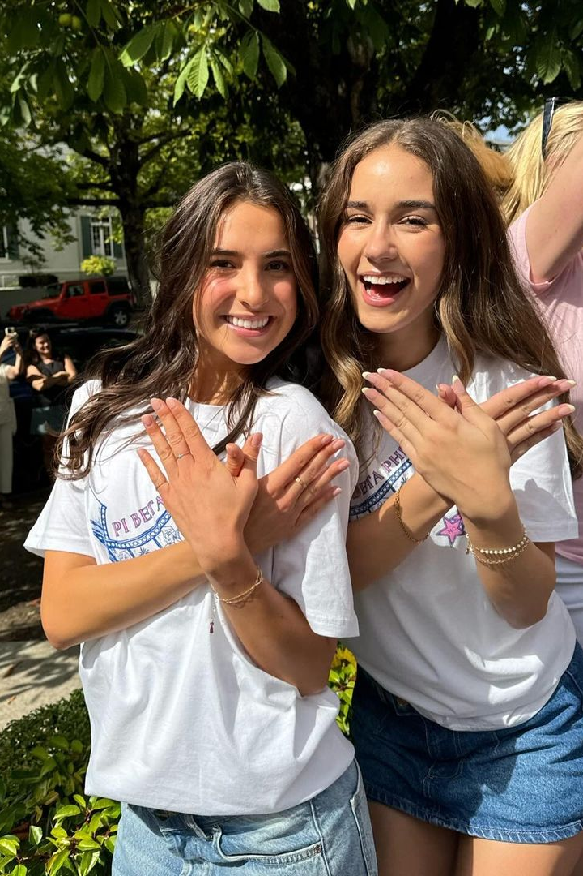
Member Conduct Committee
The role of the Member Conduct Committee (MCC) in the chapter is
to promote and enforce the expectations and obligations of membership in
Pi Beta Phi. ​
Let’s practice!

Slide 98
MCC Meeting – Scenario #1
Isabelle – a New Member of the chapter
Katie – Director Member Conduct
Charley – Director New Member Experience and
Isabelle’s big sister

Slide 99
MCC Meeting – Scenario #2
Olivia – Director Member Conduct
Madison – Member Conduct Committee Member
Alexis – Junior, initiated member

Slide 100
Exec/AAC Meeting – Scenario #3
Zoey – Vice President Risk Management
Hannah – Vice President Finance/Housing
Samantha – Chapter President
Allison – AAC Advisor
Katherine – Initiated Member

Slide 101
MCC Meeting Documentation
Documentation should not be amended after the member signs the paperwork.
Their signature is confirmation of accurate information, not an admission.
Members should always understand they are signing this documentation and what that means.​
Notes should be an unbiased account of meeting.​
It must be as detailed as possible and written neatly so others can utilize the documentation.

Slide 102
Power Dynamics in Pi Phi

Slide 103
Power Dynamics & Hazing in Pi Phi
Why does this matter?
  Hazing has no place in Pi Beta Phi and is in direct opposition to our core value of Sincere Friendship​.
  The definition of hazing has changed dramatically​.
  Members consistently demonstrate they do not fully understand how
  Pi Beta Phi, their university and the state/province defines hazing or the potential consequences​.
  Tolerance for hazing, no matter the intent, is extremely low​.
  Accountability for activities defined as hazing is extremely high​.
  Universities and organizations, like Pi Phi, must quickly hold chapters and members accountable for hazing.

Slide 104
Power Dynamics & Hazing in Pi Phi
“Sororities don’t haze.”
“Fraternities haze way worse.”
“Pi Phi doesn’t haze.”
“My chapter doesn’t haze New Members.”
“We would never make New Members do anything they didn’t want to.”
“They wanted to be hazed – they asked for it!”

Slide 105
Power Dynamics & Hazing in Pi Phi
Bullying → Exclusion
Hazing → Inclusion

Slide 106
Pi Beta Phi’s Anti-Hazing Policy
Hazing by any collegiate or alumna member of Pi Beta Phi is prohibited. Willingness, permission or approval by a person being hazed is not a defense.​
Hazing in Pi Beta Phi is defined as any conduct, action taken or situation created, regardless of intent, directed toward any other individual where participation may be voluntary, forced or coerced that:
  Has the potential to cause or actually results in emotional, mental or physical harm.​
  Involves the consumption of or opportunity to consume alcohol or drugs.​
  Embarrasses, demeans or has the potential to create a superior/inferior relationship between the participants.

Slide 107
Pi Beta Phi’s Anti-Hazing Policy
Each collegiate and alumna member of Pi Beta Phi must:​
  Follow all applicable federal, state/provincial and local laws and institution or College Panhellenic governing council policies on hazing.​
  Eliminate hazing by refusing to participate in any form of hazing and/or by intervening and reporting hazing they observe or become aware of.
Any chapter or individual member whose actions or attitudes conflict with the Fraternity’s policy against hazing will be subject to member accountability by the chapter and/or Grand Council.

Slide 108
Hazing by any collegiate or alumna member of Pi Beta Phi is prohibited.

Slide 109
Willingness, permission or approval by a person being hazed is not a defense.

Slide 110
Hazing in Pi Beta Phi is defined as any conduct, action taken or situation created, regardless of intent, directed toward any other individual where participation may be voluntary, forced or coerced that…

Slide 111
Has the potential to cause or actually results in emotional, mental or physical harm.

Slide 112
Involves the consumption of or opportunity to consume alcohol or drugs.

Slide 113
Embarrasses, demeans or has the potential to create a superior/inferior relationship between the participants.

Slide 114
Each collegiate and alumna member of Pi Beta Phi must:​
Follow all applicable federal, state/provincial and local laws and institution or College Panhellenic governing council policies on hazing.
Eliminate hazing by refusing to participate in any form of hazing and/or by intervening and reporting hazing they observe or become aware of.

Slide 115

Stop Campus Hazing Act (SCHA)
Federal legislation signed into law in December 2024
Improves hazing reporting by requiring colleges to include hazing incidents in their Annual Security Report, the Clery Report
Prevents hazing by establishing campus-wide, research-based hazing education and prevention programs
Help students and their parents make informed decisions about joining organizations on campus by requiring colleges to publish on their websites the institution’s hazing prevention policies and the organizations that have violated them

Slide 116

Examples We’ve Seen in Pi Phi
Yelling at or criticizing a New Member class or youngest class, most commonly to trick them into thinking they did something wrong​
Dressing a specific group of members up in costumes that set them apart somehow​, including “fashion shows”
Parties or celebrations during Spirit Week, often involving seniors as the hosts​
Withholding details of events or hosting surprise events
Taking members phones or not allowing them access to their phones
Quizzing members on Pi Phi or chapter facts outside of their approved New Member Education Program curriculum​

Slide 117
Examples We’ve Seen in Pi Phi
Restricting places New Members can go in the chapter facility (sets of stairs, certain rooms, etc.)​
Encouraging censors to intimidate or scare New Members prior to a Pi Phi ceremony or ritual
Family line traditions that could make New Members uncomfortable or feel like they have to do it in order to be “in” the family
Perpetuating rumors, or leading New Members to believe that the rumors might be true

Slide 118
Questions to Ask Yourself
Are we keeping this a secret from AAC?​
Are we keeping this a secret from members who are not participating? ​
Are we keeping this a secret from a subset of members participating?​
Would we allow a visiting Leadership Development Consultant (LDC) to participate in or observe this?​
Are we telling our members not to share the information with our visiting LDC?
Does it involve underage drinking? ​
Does it involve embarrassing or demeaning behavior?​
Is it a parody of a legitimate Pi Phi ceremony? ​
Is it something we would do in any other situation? ​
What is its purpose? ​
Which Pi Phi core value does this reflect? ​
Would we want our parents or university administration to know about it?

Slide 119
How Do We Prevent Hazing
Ensure both initiated members and New Members receive education on Pi Phi, university and state hazing policies/laws
Create a chapter culture that prioritizes members’ safety and inclusivity over problematic events
Create a chapter culture that communicates scare tactics and power dynamics are not building blocks of our sisterhood
Demonstrate strong leadership by ending chapter traditions that could be hazing
Conduct chapter-wide bystander training as a tool each semester​
Ensure that your chapter is not participating in or encouraging the hazing of fraternity New Members (doing dances/singing, filming videos, etc.)
Tell AAC or a member of the Regional Team about any concerns
If you suspect a hazing event is planned, talk to anyone likely to be involved
one-on-one

Slide 120
Suggestions
There’s no such thing as over-educating on the topic of hazing​.
Avoid the word “hazing”​ if that word isn’t received well in your chapter.
    Ask if a behavior creates an “uneven power dynamic” or an “inferior/superior relationship."​
    Ask if a behavior has the potential to make a member uncomfortable.
Pay special attention to things small groups of members are doing, outside of what is on your chapter calendar​.
Eliminating hazing can be hard to do by yourself; you have resources to help you​.
Confidential reports can be made to Pi Phi HQ or the Anti-Hazing Hotline.

Slide 121
Member Accountability Votes

Slide 122
Language is Important
Conduct
Standards
Discipline
Member Accountability

Slide 123

Member Accountability Guide
Includes all components of the member accountability process
Process must be followed exactly as it is written in this guide
Updated in September 2024

Slide 124
Accountability Vote Steps
Inform and consult Regional Fraternity officers
Verify reported misconduct
Exec/AAC meet with the MIQ
Terms of Probation are drafted
Terms are reviewed, and further approval is requested
Notify member of recommended accountability action
Chapter or special meeting notice given
Chapter meeting to consider the vote
Inform Fraternity officers of vote outcome
Accountability follow-up
Vote to remove member from probation, extend probation or consider dismissal

Slide 125
Risk Management Education

Slide 126
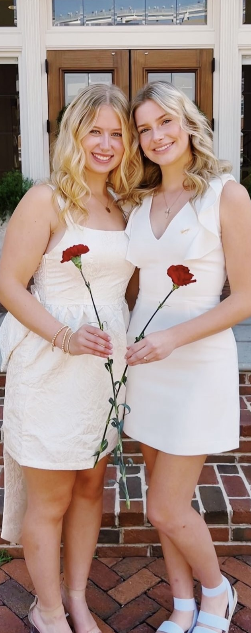
VPRM Position Description - Education
Coordinates the efforts of all officers to ensure members are aware and educated on Fraternity and campus/community policies and local, state and provincial and federal laws​.
Ensures the chapter’s compliance with any campus, council or community risk management requirements.

Slide 127
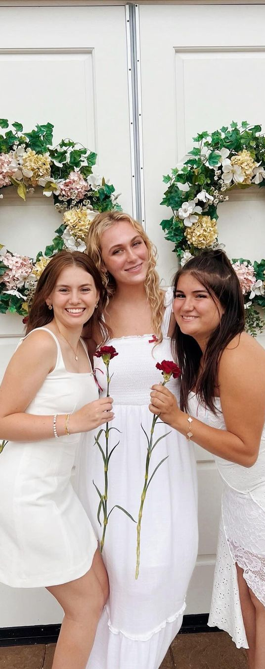
DPPE Position Description - Education
Provides required and ongoing education on Fraternity policies, chapter bylaws, campus and community policies and local, state/province and federal laws​.
Works toward the health and safety of members by education on prevention education topics​.
Manages the chapter’s implementation of Critical Conversations prevention education program through facilitation of material and collaboration with appropriate Headquarters staff, facilitators and advisors.

Slide 128
Annual Chapter Education
Initiated members should receive the following education every year:
  Risk Management Workshop reviewing all Policy and Position Statements (CP, VPRM, DPPE)​
  Review of Policy and Position Statements specific to event planning (DSE)​
  Campus, governing council and applicable state/provincial or local laws (VPRM, DPPE)​
  Emergency Procedures (CP)​
  Member Obligations (VPO)
  Any required campus or council education

Slide 129
Social Event Education
Before each social event:
  Refresh of event planning expectations and emergency procedures with all members (DSE)​
  Train event monitors (DSE)

Slide 130
Ongoing Education
Anti-hazing education​
Timely policy reminders​
Timely wellness and prevention education​
Changes to policies​
Other topics as relevant to your chapter and/or required by your campus

Slide 131
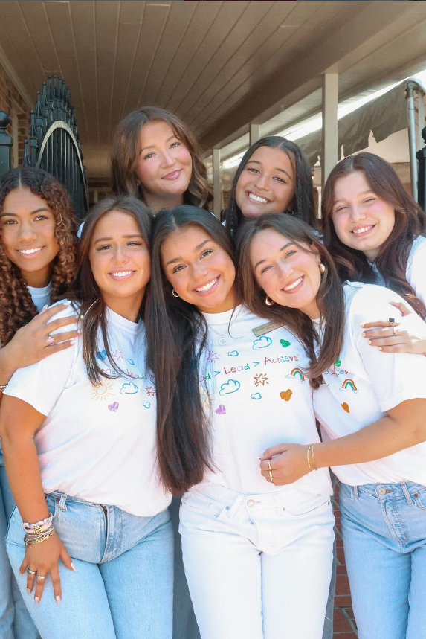
Education Inventory
Column 1: Requirements through Pi Phi and/or your university​
Column 2: What your chapter currently educates on​
Column 3: Gaps between what your chapter currently does and what it is required to do

Slide 132
Prioritizing Education Opportunities
Priority 1 (next 4 weeks): Both your university and Pi Phi require, time sensitive or upcoming due dates​
Priority 2 (next 6-8 weeks): Either your university or Pi Phi require or driven by specific chapter concern
Priority 3 (next 4-6 months): Other education required not yet been completed or opportunities for further development

Slide 133
Delivery Methods
Policies and laws: Utilize the Policy and Position Statement Education Guide and PowerPoint Workshop in the Resource Library.​
Prevention wellness topics: Utilize Critical Conversations Webisodes and accompanying discussion guide.​
Risk Management due to recent issue: Consider seeking the assistance of a campus or community expert.

Slide 134
Critical Conversations: Speaker Series Visits
Coordinated by the DPPE and VPRM
You get to select which program your chapter receives
Free for all chapters
In-person visits are the best way to maximize the experience for your members – HIGHLY encouraged!
Minimum attendance expectations of 80% – should not just be NMs!​
Approach the program as an opportunity to have a tailored conversation with just Pi Phis – just your sisters
Communicate with visiting facilitator promptly​
Coordinate scheduled pre-visit phone call​

Slide 135
Key Takeaways

Slide 136
Last, But Not Least…
Your role is critically important to the success of our chapters and of
Pi Phi internationally.
There are some guided goal setting tools and reflection questions in your workbook for you to use.
Your AAC RM advisor, your Risk Management Specialist, your Regional Team, and Headquarters staff – we are ALL here to support you!
Please complete the College Weekend evaluation to help us improve this track and the weekend.

Slide 137
Thank you for joining us!

