Slide 1
Welcome + Where to Sit (By First Name)
A Abby Parrott Table 15 Abegail Stoner Table 14 Addie Gerken Table 9 Alison Vornsand Table 1 Alissa Allgood Table 9 Amanda Szecsy Table 13 Amanda Montelongo-Fisher Table 4 Amber Barron Table 6 Ann Brookshire Table 7 Annie Hoang-Pham Table 14 Audra Jahnsen Table 9 B Breanna Wagner Table 14 Brittany Welter Table 17 C Camille Howard Table 12 Carla Hashley Table 10 Carol Lee Table 4 Carolina Pernia Table 6 Caroline Ayers Table 4 Caroline Cassle Table 2 Caroline Mulligan Table 16 Cherie Moman Table 13 Cheryl Gustafson Table 15 | Chloe Jen Table 15 Claire Schwartz Table 9 Courtney Sebahar Table 1 D Debbie Wang Table 17 E Emily Lahey Table 3 Ella Mackie Table 9 G Gail Lusk Table 1 Gillian Gagnon Table 14 Gina Garibay Table 7 Ginger Gidden Table 5 Grace Larsen Table 10 H Hadalee Goodman Table 8 Haley Heiche Table 7 Heather Horton Table 13 Heather Weisberger Table 10 Helena Brante Table 8 I Isabel Bousson Table 1 Ivana Orlovic Table 12 | J Jacquelyn Bratland Table 12 Jamie Burke Table 11 Janina Navarro Table 6 Jean Tulin Table 17 Jenifer Marvin Table 4 Jennifer Dugan-Burns Table 1 Jennifer Babcock Table 15 Jessica Tucker Table 11 Jessica Mayne Table 5 Judy Klote Table 16 K Karen Johnson Table 13 Kate Coulter Table 8 Kate Walsh Table 5 Kathryn Collins Table 16 Katie Howard Table 11 Kelli Hitchman-Craig Table 9 Kelly Shamon Table 14 Kelly Rodriguez Table 5 Kimberly Weir Table 12 Kristen Saffa Table 5 Kyle Noble Table 13 Kylee Ramsey Table 6 | L Lauren Thrall Table 3 Laurie Hoskins Table 3 Layla Finch Table 7 Leisa Lowrey Table 12 Leslie Scantling Table 15 Lizzie Bromley Table 7 Loren Welsh Table 2 M MaKayla Luper Table 16 Mallory Skelton Table 2 Mandie Greiwe Table 3 Marla Schroeder Table 4 Mary Smith Table 2 Mary Tatum Table 1 Maureen Sherman Table 14 Maya Rodriguez Table 8 Melissa Speir Table 2 Melissa Hancock Table 13 Molly Kate Goar Table 4 Monica Frohreich Table 12 | N Nicole Johnson Table 3 P Paige Grenier Table 10 R Reagan Powers Table 6 S Sara Nichols Table 16 Sarah Brawley Table 5 Sarah McGee Table 10 Sharyl Ponce Table 10 Susie Wilson Table 11 T Talia Pekari Table 11 Talor Allen Table 8 Tara Applegate Table 8 Taylor McDonald Table 7 Tracey Cross-Baker Table 16 W Wyonna Cattel Table 3

Slide 2
Welcome
Ana Mancebo Miller
Grand Vice President Alumnae

Slide 3

Alumnae Advisory Committee
College Weekend 2025

Slide 4
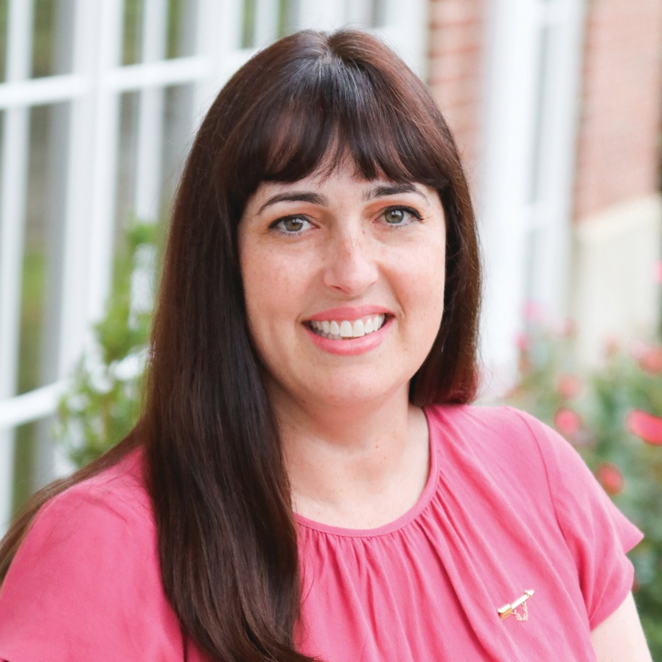
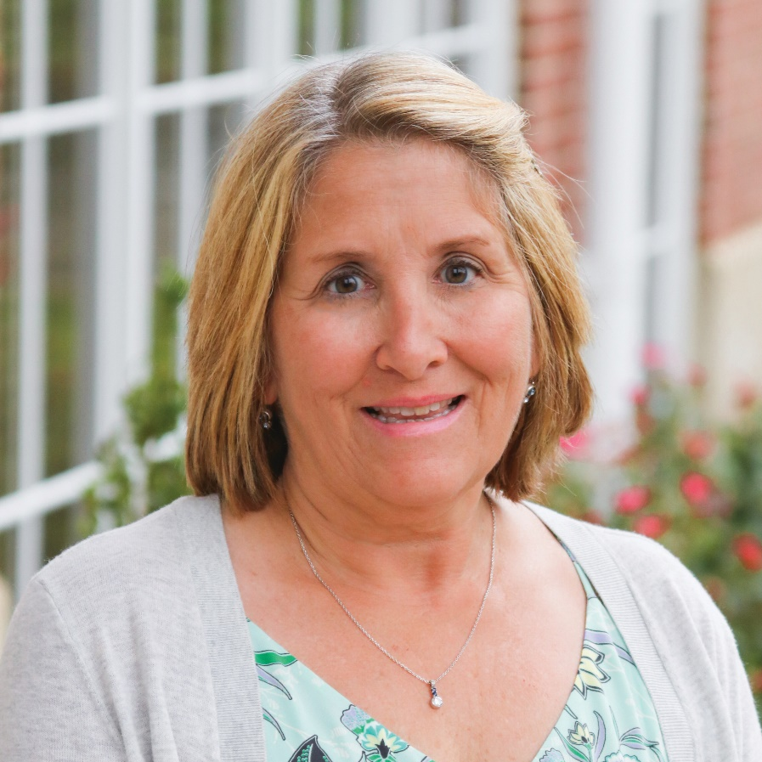
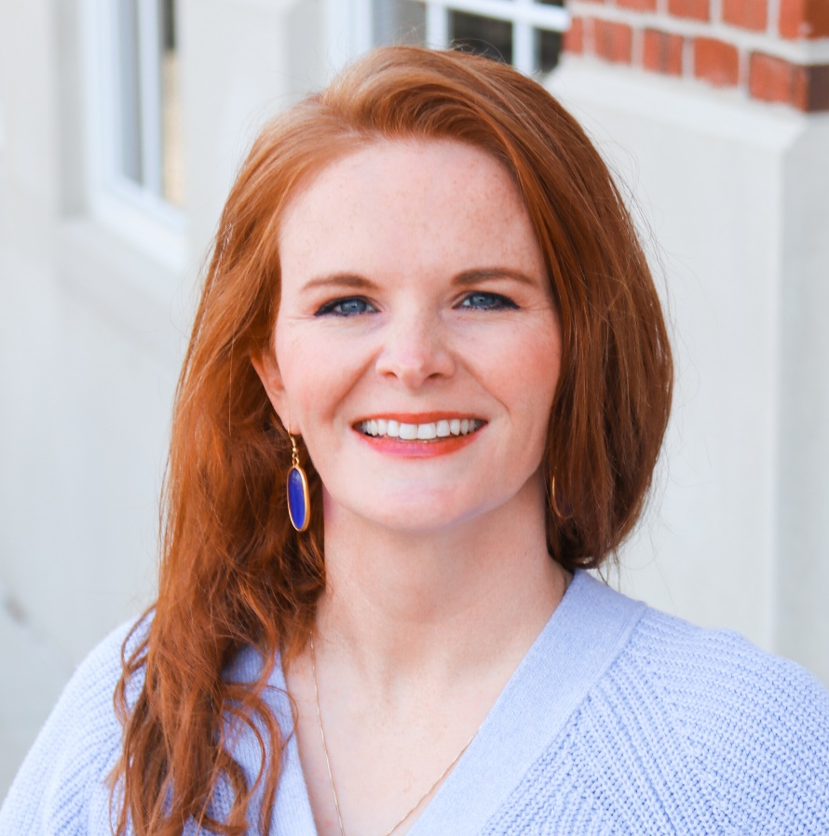
AAC Track Facilitators
Michelle Drouse Woodhouse
CALIFORNIA ETA
Director Alumnae
Kimberly Sisk Crowe
KENTUCKY BETA
Region 3 Alumnae Engagement Director
Allison Kimball
HEADQUARTERS STAFF
Alumnae Services Director

Slide 5
AAC College Learning Outcomes
By participating in Pi Beta Phi’s Alumnae Advisory Committee (AAC) College, participants will be able to:
Utilize Pi Beta Phi’s Leadership Model to guide their actions and increase their awareness of AAC’s role in representing the Fraternity with the chapter they advise.
Apply techniques to be a collaborator, listener and coach when addressing common issues facing Pi Beta Phi chapters.
Increase their confidence in and knowledge of Fraternity resources and support structures.

Slide 6
Schedule at a Glance
Friday (tonight!)
Welcome and Networking
Welcome
Introductions and networking
Saturday Morning
Context for Pi Phi Leaders
Pi Phi Today
Q&A with Grand President and Executive Director
Leadership and Nominating Committee Visit
Leading with Values & Inclusive Leadership
Saturday Afternoon
Building Content Competency
Specialty Area review and Deep Dive
Recruiting and Retaining a strong AAC
Saturday Evening
Application in the AAC Role
Pi Phi Partnerships
Pi Beta Phi Foundation and Fraternity Housing Corporation Visit
Organizational Update on meeting ritual
AAC Track wrap-up

Slide 7
Making the Most of College Weekend
Make new friends and network! Exchange labels with Advisors you want to connect with after the event!
Curiosity and learning
Track participation
Positivity

Slide 8
Table Introductions
Name, chapter of Initiation, chapter you support, AAC role

Slide 9
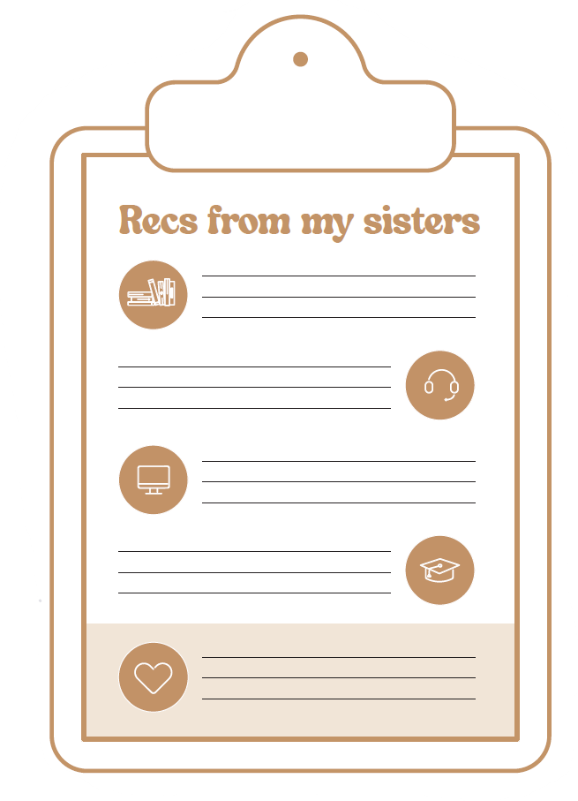

What are you reading, watching, learning, or listening to?
Turn to page 50 in your workbooks. Think about any books, tv series, movies, podcasts, songs that you have read/watched/heard recently that you have loved!
Take a couple minutes to write down any recs you want to share with your table at the bottom
Go around your table and discuss your recommendations and write down any that interest you!

Slide 10

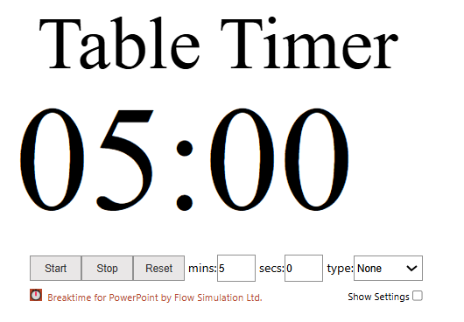

Slide 11


Let’s Network!
Contact Label Sheets Pi Phi Connections, page 79

Slide 12
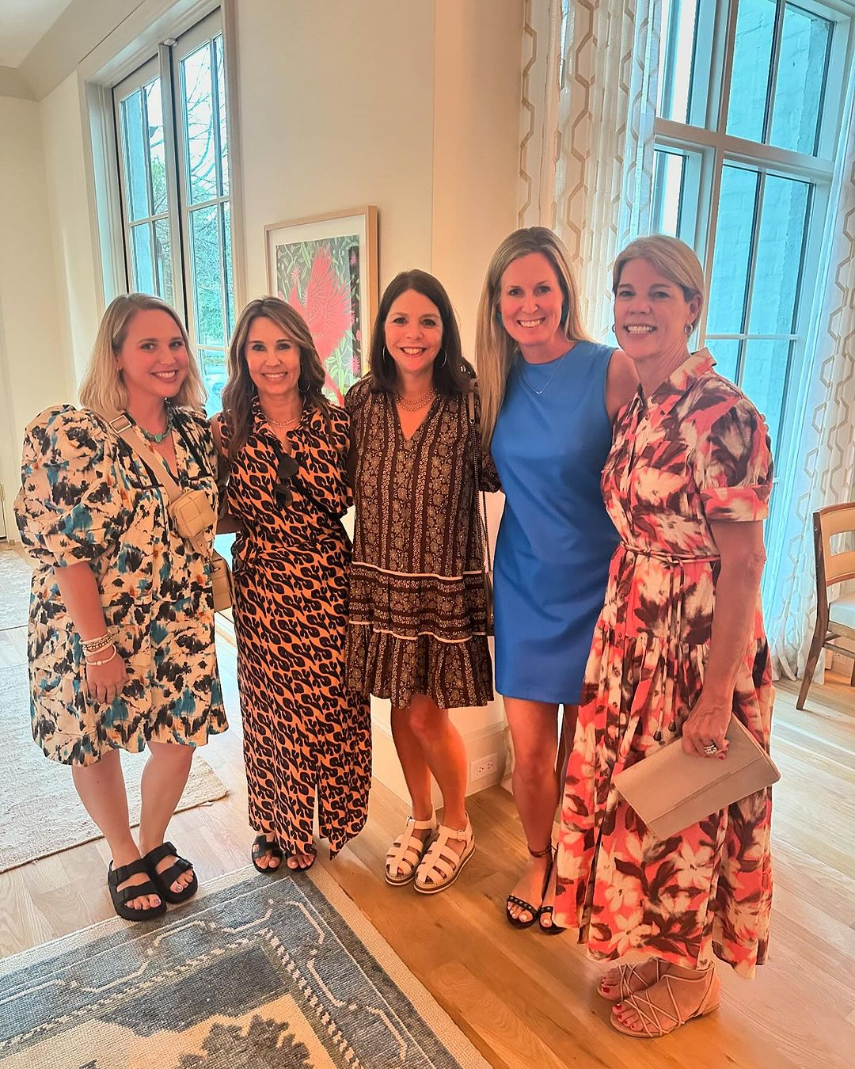
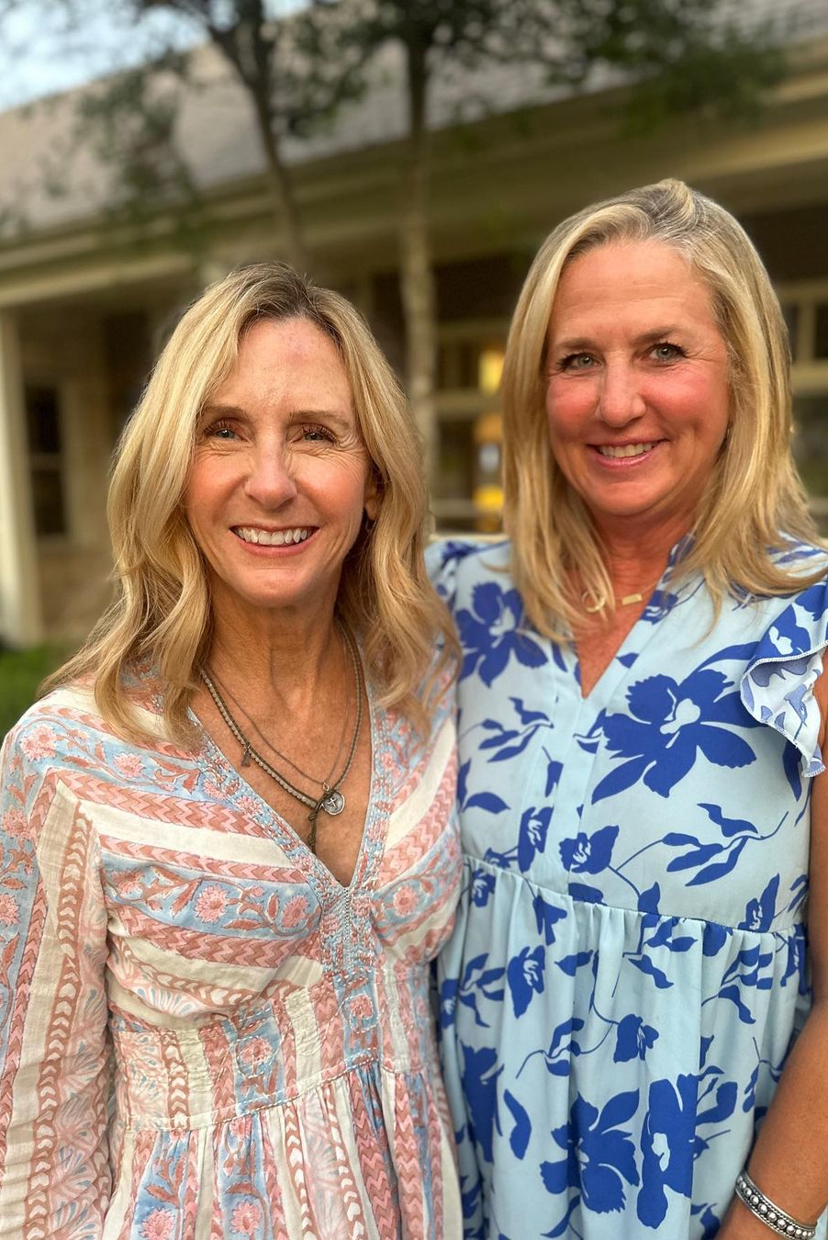
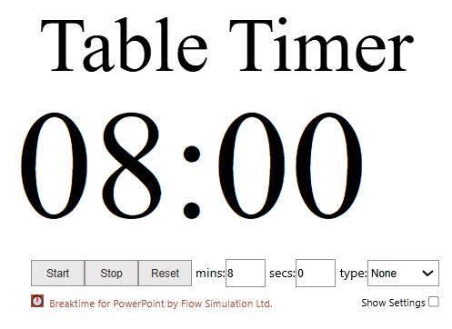
Specialty Area Networking
What are you most proud of about being an Advisor in this area?
What unique challenges have you faced as an Advisor in this area?
What kind of support do you need from other Advisors to do your role well?
What kind of support can you offer to other Advisors to do your role well?

Slide 13
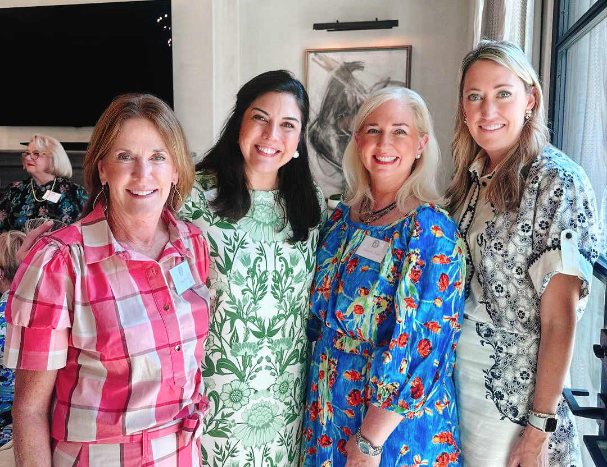
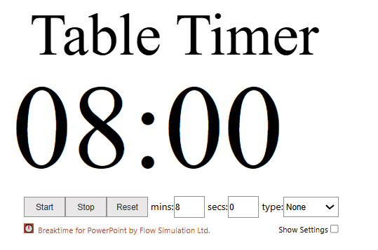
Regional Networking
What are you most proud of about being an Advisor in this region?
What unique challenges have you faced as an Advisor in this region?
What does it look like to give and receive support within this region?

Slide 14
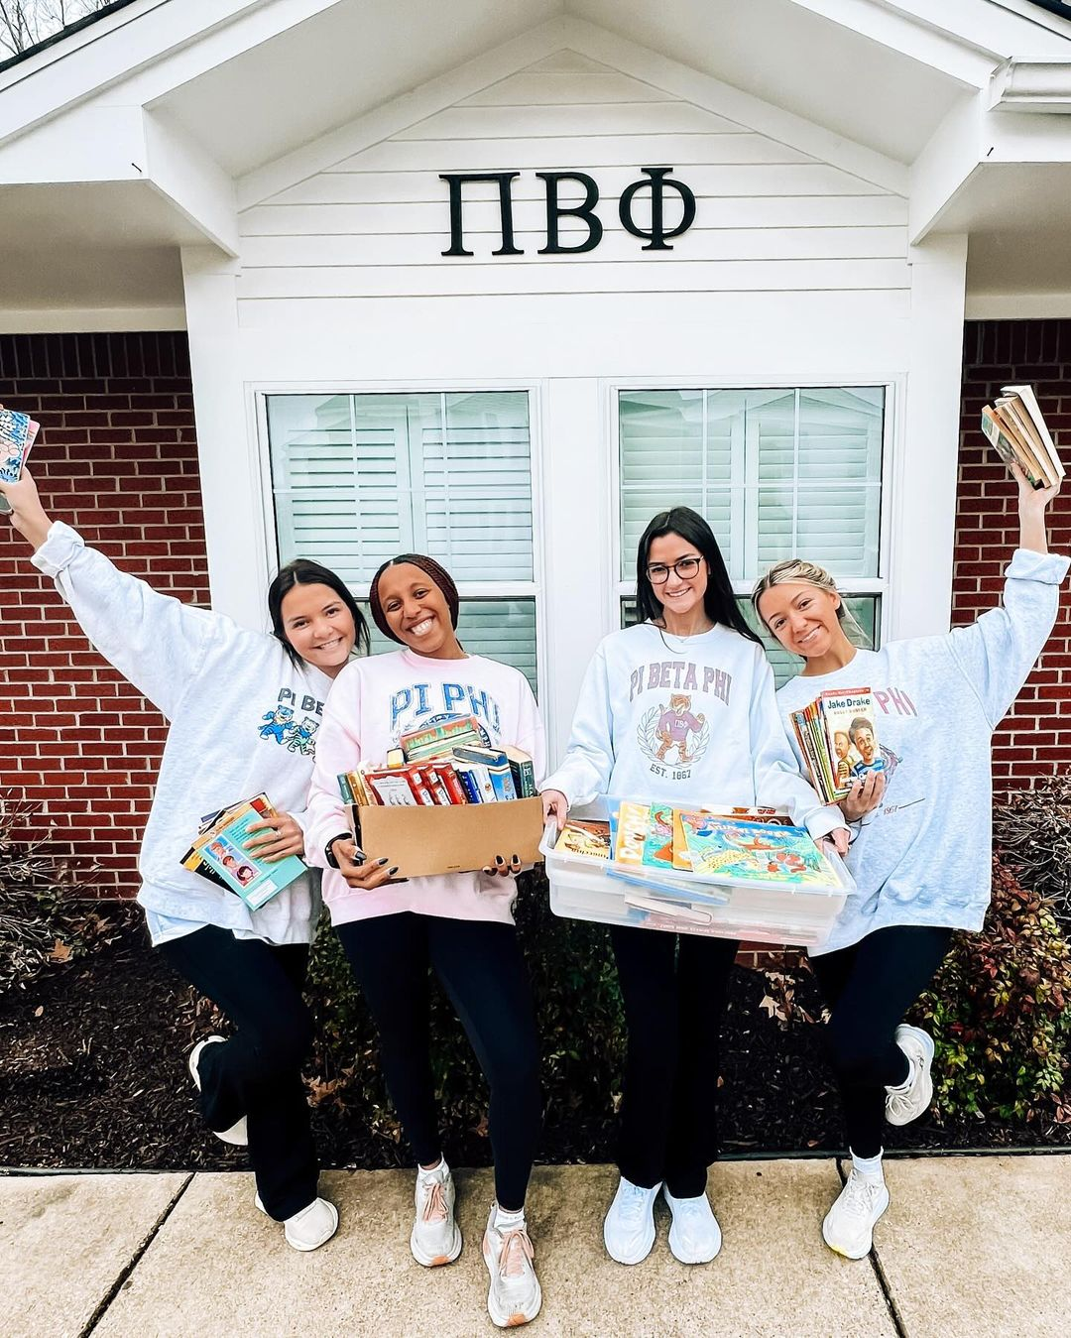
See you at 9 a.m.!
We will be sitting at the same seats tomorrow, so feel free to leave any materials you feel comfortable at your spots.

Slide 15
Welcome + Where to Sit (By First Name)
A Abby Parrott Table 15 Abegail Stoner Table 14 Addie Gerken Table 9 Alison Vornsand Table 1 Alissa Allgood Table 9 Amanda Szecsy Table 13 Amanda Montelongo-Fisher Table 4 Amber Barron Table 6 Ann Brookshire Table 7 Annie Hoang-Pham Table 14 Audra Jahnsen Table 9 B Breanna Wagner Table 14 Brittany Welter Table 17 C Camille Howard Table 6 Carla Hashley Table 10 Carol Lee Table 4 Carolina Pernia Table 6 Caroline Ayers Table 4 Caroline Cassle Table 2 Caroline Mulligan Table 16 Cherie Moman Table 13 Cheryl Gustafson Table 15 | Chloe Jen Table 15 Claire Schwartz Table 9 Courtney Sebahar Table 1 D Debbie Wang Table 17 E Emily Lahey Table 3 Ella Mackie Table 9 G Gail Lusk Table 1 Gillian Gagnon Table 14 Gina Garibay Table 7 Ginger Gidden Table 5 Grace Larsen Table 10 H Hadalee Goodman Table 8 Haley Heiche Table 7 Heather Horton Table 13 Heather Weisberger Table 10 Helena Brante Table 8 I Isabel Bousson Table 1 Ivana Orlovic Table 12 | J Jacquelyn Bratland Table 12 Jamie Burke Table 11 Janina Navarro Table 6 Jenifer Marvin Table 4 Jennifer Dugan-Burns Table 1 Jennifer Babcock Table 15 Jessica Tucker Table 11 Jessica Mayne Table 5 Judy Klote Table 16 K Karen Johnson Table 13 Kate Coulter Table 8 Kate Walsh Table 5 Kathryn Collins Table 16 Katie Howard Table 11 Kelli Hitchman-Craig Table 9 Kelly Shamon Table 14 Kelly Rodriguez Table 5 Kim Miller Table 11 Kimberly Weir Table 12 Kristen Saffa Table 5 Kyle Noble Table 13 Kylee Ramsey Table 6 | L Lauren Thrall Table 3 Laurie Hoskins Table 3 Layla Finch Table 7 Leisa Lowrey Table 12 Leslie Scantling Table 15 Lizzie Bromley Table 7 Loren Welsh Table 2 M MaKayla Luper Table 16 Mallory Skelton Table 2 Mandie Greiwe Table 3 Marla Schroeder Table 4 Mary Smith Table 2 Mary Tatum Table 1 Maureen Sherman Table 14 Maya Rodriguez Table 8 Melissa Speir Table 2 Melissa Hancock Table 13 Molly Kate Goar Table 4 Monica Frohreich Table 12 | N Nicole Johnson Table 3 P Paige Grenier Table 10 R Reagan Powers Table 6 S Sara Nichols Table 16 Sarah Brawley Table 5 Sarah McGee Table 10 Sharyl Ponce Table 10 T Talia Pekari Table 11 Talor Allen Table 8 Tara Applegate Table 8 Taylor McDonald Table 7 Tracey Cross-Baker Table 16 W Wyonna Cattel Table 3

Slide 16
Alumnae Advisory Committee
College Weekend 2025

Slide 17
Pi Phi Today
Mackenzie Gatti
Senior Director of
Chapter Services

Slide 18
Collegians Today
What they’re called
When they were born
Where they’re from
Their path to membership

Slide 19
Pi Phi Chapters
Collegiate membership size
Chapter sizes – largest, smallest, average

Slide 20
Pi Phi Chapter Sizes
Size of Chapter | Number of Chapters
350+ members | 7 chapters
250-350 members | 14 chapters
100-250 members | 57 chapters
50-100 members | 25 chapters
Under 50 members | 29 chapters

Slide 21
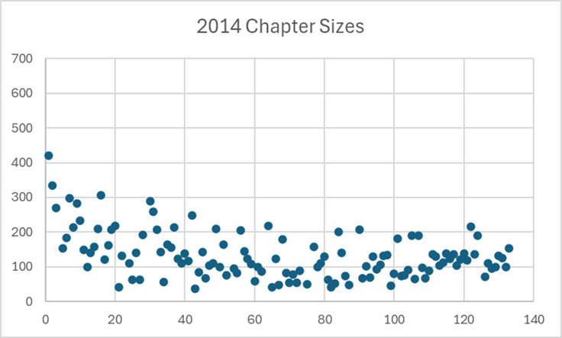
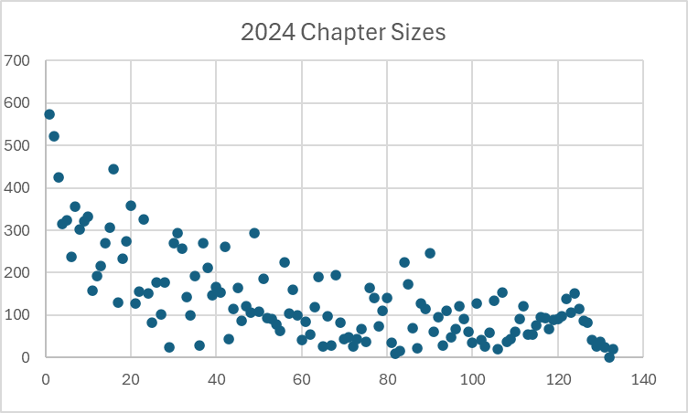
Pi Phi Chapter Sizes

Slide 22
Pi Phi Chapter Sizes
Size of Chapter | Average change in last 10 years
301+ members | +124 members
201-300 members | +51 members
101-200 members | +15 members
51-100 members | -14 members
Under 50 members | -45 members

Slide 23
Chapter Finances
Chapter Budgets
Chapter Reserves

Slide 24
Chapter Budgets
Accurate budgeting continues to be a challenge and concern for chapters of all sizes and financial strength.
Chapters with losses:
  2024: 43
  Expected in 2025: 18
Fraternity-wide total chapter revenue has returned to post-pandemic levels, but this does not tell the entire story for many chapters.

Slide 25
Chapter Reserves
Months of Reserves | 2017 | 2024
1 month or less | 0 | 13
1-3 months | 11 | 15
3-6 months | 46 | 19
6-12 months | 62 | 36
More than 12 months | 12 | 49

Slide 26
Member Satisfaction
Most members stated their Pi Beta Phi experience meets or exceeds their expectations (92.14%) and are somewhat or very satisfied with their level of enjoyment in Pi Beta Phi (87.63%). (Annual Member Evaluation 2024)
The lowest level of agreement (68%) is with the belief the cost of Pi Beta Phi membership is a worthwhile investment. (Annual Member Evaluation 2024)
Membership status data shows this!

Slide 27
Membership Status Changes

Slide 28
Local Volunteers
1358 local volunteers, 1060 are on AACs
When they were initiated – more than half initiated in the 2010s!
Who they are

Slide 29
Risk Management
Hazing focus

Slide 30
Pi Phi Chapter Health

Slide 31
Chapter Health Defined
Sustainability
Longevity

Slide 32
Chapter Health Indicators
Initiated member retention
New Member retention
At total on bid day
Open House Priority %
Ratio of chapter membership size to beds in the facility
Percentage of chapter that is graduating each semester
And a financial score that incorporates:
    Cumulative income: Chapters cumulative income or loss over the last five years
    Income consistency: How many years out of the last five has the chapter had income?
    Reserves: Percent of current year revenue in reserves
    Affordability: Percent of revenue used to pay rent to property owner/manager
    Financial control: Difference between budgeted expenses and revenue and actual expenses and revenue

Slide 33
Follow up
Discussion
Lisa Gamel Scott
Grand President
Shawn Eagleburger Executive Director

Slide 34
Leadership and Nominating Committee
Paula Shepherd & Jessica Chavez
Leadership and Nominating Committee (LNC) Members

Slide 35
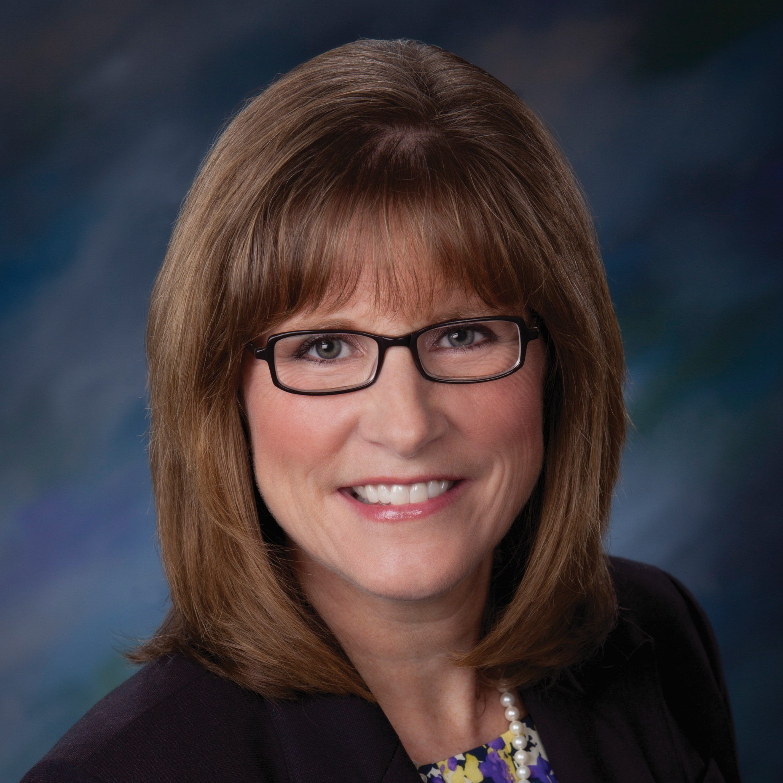
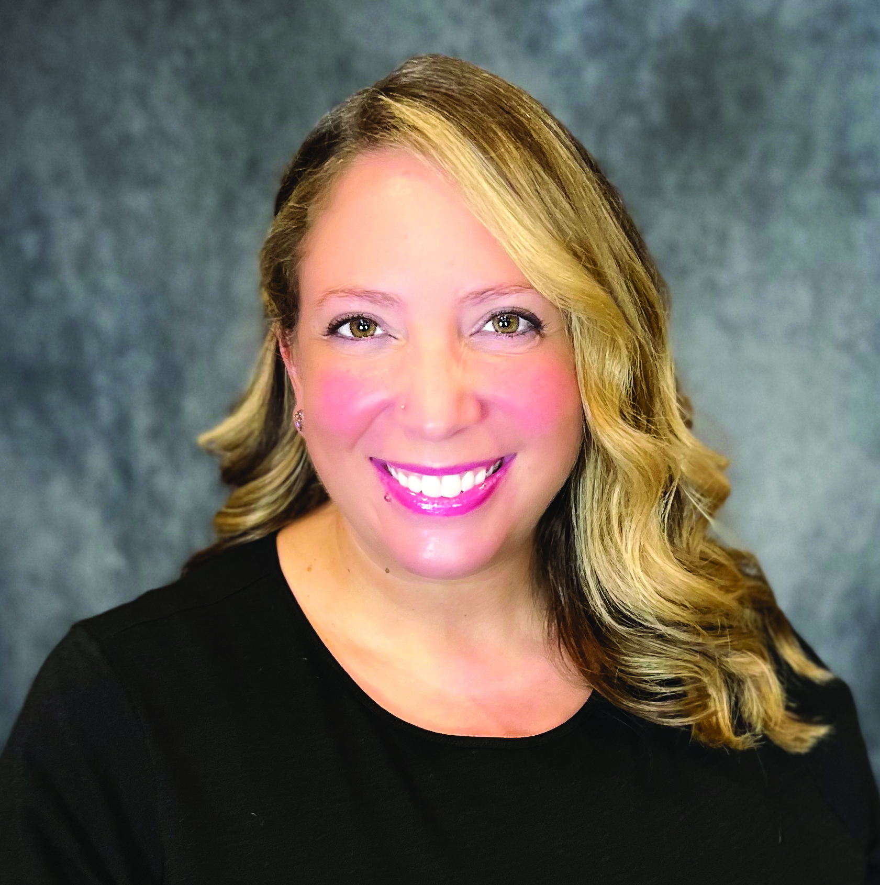
Leadership and Nominating Committee (LNC)
Paula Pace Shepherd
TEXAS EPSILON
Leadership and Nominating Committee (LNC) Member
Jessica M. Chavez
NEW MEXICO ALPHA
Leadership and Nominating Committee (LNC) Member

Slide 36
Overview of LNC and Role of LNC
Pi Beta Phi Fraternity is a volunteer-based organization, and our volunteers are the heart of this organization.
LNC is entrusted by Grand Council and the Fraternity to identify and vet potential volunteers who will best serve the needs of the Fraternity as a whole.
We could not remain in business without volunteers, for we depend on their commitment to Pi Beta Phi to enhance and expand the organization's development.

Slide 37
LNC Pods
Ashlee Janovak (lncashlee@pibetaphi.org) Region One Grand Vice President Alumnae Director Alumnae Alumnae Club Support Officers Fraternity Government Relations Coalition Representative Music Chair HQ Staff | Michelle Billard (lncmichelle@pibetaphi.org) Region Four Director Community Relations Arrow in the Arctic HQ Staff | Betty Smithgall (lnc@pibetaphi.org) Region Seven Grand President Leadership Development Officer HQ Staff
Nadia Smid (lncnadia@pibetaphi.org) Region Two Grand Vice President Inclusion/Community Relations Director Diversity, Equity and Inclusion Diversity, Equity and Inclusion Advisory Committee HQ Staff | Maggie Ibrahim-Taney (lncmaggie@pibetaphi.org) Region Five Director Chapter Support Archivist/Historian HQ Staff | Jessica Chavez (lncjessica@pibetaphi.org) Region Eight Grand Vice President Fraternity Growth Director Recruitment Director Operations RFM Officer HQ Staff
Lara Omps-Botteicher (lnclara@pibetaphi.org) Region Three Grand Vice President Collegians Director Risk Management Awards Committee HQ Staff | Jessie Ashton (lncjessie@pibetaphi.org) Region Six Grand Vice President Finance/Housing Director Finance/Housing Fraternity Housing Corporation Board HQ Staff | Paula Shepherd (lncpaula@pibetaphi.org) Region Nine Grand Vice President Member Experience Director Member Experience Panhellenic Officers Legislative Committee Parliamentarian HQ Staff

Slide 38
Service to the Organization: Volunteering
Committees
    Diversity, Equity and Inclusion (DEI) Advisory Committee
    Awards Committee
Appointed Officers
    Music Chair
    Panhellenic Officers
    Parliamentarian
    Archivist/Historian
    And more!
Specialists
Elected positions

Slide 39
Service to the Organization: Volunteering
Who do you know?
  Potential volunteers (Neighbor, close friend, or member of your alumnae club)
What feedback do you have to share?
We want to get to know more about YOU!
  What do you enjoy? What excites you about volunteering?
  Not interested now, but want to learn more?
  Not sure what interests you?
  Not sure of your skillset?
Come talk to us!

Slide 40
Service to the Organization: Let's Talk!
Connect with your regional LNC liaison at any time
  Liaisons
          Region One: Ashlee Janovak, lncashlee@pibetaphi.org
          Region Two: Nadia Smid, lncnadia@pibetaphi.org
          Region Three: Lara Omps-Botteicher, lnclara@pibetaphi.org
          Region Four: Michelle Billard, lncmichelle@pibetaphi.org
          Region Five: Maggie Ibrahim-Taney, lncmaggie@pibetaphi.org
          Region Six: Jessie Ashton, lncjessie@pibetaphi.org
          Region Seven: Betty Smithgall, lnc@pibetaphi.org
          Region Eight: Jessica Chavez, lncjessica@pibetaphi.org
          Region Nine: Paula Shepherd, lncpaula@pibetaphi.org
  LNC@pibetaphi.org
Meet with us this weekend!
Questions?

Slide 41

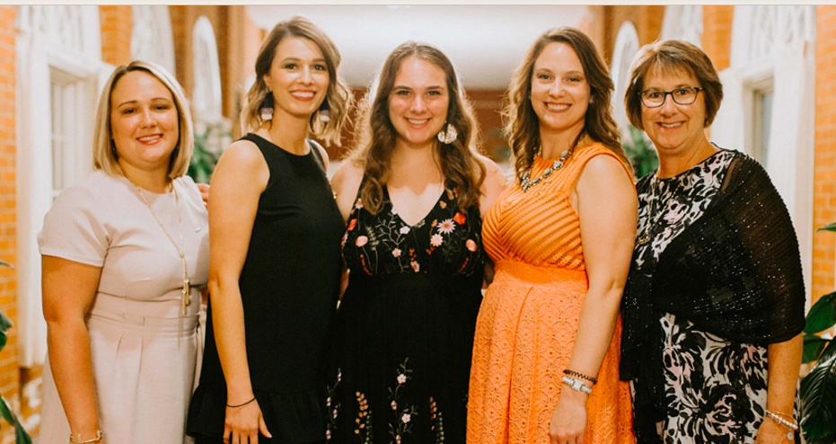
Schedule a meeting with us!

Slide 42
Leading with an Inclusive Heart
Understanding the role of equity and inclusion in AAC and advising collegians

Slide 43
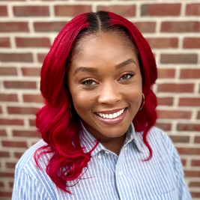
Great to see YOU!
Teresia Williams
HEADQUARTERS STAFF
Education and Inclusion Director

Slide 44
Your Story in a Name…
Who gave you your name? Why?​
What is the origin of your name? ​
When did you come to know this?​
Do you have any nicknames?
Who gave you these?​
What do you prefer to be called?

Slide 45
Shared Language
Understanding Pi Phi’s Inclusion Terminology
Notes:
clusio

Slide 46
Shared Language Helps to Ground and Unify Us

Slide 47
Shared Language
Diversity: The presence of different identities, backgrounds, experiences, and perspectives within an organization or community. Each Pi Phi brings their own uniqueness to strengthen our sisterhood. These characteristics impact the way a member is perceived and received by others, as well as how a member perceives the world.
Notes:
Highlight the inclusive language guide in their package

Slide 48
Shared Language
Equity: The fair treatment, access, opportunity, and advancement for all people. In life, advantages and barriers exist – and as a result, we do not all start from the same place. Pi Beta Phi believes a premier member experience should be obtainable by every member and therefore the Fraternity works to remove unnecessary barriers.

Slide 49
Shared Language
Inclusion: Being welcomed and truly valued for what you contribute. Pi Beta Phi desires to create an environment where all members feel they have a voice, are valued, feel validated and can fully participate.

Slide 50
Shared Language
Identity: How we define ourselves as individuals, including our personal characteristics, history, personality, name, race, sexual orientation, gender and other characteristics that make us unique and different from other individuals.

Slide 51
As true friends, we honor the uniqueness of each sister.
We empower one another through meaningful relationships grounded in empathy. We promise an inclusive sisterhood where every member feels welcome, is supported and knows they belong.
As the first fraternity for women, we own our role and responsibility in the fraternal movement. We recognize our power and privilege as college-educated women to work for an equitable society. We commit to developing the servant leaders our diverse world needs.

Slide 52
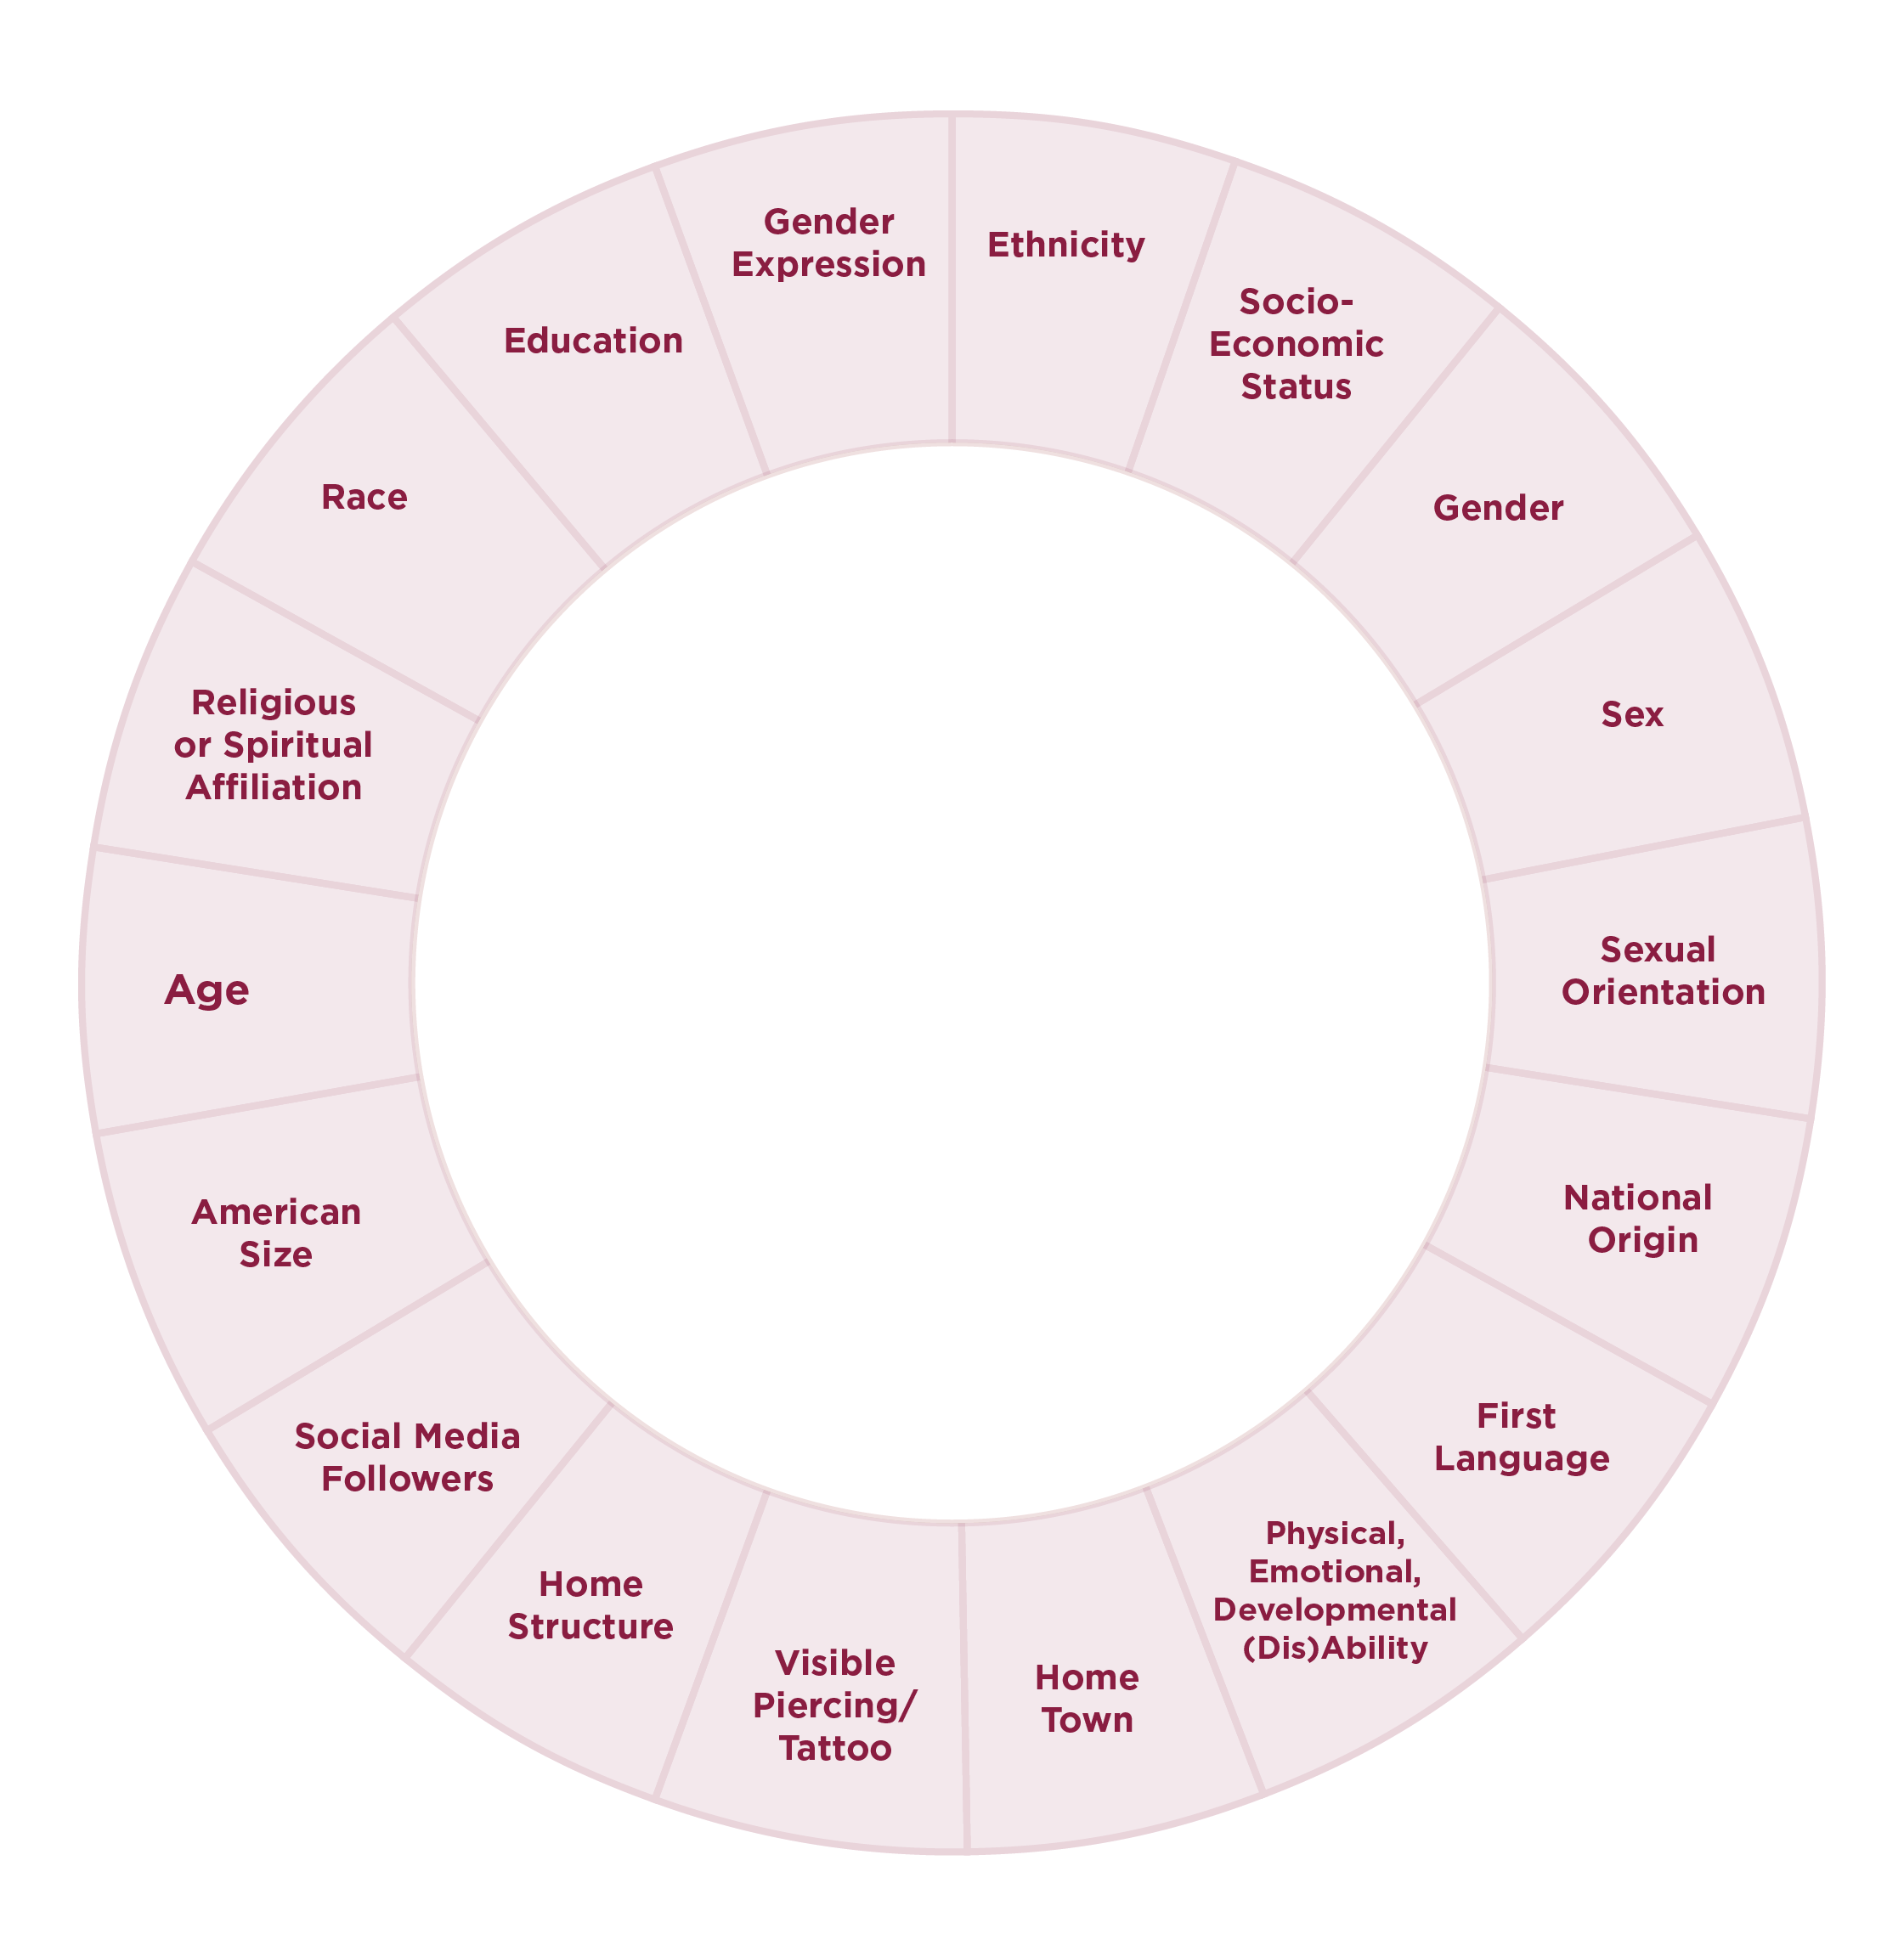
Social Identity
Involves the ways in which one characterizes oneself, the affinities one has with other people, the ways one has learned to behave in stereotyped social settings, the things one values in oneself and in the world, and the norms that one recognizes or accepts governing everyday behavior.
Pi Beta Phi Inclusive Language Guide

Slide 53

The Circles Within Me

Slide 54
Competency and Humility

Slide 55
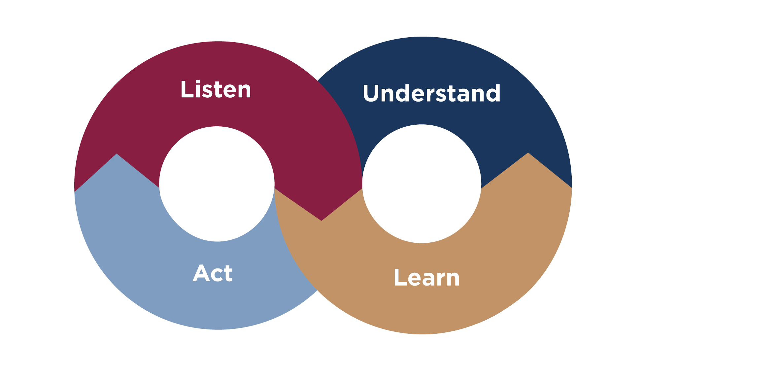

Slide 56
Happy Holidays?
November has come and multiple members have shared with you how excited they are about the holiday season. The chapter president asks to schedule a meeting with you about holiday decorations, event calendar, meals, and budgets as their hope is to be more inclusive of holidays outside of Christmas. After three meetings with chapter officers and fellow AAC members, the chapter has decided to pivot and center Hannukah and Kwanza as 20% of the chapter identifies with these holidays (per the AME). You share with your housing staff that things will be different this holiday season and that the meal menu and decorations will reflect the numerous ethnicities, religions and cultures reflected in the chapter.
New decorations and meals are introduced the week before Thanksgiving. You overhear chapter members on multiple occasions talking and using offensive speech when talking about members, their cultures and holiday celebrations. Multiple confrontations have occurred between members.
Notes:
Teresia to write own remarks

Slide 57
Happy Holidays?
What are the important aspects of this scenario? Has anyone experienced anything similar?
Who are the key stakeholders in this scenario?
What would be your role in helping to address the behaviors and who would you need to work with?
What struggles would you have assisting the chapter in handling this scenario?
Other takeaways?
Notes:
Teresia to write own remarks

Slide 58
Specialty Area Review and Deep Dive
Allison Kimball
HQ Alumnae Services Director

Slide 59
Specialty Area Conversations
  Discussion
    What trends are you seeing in this area, or more generally over your years of service?
    What does your chapter do well in this area? What makes you most proud? Share tips with others!
    What are the current challenges your chapter has in this area? Ask the group for ideas!
  Pick a Spokesperson for your table
    Key highlights that were discussed
    Strengths/Challenges within specialty area

Slide 60
Join your Specialty tables:
AAC
Chairs/Chapter President: Tables 1, 2, 8, 9
Operations: Tables 3, 10
Risk Management: Tables 4, 11
Member Experience: Tables X, X, 15
Finance/Housing: Tables 5, 12
Community Relations: Tables 6, 13
Inclusion: Tables 7, 14
Recruitment: Tables 16, 17

Slide 61
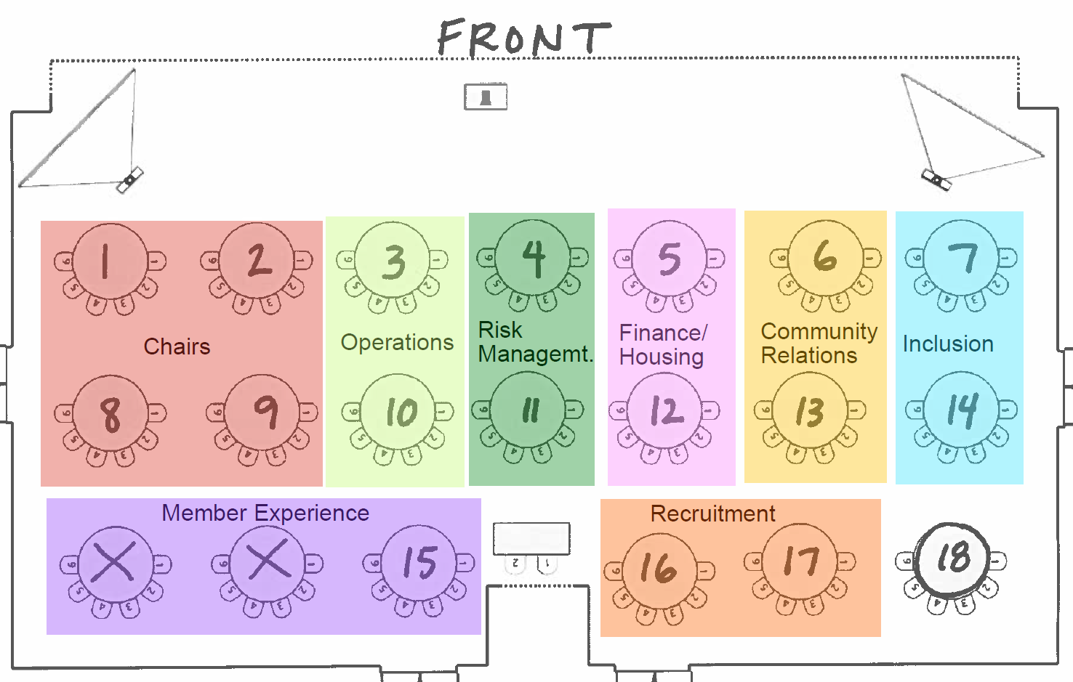

Slide 62
  Discussion
    What trends are you seeing in this area, or more generally over your years of service?
    What does your chapter do well in this area? What makes you most proud? Share tips with others!
    What are the current challenges your chapter has in this area? Ask the group for ideas!
  Pick a Spokesperson for your table
    Key highlights that were discussed
    Strengths/Challenges within specialty area

Slide 63
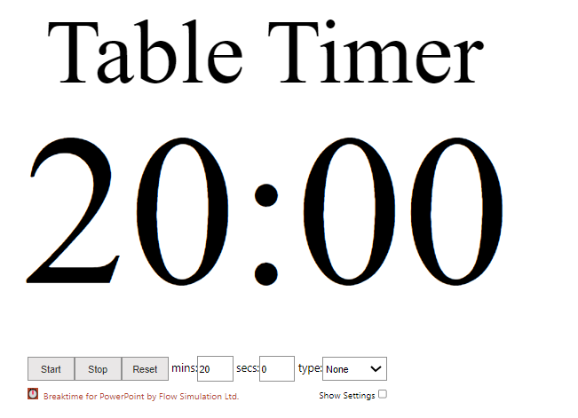

Slide 64

Chapter President/ Panhellenic Delegate
Core Responsibilities:
• Emergency Procedures
• Spokesperson for chapter
• Panhellenic relations
• Monthly Chapter Evaluation
• Chapter visitor coordination
• Presiding over meetings and Ritual

Slide 65
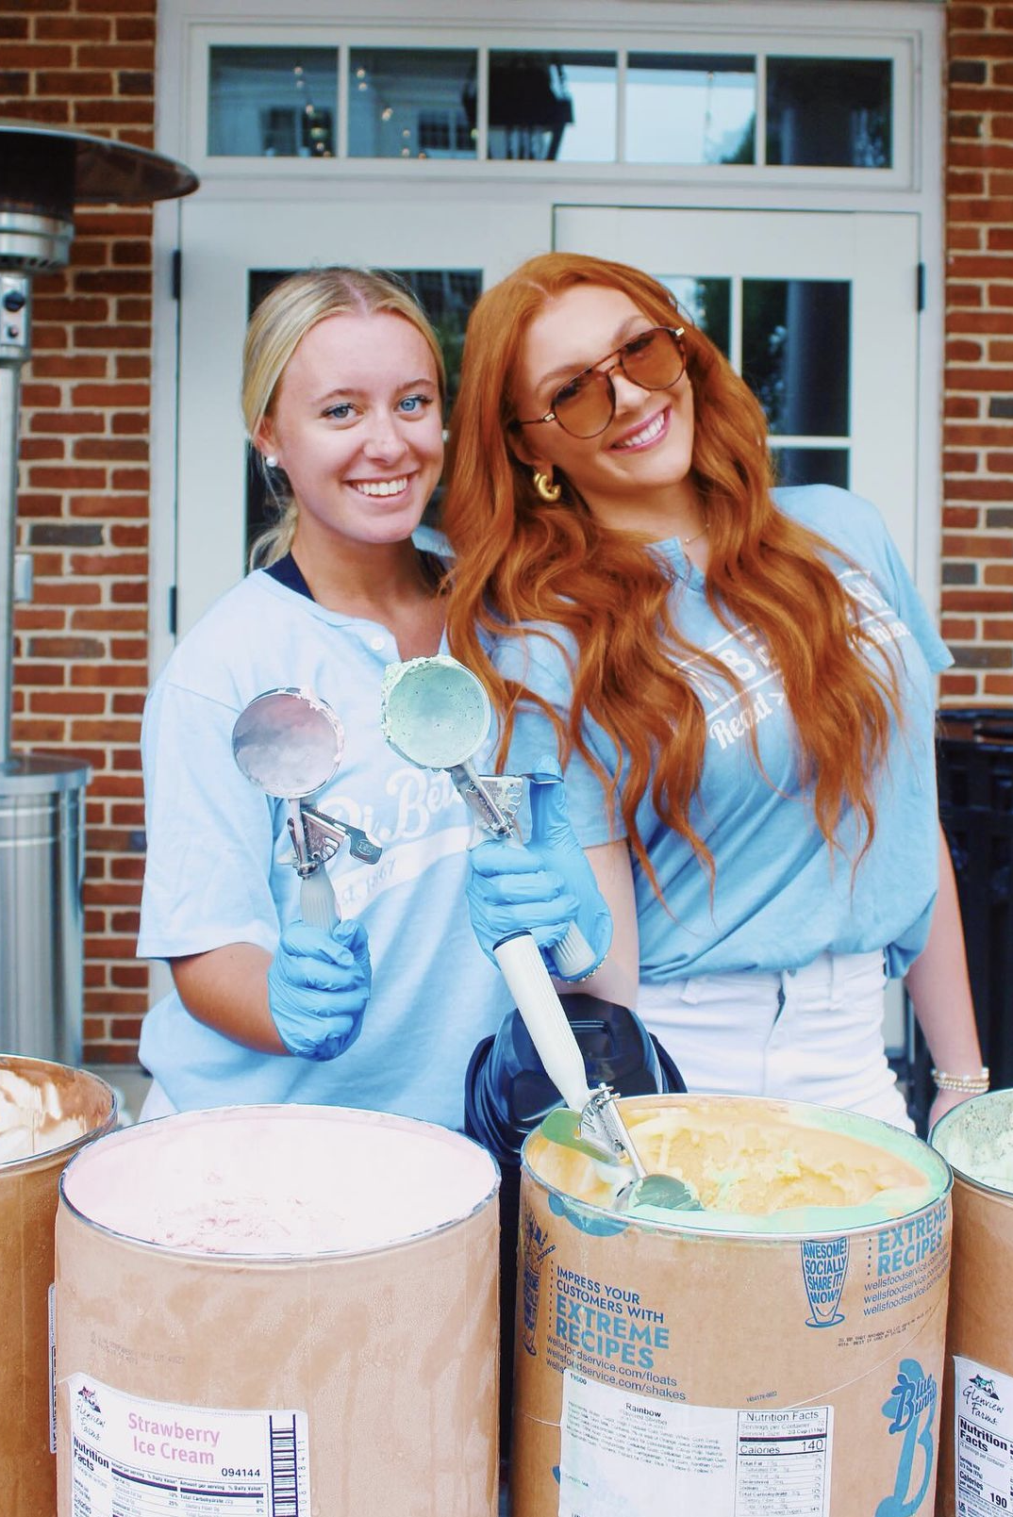
Operations Team
Core Responsibilities:
• Bylaws
• Member status changes and roster management
• Leadership & Nominating Committee
• Officer elections and appointments
• Officer transitions and training
• Awards nomination submissions
• Meeting logistics and record keeping
• First Vice President

Slide 66
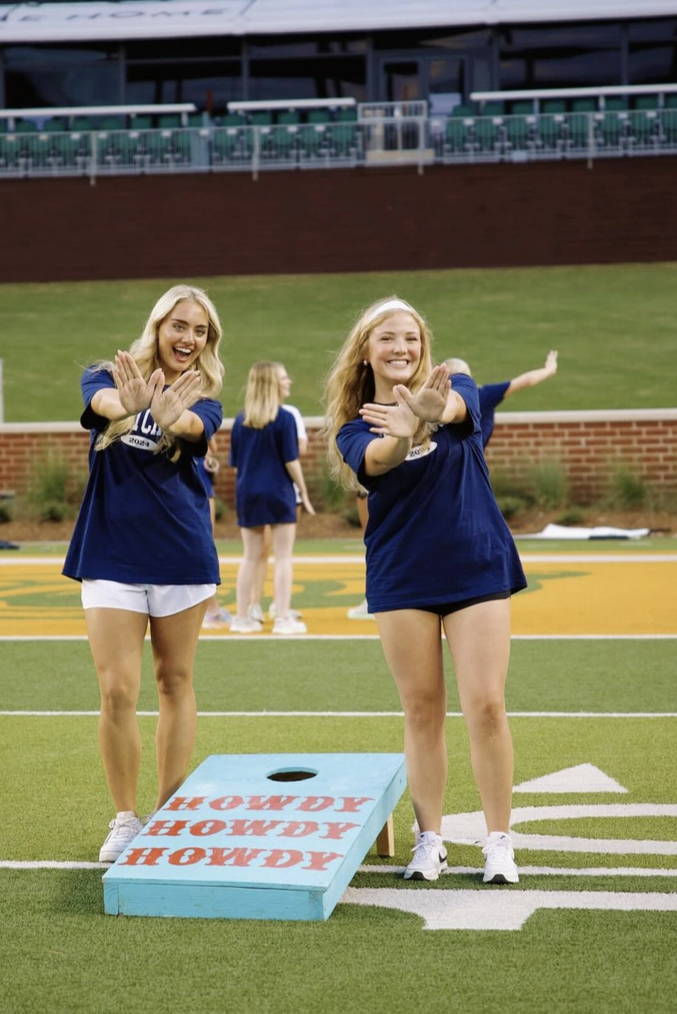
Risk Management
Core Responsibilities:
• Event planning
• Member Conduct Committee
• Member Accountability process
• Policy education and adherence
• Prevention education and Critical
Conversations execution

Slide 67
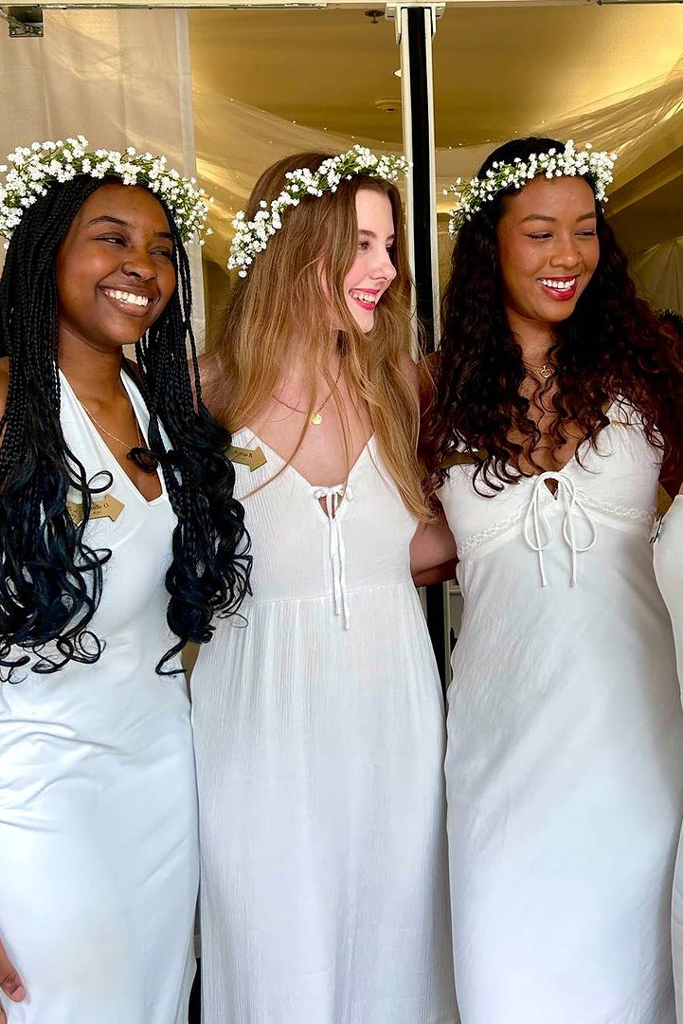
Member Experience
Core Responsibilities:
• Sisterhood programming
• Leading with Values seminars
• New Member Education Program
• Bid Day
• Big sister/little sister program
• Ceremonies/Pledging & Initiation
• Fraternity heritage celebrations/Founders’ Day
• Archives
• Annual Member Evaluation
• Pi Phi for Life Programming
• Academic support programming
• Arrowboard

Slide 68
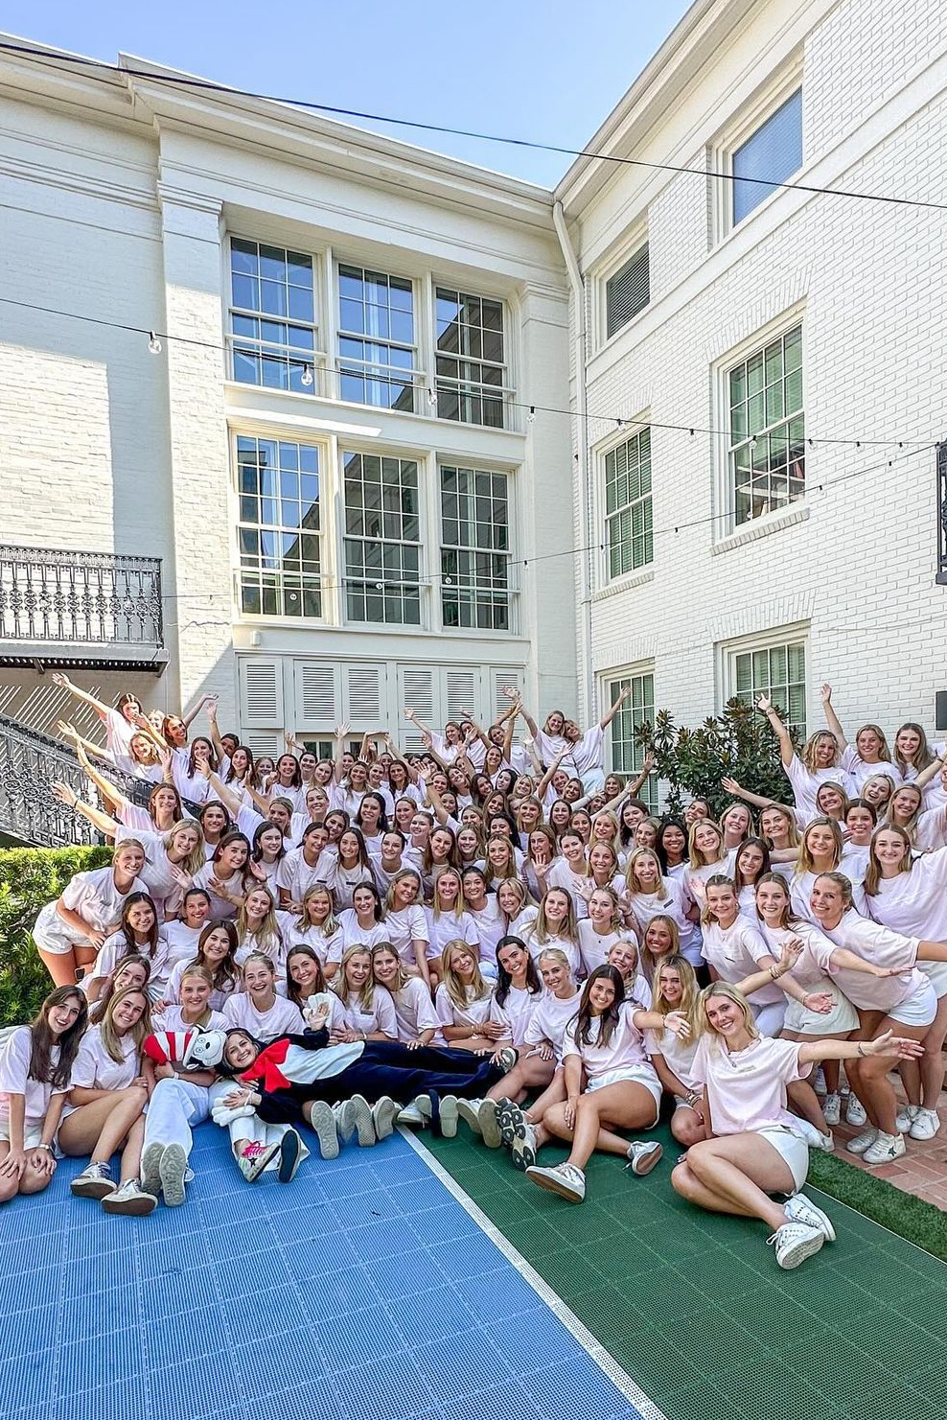
Finance/Housing
Core Responsibilities:
• Member finances and invoicing
• Automatic Financial Probation (AFP)
• greekbill
• Chapter budget
• Chapter Budget Committee
• Writing checks, paying chapter invoices and
issuing reimbursements
• Financial record keeping
• Chapter House Corporation (CHC)/Fraternity
Housing Corporation (FHC) partnership
• Chapter facility or storage unit management
• Submitting fundraised dollars to Pi Beta Phi
Foundation or other charitable organizations

Slide 69
Community Relations
Core Responsibilities:
• Chapter brand/image
• Social media
• Chapter website
• Recruitment videos and marketing
• The Arrow® magazine submissions
• Literacy programs and initiatives
• Read > Lead > Achieve®
• Champions are Readers®
• Fraternity Day of Service
• Philanthropy events
• Alumnae/caregiver relations and events

Slide 70
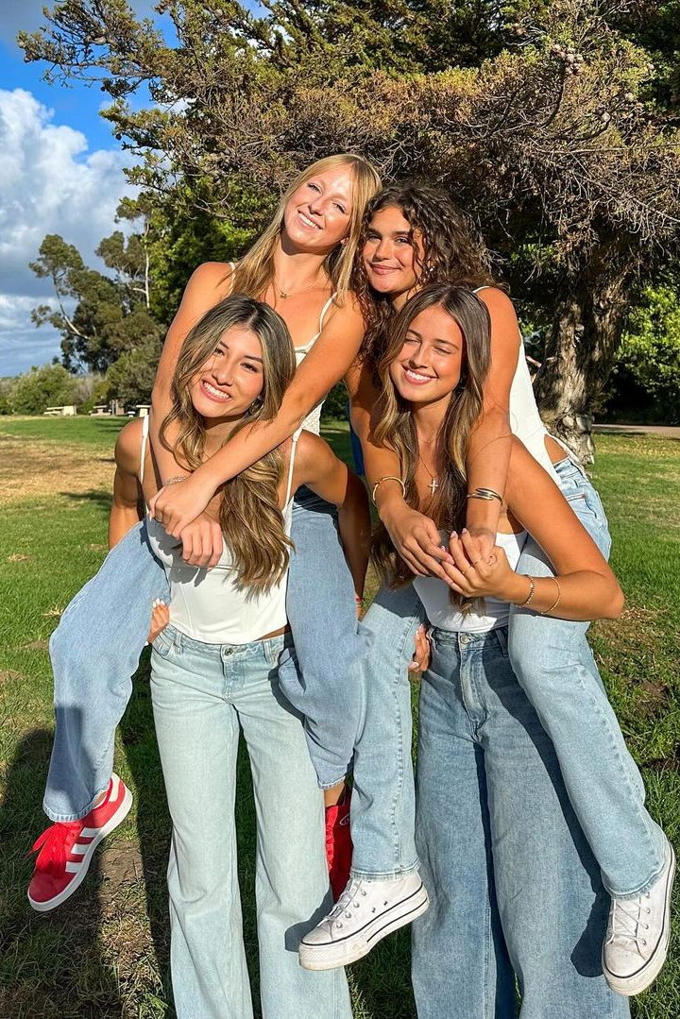
Inclusion
Core Responsibilities:
• Diversity, equity and inclusion programming
and education
• Supporting inclusive programming and
activities across the chapter
• Input into chapter policies and procedures
from inclusive lens
• Celebrating diversity within chapter

Slide 71
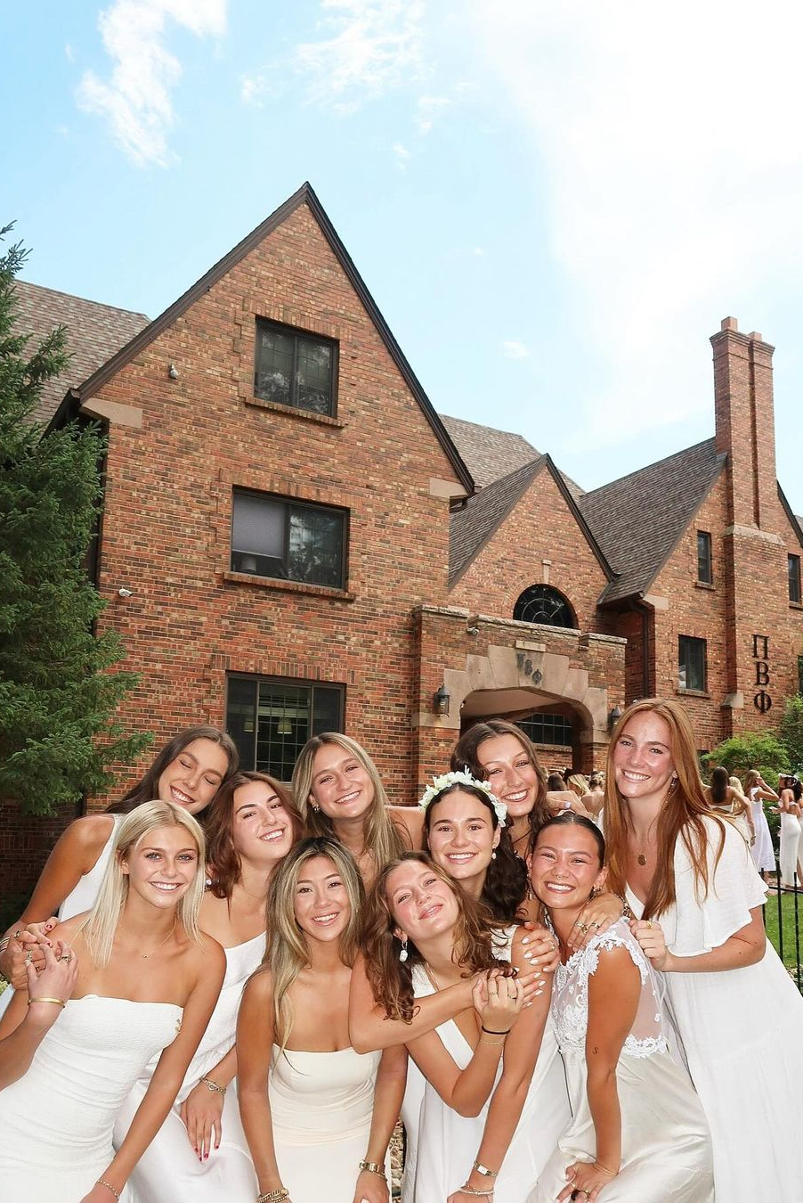
Recruitment
Core Responsibilities:
• Primary recruitment planning and execution
• Continuous Open Bidding/informal
recruitment planning and execution
• Membership growth goals
• Recruitment prep workshops
• Membership selection
• Chapter Membership Selection Committee
• Recruitment Information Forms
• OmegaRecruit

Slide 72
AAC Recruitment
Kimberly Crowe
Alumnae Engagement Director

Slide 73
Chapters cannot operate without strong alumnae support. When collegians and advisors work together towards a common goal, it creates not only an essential and important partnership but also a rewarding experience for everyone involved.
-Washington Beta JENNIFER LAMOTTE GARETY, Colorado Alpha AAC Operations

Slide 74
Turn and Talk
Take about 5 minutes to turn and talk with a table partner about your personal experiences as a volunteer.
Who/what helped lead you to volunteer?
What are the reasons you volunteer?
Did you develop a special connection with a collegian?
What are the benefits of volunteering on AAC?

Slide 75
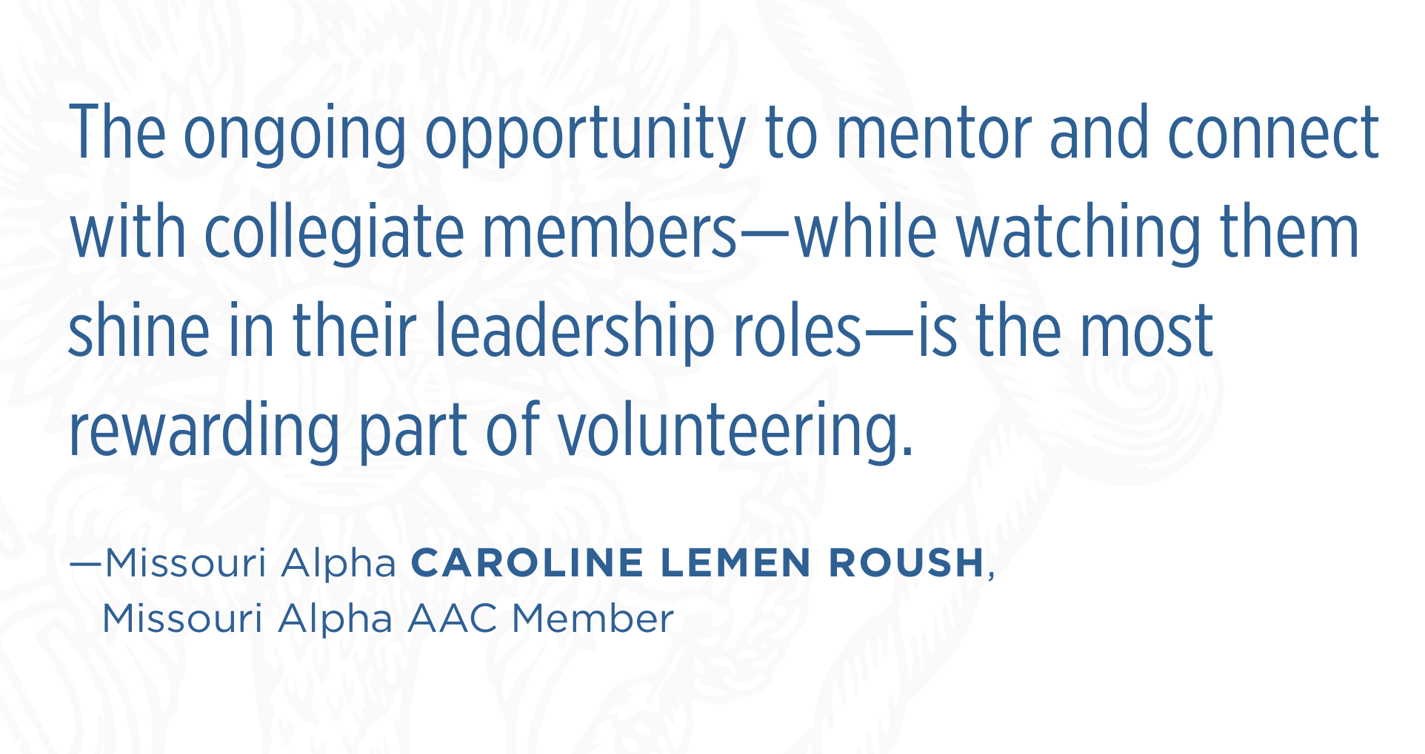
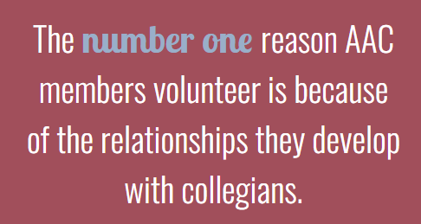

Slide 76
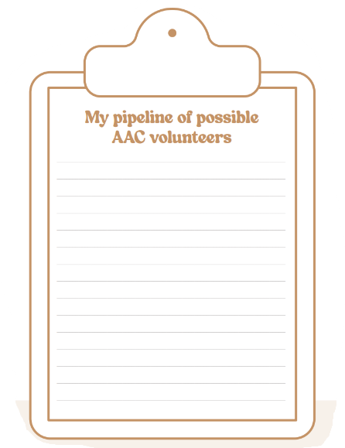
Personal Connections
Think on your experiences and write down the names of Pi Phi alumnae you could reconnect with at some point.

Slide 77
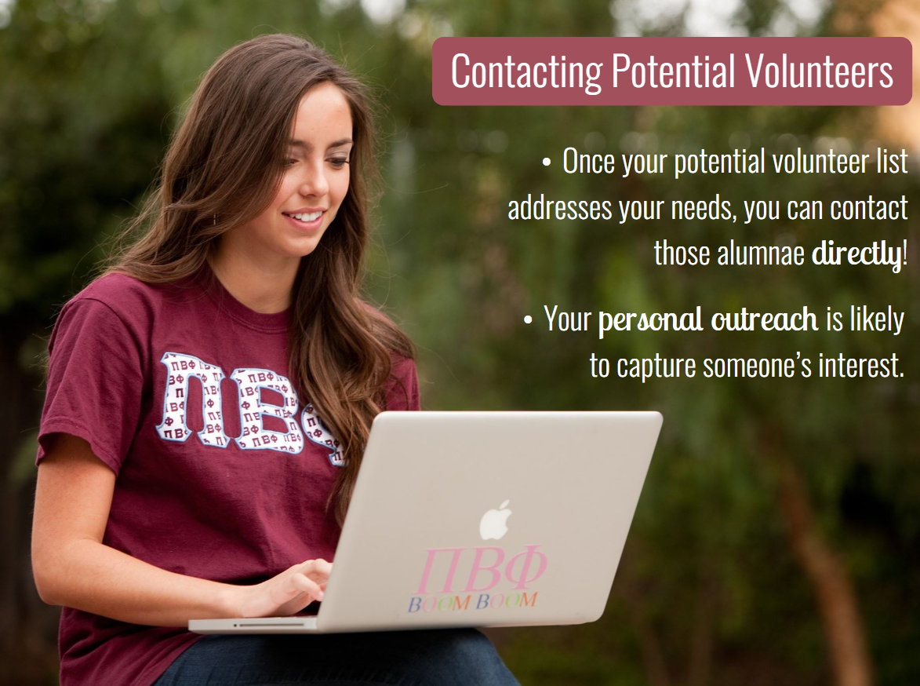
Identifying Potential AAC Members
Partner with local Alumnae Clubs
Post on Social Media
Utilize referrals from current volunteers
Search for Alumnae in Find My Sisters
Engage with Recent Graduates

Slide 78
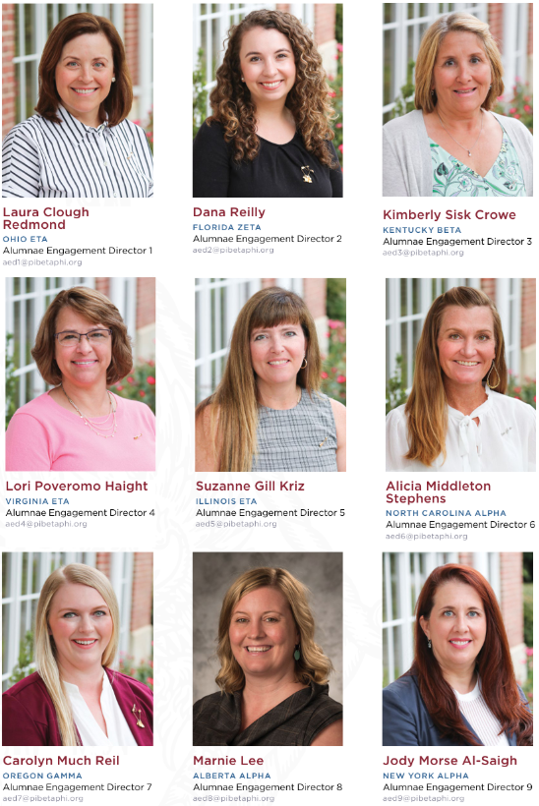
Working with your AED
Your Alumnae Engagement Director (AED) for your region is a great resource because they are the person to introduce needs to the Regional Team and facilitate conversation around how to they can help address those needs.

Slide 79
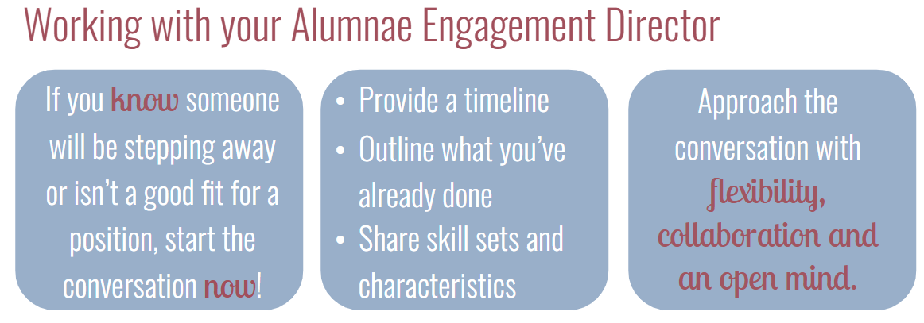

Slide 80
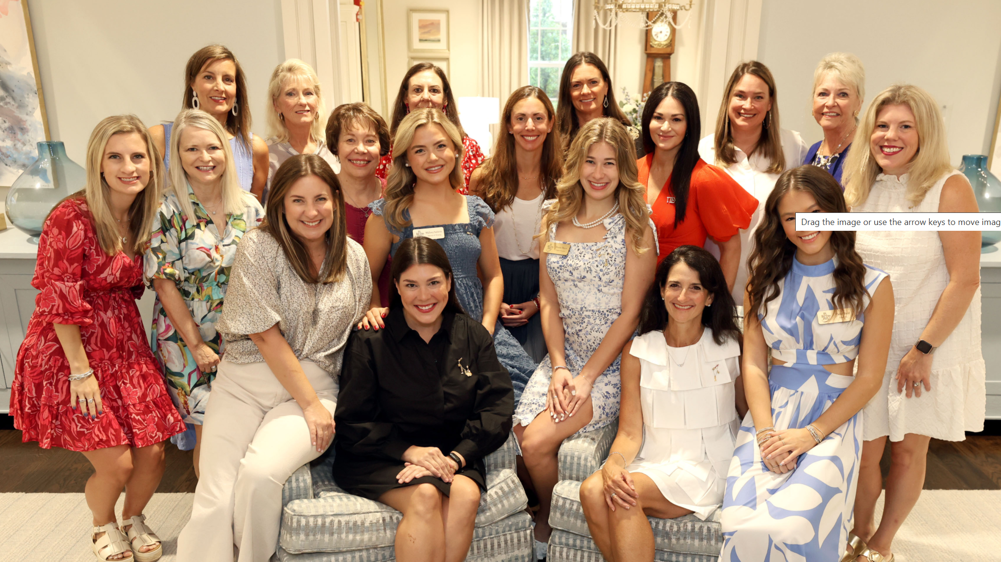
Retaining a strong AAC
Lean on each other for support
Divide and conquer
Develop a recognition plan
Find out what makes each AAC member feel valued
Foster sincere friendship!

Slide 81

New AAC Recruitment Toolkit!
To recruit alumnae to join your AAC or help other chapters find potential advisors, visit pibetaphi.org/recruitAAC
to download the
AAC RECRUITMENT TOOLKIT with valuable tips, resources and guidance.

Slide 82

for your continued dedication to our sisterhood!

Slide 83
Partnerships for Success
Michelle Woodhouse
Director Alumnae

Slide 84
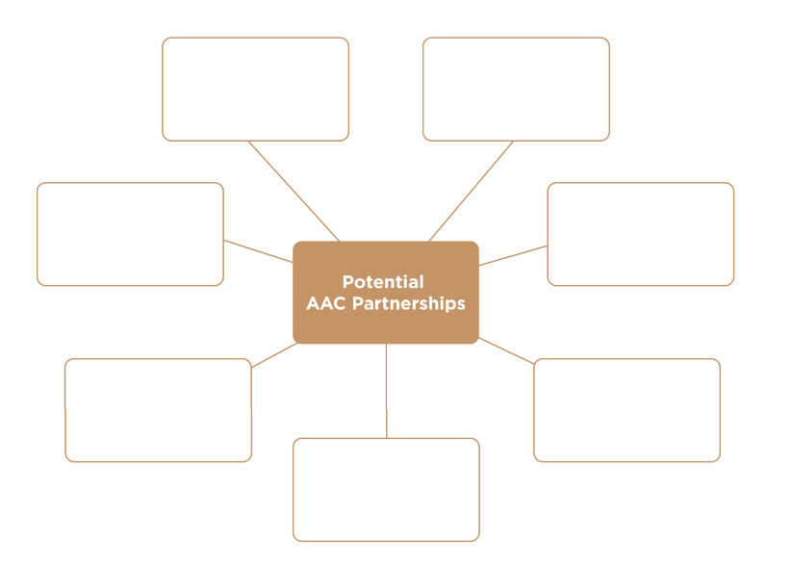
CHC
FSA (Campus Staff)
Local Alumnae Club
FHC
Parents &
Caregivers
Other local Advisors
Regional
Team

Slide 85
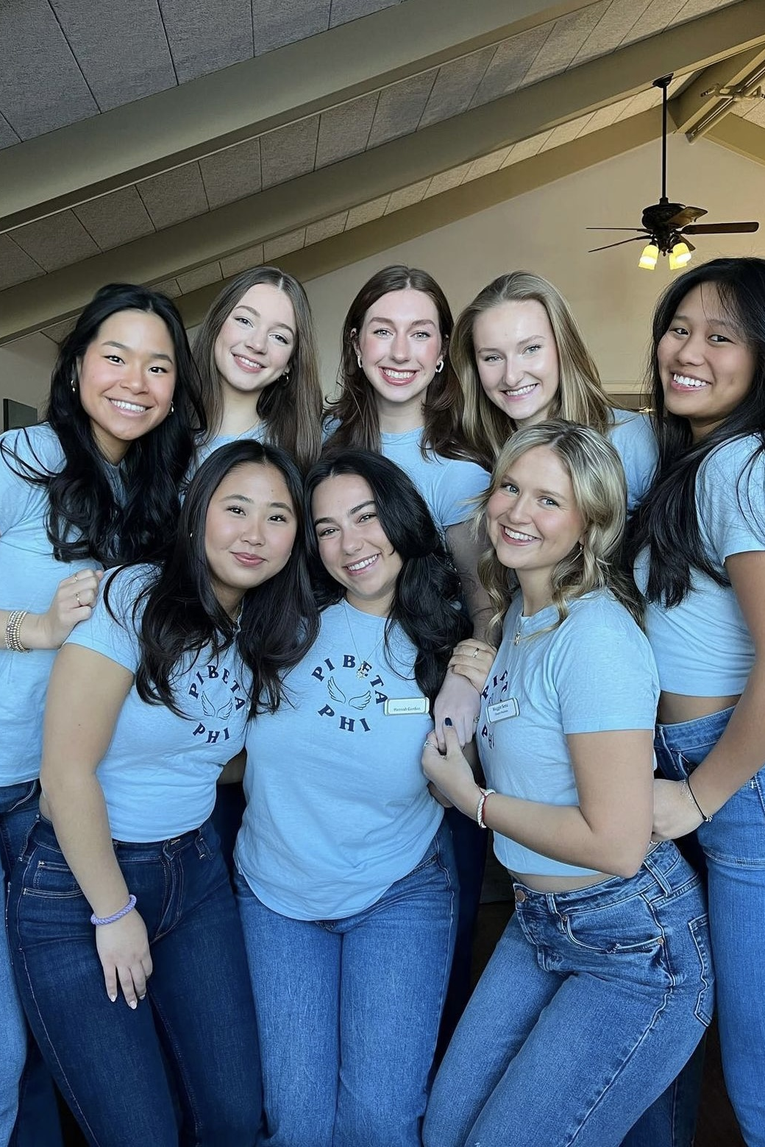
Identifying your partners
Grab one green, one yellow and one red strip.
Navigate the room and use the stickers to indicate how often each partner/constituent comes up in your Advisor role.
  Green = a frequent partnership in your role
  Yellow = partnership comes up from time-to-time but is not central to your role
  Red = partnership doesn't come up much or at all

Slide 86
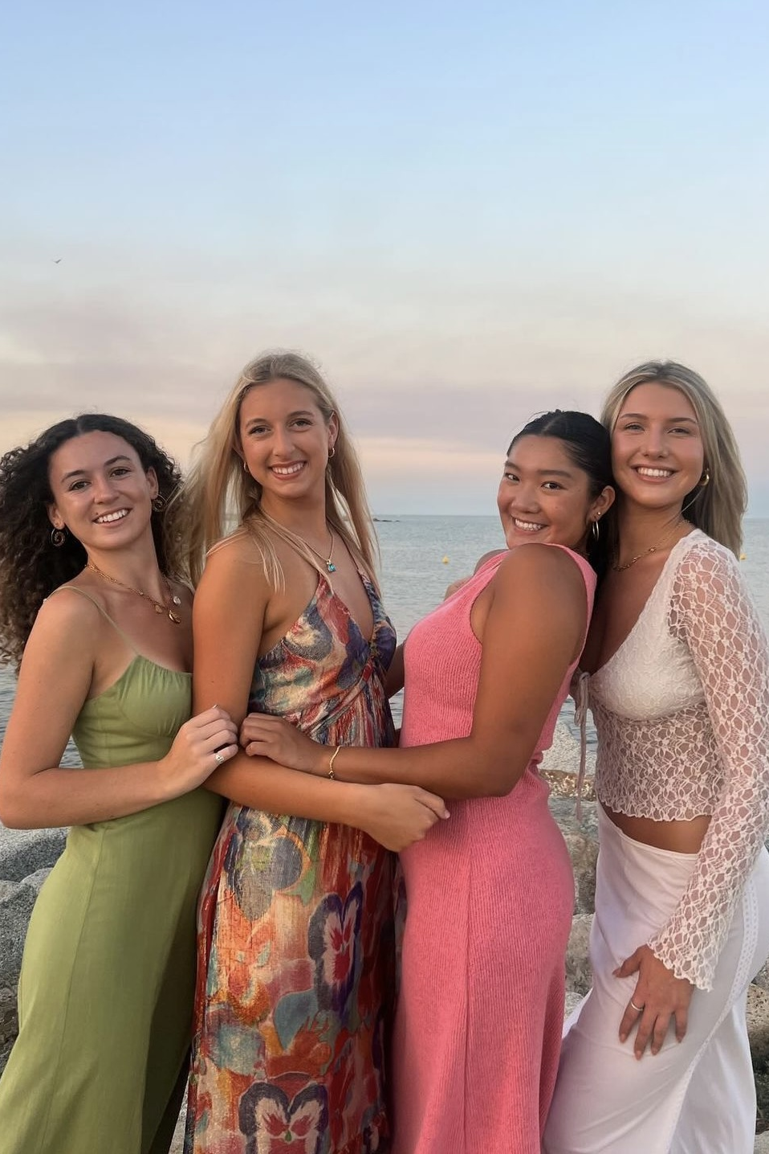
Discuss with a Partner
In this partnership, how has trust and friendship played a role (or not, if it is absent)?
What is a “win” I’ve had with this partnership, even if it’s a small win?
What is one thing we could do to enhance this partnership?

Slide 87
Partnership Highlight:
Pi Beta Phi Foundation
Wendy Pratt
Foundation President, Board of Trustees
Kathleen Meriano
Foundation Vice President Development, Board of Trustees

Slide 88
Partnership Highlight:
Pi Beta Phi FHC
Shawn Eagleburger
Executive Director

Slide 89
Meeting Ritual Update
College Weekend 2025

Slide 90
The Origin of Our Meeting Ritual
Historical Significance:
Meeting Ritual adopted in 1893, 26 years after our founding
Emma Harper Turner determined we need a uniformed opening and closing to our meetings
Purpose:
Connect all members in shared, unifying practice of saying meeting Ritual
Modern Challenges:
Not consistently used across chapters
Some members feel disconnected or face challenges in practicing it
Misalignment with the beliefs or feelings of members
Our Commitment:
Pi Beta Phi is focused on empowering one another and creating a sisterhood where our members feel seen, understood, supported, and valued

Slide 91
Evolving Meeting Ritual
Informed Decision
Result of a two-year process of feedback, research, and dialogue
Preserving Tradition
Evolution honors our traditions
Aims to ensure every sister feels connected, welcomed, and valued
Purpose Remains Unchanged
Sets a unified tone for conducting Fraternity business

Slide 92
The Journey to Evolve
The 7 Guardrails for Ritual Evolution:
The Creed (phrases beginning with "Whatsoever") remains unchanged and used in the closing
Removes references to Christ, God and Trinity
Infers core values without explicitly listing them
Maintains tone, cadence, and elevated language
Remains simple, short and memorable
Aligns with Ritual's original purpose
Preserves historical significance

Slide 93
Reflect on what it means to live our Pi Phi values

Slide 94
What if this was how I felt?

Slide 95
What this Means for You
Pi Phi is sharing with alumnae clubs, members at large in phased communication plan
Current Ritual remains in use until Fall 2025
Does not impact Initiation
Meeting Ritual Evolution Guide to follow

Slide 96
Quotes from members last week...
"A tradition is just a tradition because it carries on. Soon, this new Ritual will be our tradition" - Chapter Officer
"While it's hard to personally let go of a long-standing tradition because its near and dear to my heart, it's worth it to make those that feel conflicted more included." - Chapter President
"I may need help in supporting our members who do identify as Christian or Catholic as this continues to roll out.“ - Chapter President
"I just attended the meeting Ritual zoom and wanted to say thank you for all the work Grand Council and HQ have put into this. Beyond the fact that I'm personally excited to see these changes that seem well thought out – I really appreciate how this is being announced and that the Fraternity is giving members a chance to feel heard and take time to process." - AAC Chair
"Our chapter has been using a meeting Ritual they have written, which they love. My biggest concern is getting them to adapt the new meeting Ritual." - AAC Chair
"I welcome these changes, and I appreciate the way this has been handled by the Fraternity. We learned from past experience, and we are sensitive to those afraid of change. Pi Phi is growing!" – Foundation volunteer and past Fraternity Officer

Slide 97
Meeting Ritual Update
College Weekend 2025

Slide 98
Weekend Wrap-up
Michelle Drousé
Woodhouse
Director Alumnae

