Slide 1
Table Assignments
AL Beta | 11
AL Gamma | 10
AZ Alpha | 11
AZ Beta | 8
AZ Gamma | 15
AR Alpha | 11
CA Beta | 9
CA Delta | 9
CA Epsilon | 8
CA Eta | 5
CA Gamma | 5
CA Kappa | 5
CA Mu | 15
CA Xi | 12
CA Zeta | 14
CO Alpha | 11
CO Delta | 7
CO Epsilon | 17
CO Gamma | 9
CT Alpha | 2
D.C. Alpha | 4
DE Alpha | 6
FL Alpha | 16
FL Beta | 3
FL Delta | 8
FL Epsilon | 5
FL Eta | 5
GA Alpha | 10
GA Beta | 4
ID Alpha | 12
IL Alpha | 16
IL Eta | 13
IL Theta | 17
IL Zeta | 2
IN Alpha | 16
IN Beta | 9
IN Delta | 2
IN Gamma | 15
IN Zeta | 13
IA Beta | 13
IA Gamma | 12
IA Zeta | 6
KS Alpha | 8
KS Beta | 2
KY Alpha | 1
KY Beta | 3
LA Alpha | 14
LA Beta | 10
ME Alpha | 16
MI Alpha | 17
MI Beta | 2
MI Gamma | 9
MN Alpha | 1
MS Alpha | 15
MS Beta | 11
MS Gamma | 3
MO Alpha | 8
MO Gamma | 13
MT Alpha | 12
NE Beta | 6
NE Gamma | 15
NM Alpha | 12
NV Alpha | 5
NY Eta | 4
NC Alpha | 6
OH Alpha | 1
OH Epsilon | 16
OH Iota | 7
OH Kappa | 7
OH Theta | 1
OK Alpha | 10
OK Beta | 6
ON Alpha | 17
OR Alpha | 9
PA Eta | 7
PA Zeta | 13
SC Alpha | 11
SC Beta | 10
SD Alpha | 12
TN Beta | 4
TN Delta | 1
TN Gamma | 3
TX Alpha | 8
TX Beta | 14
TX Delta | 10
TX Epsilon | 15
TX Eta | 3
TX Gamma | 14
TX Zeta | 3
UT Alpha | 14
VA Delta | 16
VA Epsilon | 2
VA Gamma | 4
VA Theta | 7
WA Alpha | 7
WA Gamma | 17
WV Alpha | 1
WI Alpha | 14
WI Epsilon | 13

Slide 2
Welcome to the Chapter President College!
Pi Beta Phi College Weekend
January 24-26, 2025

Slide 3
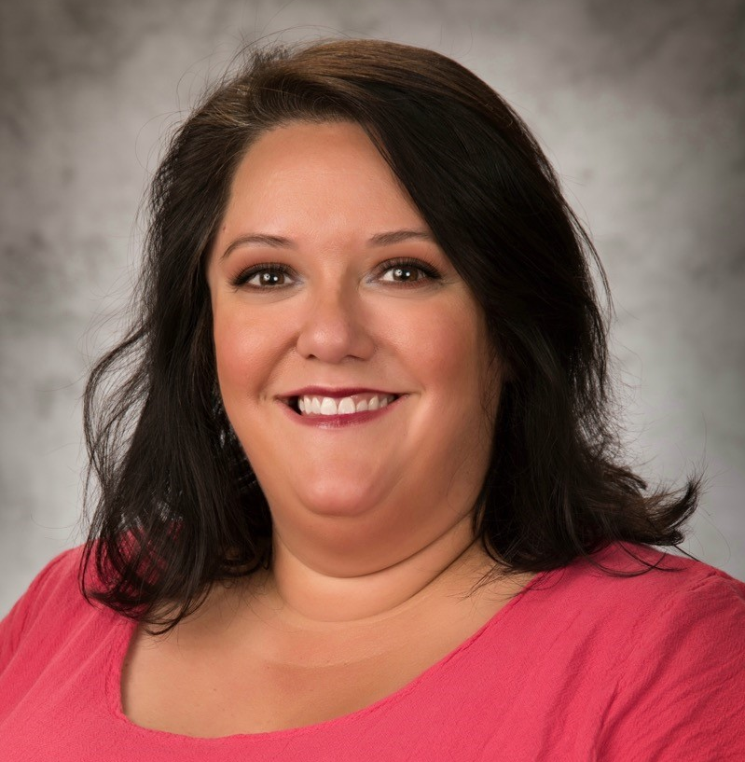
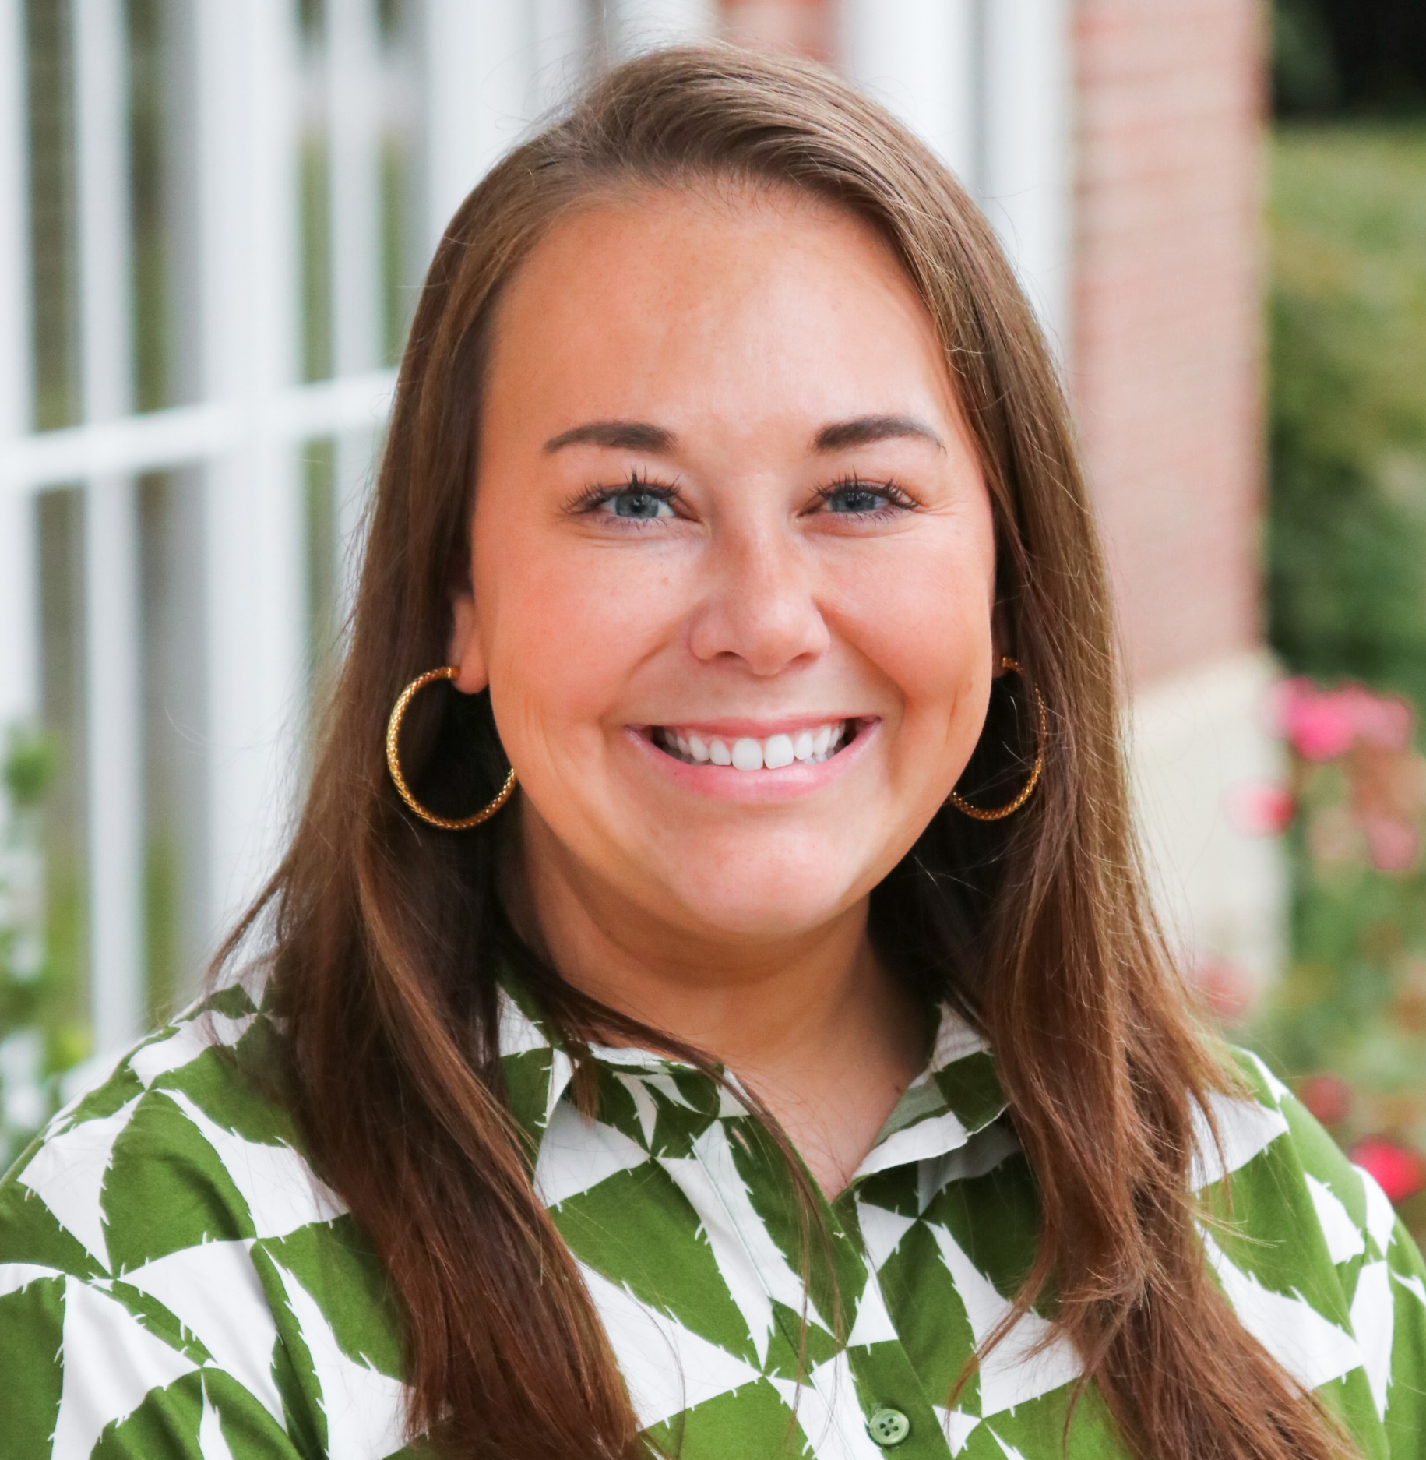
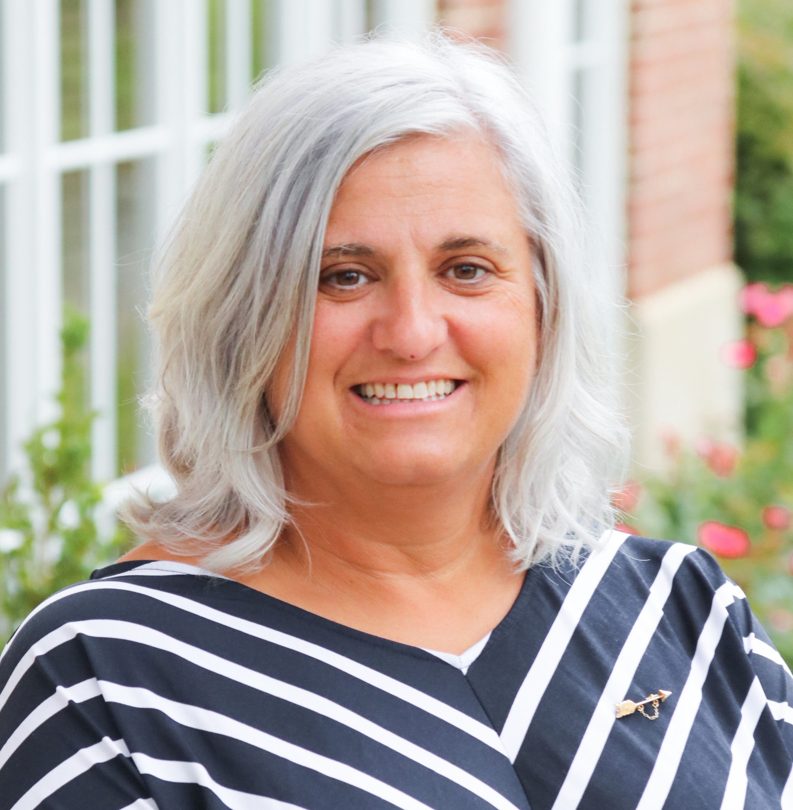
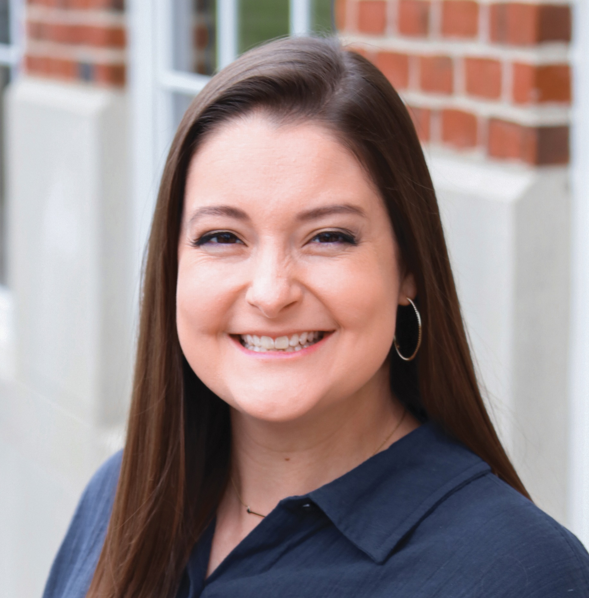
Chapter President Track Facilitators
Brooke Avila
Region 5 Collegiate Regional Director
Molly Harris-Stevens
Region 6 Collegiate Regional Director
Kris Murphy
Region 9 Collegiate Regional Director
Samantha Eldridge
Chapter Services Director
Headquarters

Slide 4
Table Introductions
Name
Chapter and University
What “superpower” do you think would be most helpful as Chapter President?

Slide 5
Chapter President Track Agenda
FRIDAY | SATURDAY MORNING | SATURDAY AFTERNOON | SATURDAY EVENING
Welcome How To Prioritize When Everything Feels Important How Do You Lead? | Welcome Back Chapter President Roles and Responsibilities Executive Council Roles and Responsibilities Supporting the Panhellenic Delegate Roundtables | Organizational Priorities Being a President for All Member Accountability Roundtables | Roundtables Leading Through Crisis Leading Through Change Building Your 2025 Roadmap Wrap-Up

Slide 6




Learning Outcomes
Practice servant leadership, active listening, and collaborative communication strategies to use with your Executive Council, Alumnae Advisory Committee members, chapter, and Panhellenic community
Identify opportunities for delegation and develop time management practices to assist in prioritizing and accomplishing Chapter President responsibilities
Understand your personal responsibility to uphold expectations of the Fraternity and lead your chapter through crisis and effective change management

Slide 7
How To
Prioritize When Everything Feels Important

Slide 8
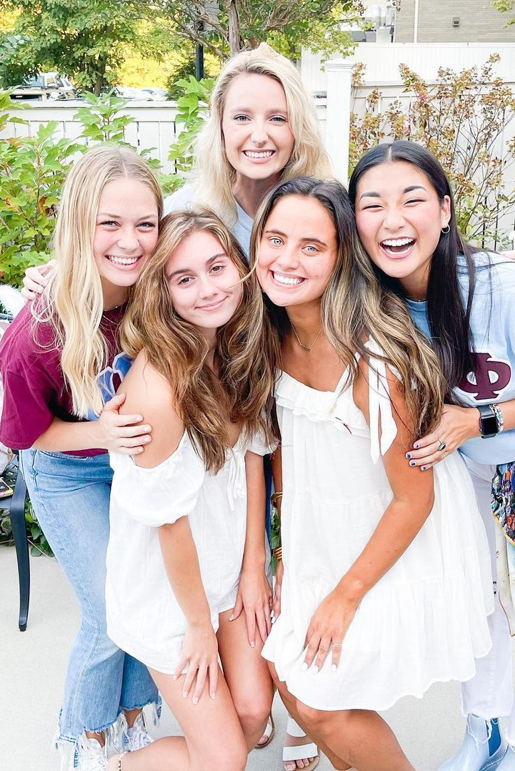
Your “Why”
Why do you say yes to Pi Phi?
Who inspires you to say “yes” to Pi Phi?
How do you inspire others to say “yes” to Pi Phi?

Slide 9
What is a task on your current to-do list?

Slide 10
 | Urgent | Not Urgent
Important
Not Important

Slide 11
 | Urgent | Not Urgent
Important | Review Emergency Procedures with the chapter Meet with Chapter Leadership Team to establish new point system for the semester/term Sign reimbursement checks Notify CRD of upcoming Pi Phi judicial hearing for a policy violation | Review Monthly Chapter Evaluation standards and set goals for the upcoming year Share key takeaways from College Weekend with AAC Chair Memorize Initiation Ceremony
Not Important | Brainstorm new ways to incentivize attendance at chapter events Make new PowerPoint slides for Chapter Meeting Plan an activity to boost chapter morale | Re-design chapter calendar in Canva with new fonts and colors Update chapter announcements bulletin board in the chapter suite

Slide 12
 | Urgent | Not Urgent
Important | DO | PLAN
Not Important | DELEGATE | ELIMINATE

Slide 13
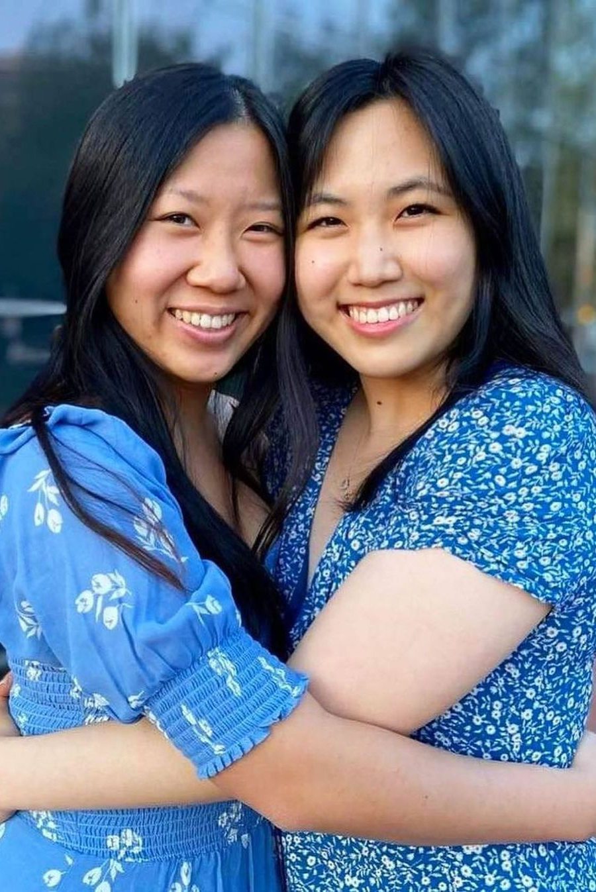
Time Management Tips
Narrow your list down to three tasks to accomplish daily
Break big projects into smaller tasks
Focus on one thing at a time
Group similar tasks and do them together
Learn to say no, or delegate more often

Slide 14
How Do You Lead?

Slide 15
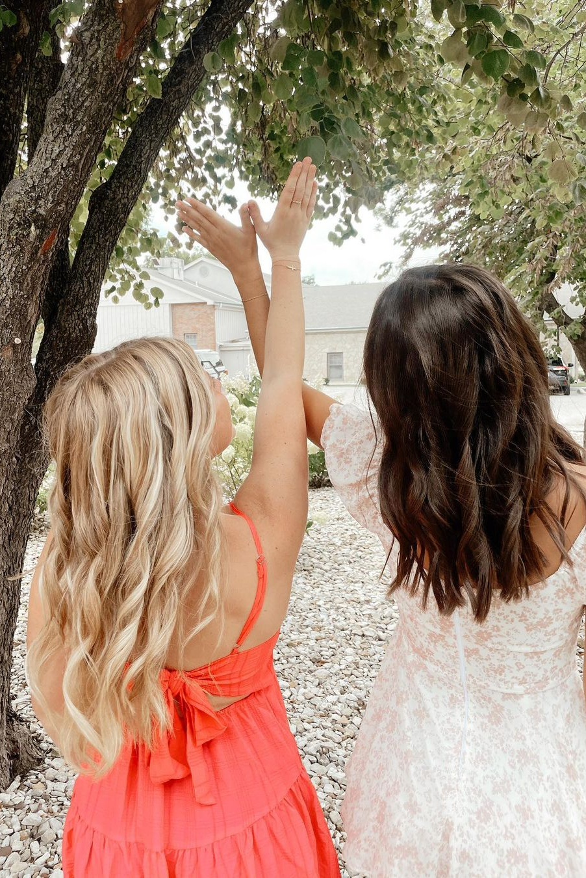
True Colors Activity
Fill out the word sort on page 58 of your workbook
  Rank the sets of words 1-4; with 4 being the MOST like you and 1 being the LEAST like you
Tally up your points according to the worksheet on page 59
Determine what color most aligns with your leadership style
Skim through the description about your color on pages 60-63 and review the table on page 64.

Slide 17
Table Assignments
AL Beta | 11
AL Gamma | 10
AZ Alpha | 11
AZ Beta | 8
AZ Gamma | 15
AR Alpha | 11
CA Beta | 9
CA Delta | 9
CA Epsilon | 8
CA Eta | 5
CA Gamma | 5
CA Kappa | 5
CA Mu | 15
CA Xi | 12
CA Zeta | 14
CO Alpha | 11
CO Delta | 7
CO Epsilon | 17
CO Gamma | 9
CT Alpha | 2
D.C. Alpha | 4
DE Alpha | 6
FL Alpha | 16
FL Beta | 3
FL Delta | 8
FL Epsilon | 5
FL Eta | 5
GA Alpha | 10
GA Beta | 4
ID Alpha | 12
IL Alpha | 16
IL Eta | 13
IL Theta | 17
IL Zeta | 2
IN Alpha | 16
IN Beta | 9
IN Delta | 2
IN Gamma | 15
IN Zeta | 13
IA Beta | 13
IA Gamma | 12
IA Zeta | 6
KS Alpha | 8
KS Beta | 2
KY Alpha | 1
KY Beta | 3
LA Alpha | 14
LA Beta | 10
ME Alpha | 16
MI Alpha | 17
MI Beta | 2
MI Gamma | 9
MN Alpha | 1
MS Alpha | 15
MS Beta | 11
MS Gamma | 3
MO Alpha | 8
MO Gamma | 13
MT Alpha | 12
NE Beta | 6
NE Gamma | 15
NM Alpha | 12
NV Alpha | 5
NY Eta | 4
NC Alpha | 6
OH Alpha | 1
OH Epsilon | 16
OH Iota | 7
OH Kappa | 7
OH Theta | 1
OK Alpha | 10
OK Beta | 6
ON Alpha | 17
OR Alpha | 9
PA Eta | 7
PA Zeta | 13
SC Alpha | 11
SC Beta | 10
SD Alpha | 12
TN Beta | 4
TN Delta | 1
TN Gamma | 3
TX Alpha | 8
TX Beta | 14
TX Delta | 10
TX Epsilon | 15
TX Eta | 3
TX Gamma | 14
TX Zeta | 3
UT Alpha | 14
VA Delta | 16
VA Epsilon | 2
VA Gamma | 4
VA Theta | 7
WA Alpha | 7
WA Gamma | 17
WV Alpha | 1
WI Alpha | 14
WI Epsilon | 13

Slide 18
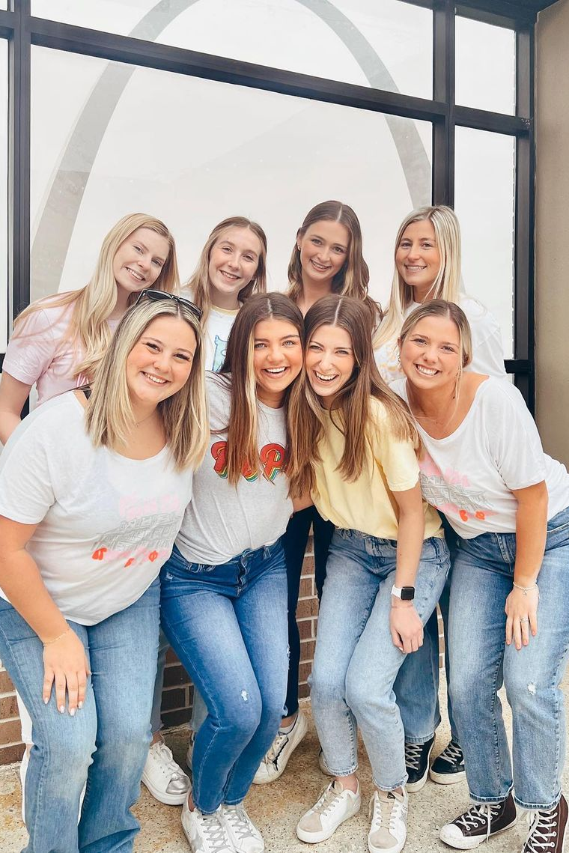
10 Things
Flip to page 66 of your workbook
Be the first table to find 10 unique things you and your tablemates have in common!

Slide 19
Chapter President
Roles and Responsibilities

Slide 20
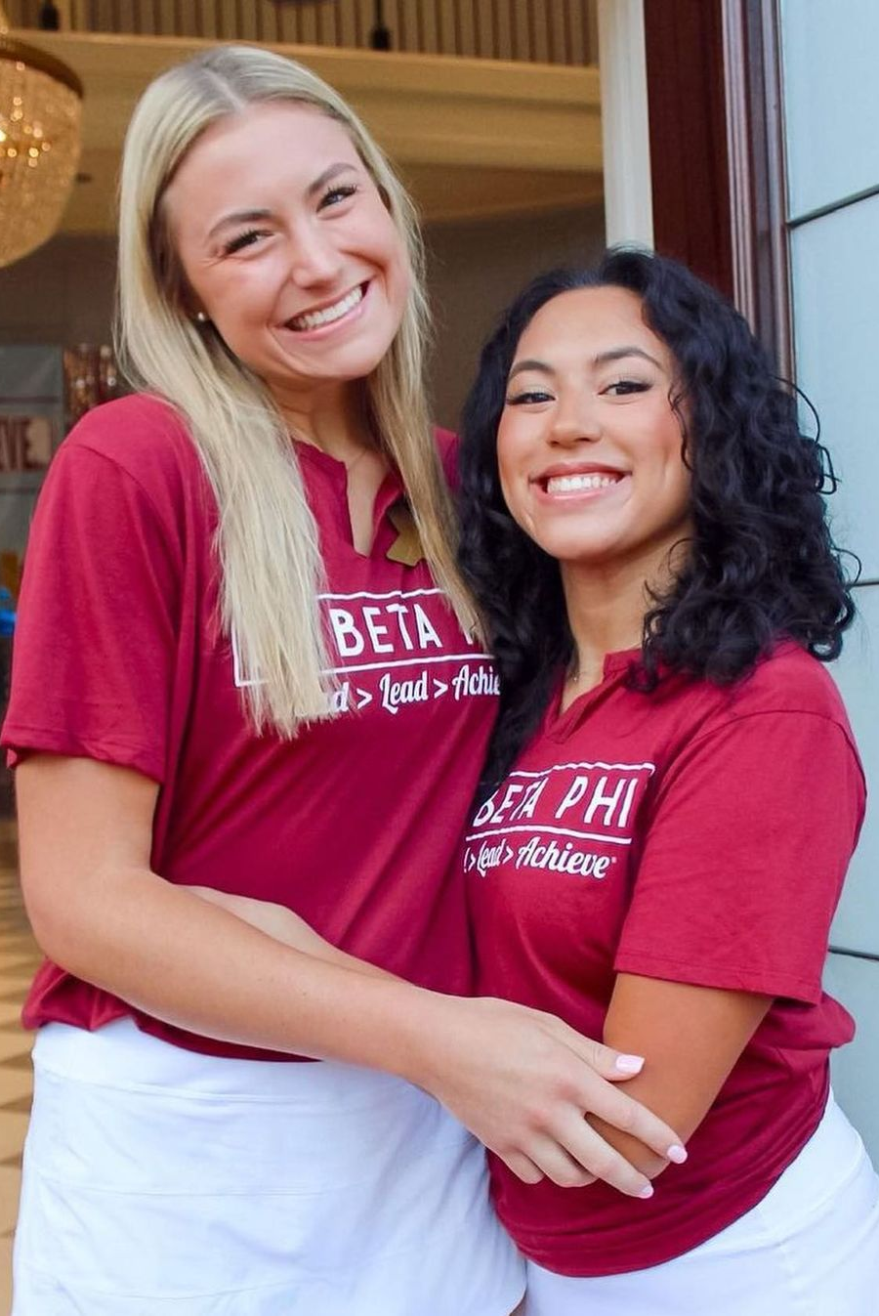
Responsibilities Activity
As a table, sort through the packet of cards in the middle of the table
Create two piles:
  One pile for cards that are on the Chapter President position description
  One pile for cards that are NOT on the Chapter President position description

Slide 21
Executive Council
Roles and Responsibilities

Slide 22
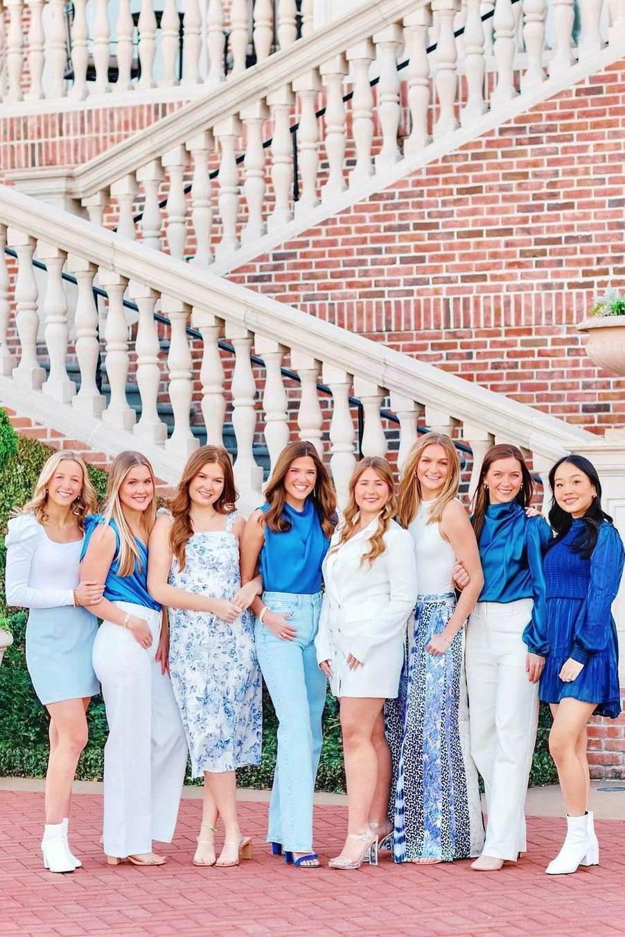
Executive Council Responsibilities
Split up the seven positions amongst your table (one person takes both VPR + VPI)
  Please take a VP position you have not held before!

Slide 23
Executive Council Responsibilities
Split up the seven positions amongst your table (one person takes both VPR + VPI)
Read position description for assigned VP and highlight important information and takeaways

Slide 24
Executive Council Responsibilities
Split up the seven positions amongst your table (one person takes both VPR + VPI)
Read position description for assigned VP and highlight important information and takeaways
Teach others at your table about your assigned Exec role!
  We will tell you when it’s time to move to the next officer.

Slide 25

Executive Council Responsibilities
VPO
VPRM
VPME
VPFH
VPCR
VPR
VPI

Slide 26
What are some examples of things Executive Council, or two VPs, may collaborate on?

Slide 27
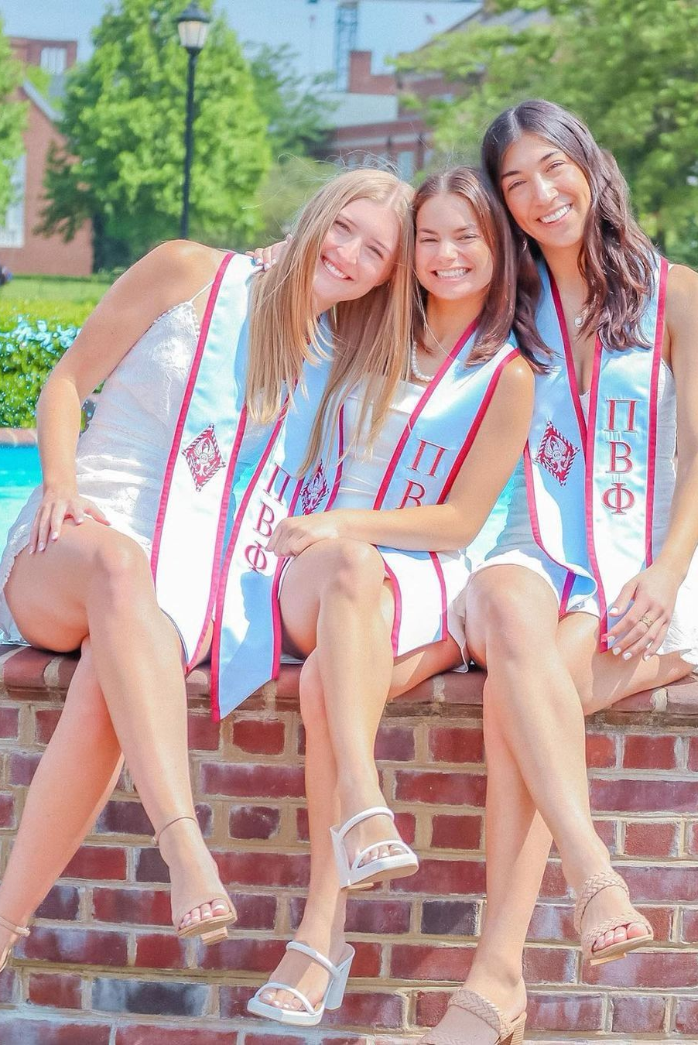

Meetings
Meetings help people feel:
  Included
  Trusted
  Important
  Able to contribute to the success of the chapter
Meetings and Voting Guide

Slide 28
Monthly Meetings
Monthly AAC/Exec Meetings:
Award nominations
Appointing officers
Approval of the slate of officers
Dispensations
Membership issues and member accountability
Voting on NMs for Initiation
Housing issues
Officer reports
MCE progress
Other updates and connections with Exec and their AAC counterparts
Monthly Chapter Leadership Team Meetings:
Upcoming events and deadlines
Officer reports as applicable
Areas for improvement
Brainstorming opportunities
Progress on goals and MCE

Slide 29
Weekly Meetings
Executive Council Meetings:
Team reports delivered by VPs
Upcoming dates, budget management
Overall health of chapter
Specialty Team Meetings:
Director reports to VP in advance of Exec/Chapter Meeting
Review of Wine and Silver Blue News and other team deadlines
Task/project plans and updates
Chapter Meetings:
Ritual
Team reports delivered by VPs
Chapter business such as elections, budget votes, accountability votes, etc.
Morale boosting activities

Slide 30
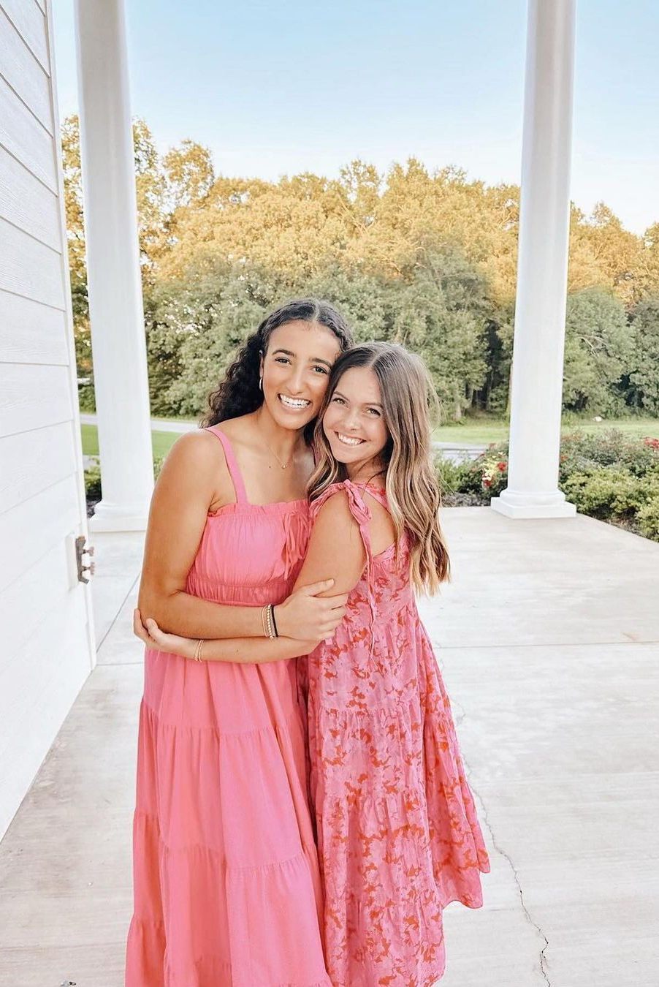
As Chapter President, you…
Lead the weekly chapter meeting and weekly Exec meeting
Meet with your Panhellenic Delegate weekly
Schedule monthly AAC/Exec Meetings and Chapter Leadership Team Meetings
Help to set the agenda and efficiently lead all meetings you preside over
Support your VPs with incorporating weekly specialty team meetings into their schedules and representing their team’s work in all meetings
Update your AAC Chair regularly after each of these meetings to discuss updates, concerns and best ways to mentor your team; and encourage each of your VPs to do the same with their AAC counterparts

Slide 31

Meeting Challenges
What would your initial, internal reaction be?
What would your intentional, external response be?
Example: Executive Council Officers are acting unprofessional and don’t take chapter meetings seriously.

Slide 32
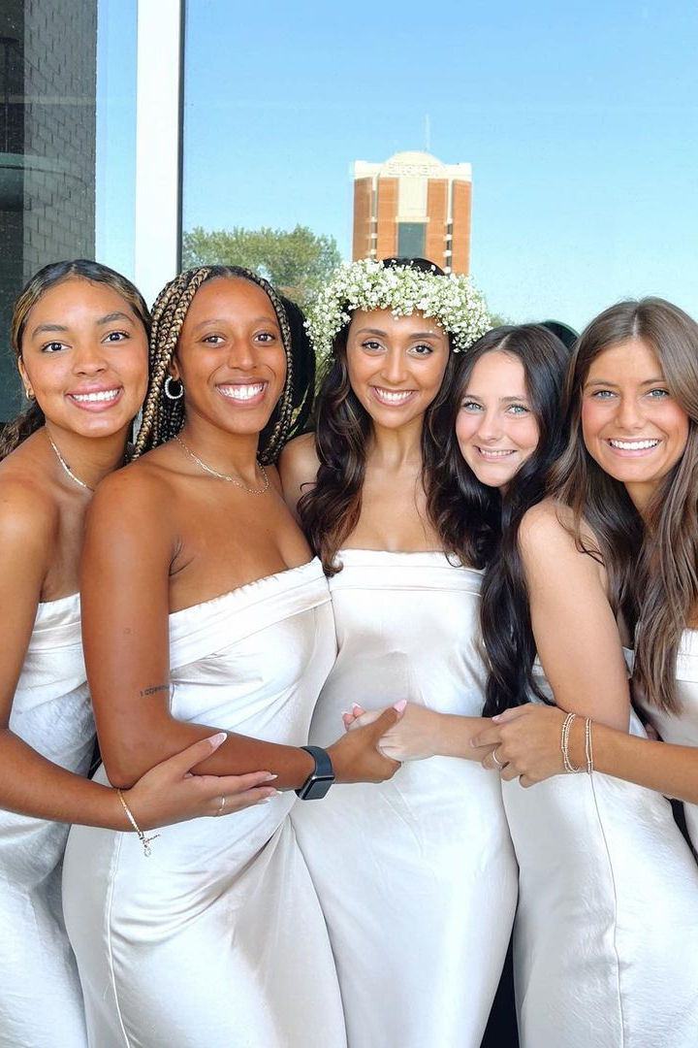
Common Meeting Challenges
Complaining cycles or negative loops in which teams get stuck
Difficulty encouraging member participation during meetings
Finding a balance between accomplishing the intended meeting agenda while also flexibly accommodating questions, concerns and side notes
Involving more introverted or silent participants
Creating motivation for implementing ideas, in terms of taking on additional responsibilities and tasks
Achieving consensus in the face of widely divergent opinions

Slide 33


3-2-1 Meeting Structure
Three reminders or tips
Two praises and celebrations of wins
One piece of feedback to improve on

Slide 34

Giving Feedback
Share feedback privately
Be proactive and timely
Offer positive and constructive thoughts
Prepare for the conversation
Ask your AAC Chair for advice

Slide 35
What skills will you support your Executive Council in developing over the next year?

Slide 36
Supporting the Panhellenic Delegate

Slide 37


National Panhellenic Conference
International conference for 26 women’s sororities
Local boards on campus called College Panhellenic Council
College Panhellenic Council has a board of elected members from all groups
Panhellenic Delegates represent each group on the campus for council business
Priorities:
Grow Panhellenic Communities
Champion the sorority experience

Slide 38

Manual of Information
Also known as the “MOI”
Contains all policies, best practices and procedures for College Panhellenics and the National Panhellenic Conference
Can be found in the Resource Library
Check this before escalating questions
When a Panhellenic matter arises, the first contact for you will be your Collegiate Regional Director.

Slide 39
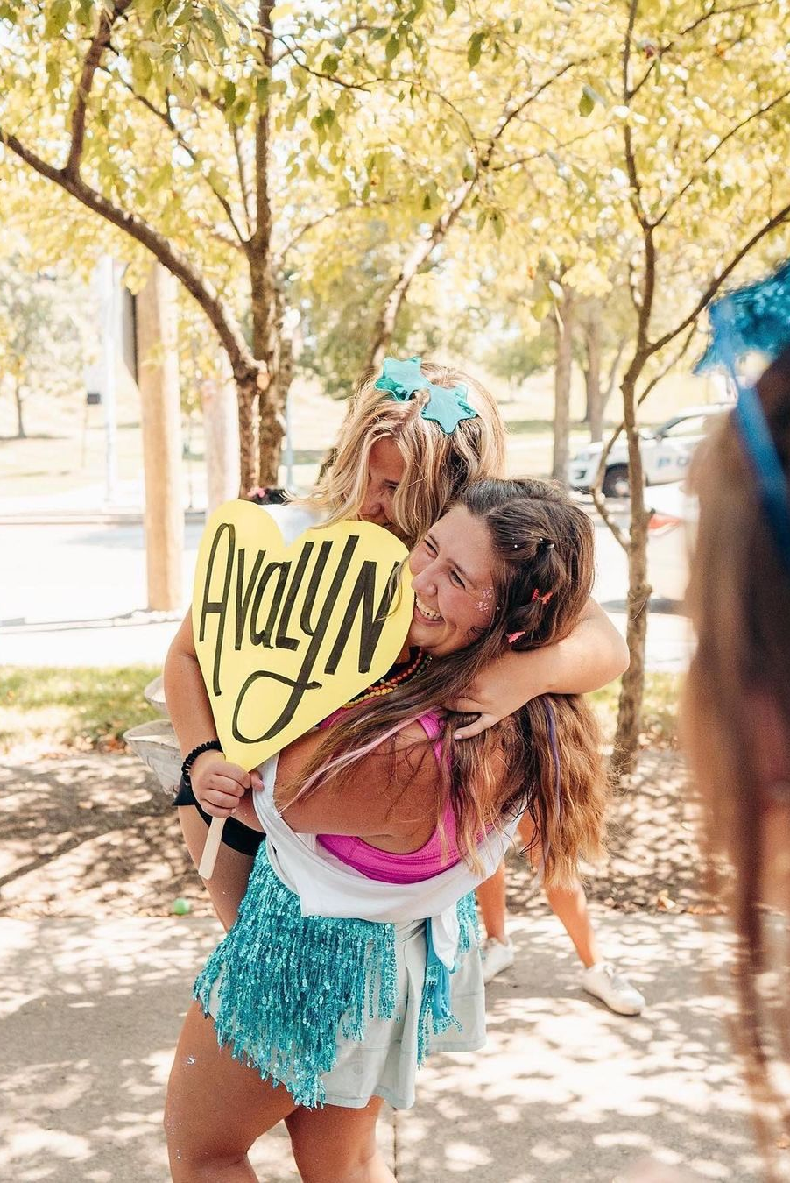
Escalated Panhellenic Matters
A list of items to escalate to your CRD can be found on pages 72-73 of your workbook
If one of these issues comes up on your campus or within your Panhellenic community, have your Panhellenic Delegate alert your CRD promptly

Slide 40
True or False?
The Chapter President attends all Panhellenic meetings with the Panhellenic Delegate.

Slide 41
False!
The Chapter President attends all Panhellenic meetings with the Panhellenic Delegate.

Slide 42
True or False?
The Panhellenic Delegate can propose a change to the Panhellenic bylaws.

Slide 43
True!
The Panhellenic Delegate can propose a change to the Panhellenic bylaws.

Slide 44
True or False?
The Panhellenic Delegate is considered a member of the Chapter Leadership Team.

Slide 45
True!
The Panhellenic Delegate is considered a member of the Chapter Leadership Team.

Slide 46
True or False?
The Panhellenic Delegate can share Panhellenic business at chapter meetings.

Slide 47
True!
The Panhellenic Delegate can share Panhellenic business at chapter meetings.

Slide 48
True or False?
The Chapter President is the chapter’s voting delegate when there is Panhellenic business to be voted on.

Slide 49
False!
The Chapter President is the chapter’s voting delegate when there is Panhellenic business to be voted on.

Slide 50

Supporting your Panhellenic Delegate
Meet 1:1 with your delegate regularly
Recognize when a matter needs to be escalated
Empower them in leadership and encourage active participation
Encourage involvement and positive Panhellenic relationships

Slide 51
Question & Answer

Slide 52


Roundtables
Leading Very Large Chapters (350-600)
Leading Large Chapters (200-350)
Leading Medium Chapters (100-200)
Leading Smaller Chapters (100 or less)
Managing the Chapter Leadership Team
Partnering with AAC
Campus and Panhellenic Partnerships
Chapter Elections
Risk Management and Peer Accountability
Primary Recruitment
Continuous Open Bidding (COB)
Chapter Facility Live-In Experience
Diversity, Equity and Inclusion
Philanthropic Efforts and Fundraising
Member Engagement and Morale
New Member Education Program
Senior Programming
What are some challenges you are facing in this area? What advice are you looking to receive?
What ideas do you have, or what have you seen work in this area?
What resources are available to help you in this area?

Slide 54
Organizational Priorities

Slide 55
Meeting Ritual Update
College Weekend 2025

Slide 56
The Origin of Our Meeting Ritual
Historical Significance:
Meeting Ritual adopted in 1893, 26 years after our founding
Emma Harper Turner determined we need a uniformed opening and closing to our meetings
Purpose:
Connect all members in shared, unifying practice of saying meeting Ritual
Modern Challenges:
Not consistently used across chapters
Some members feel disconnected or face challenges in practicing it
Misalignment with the beliefs or feelings of members
Our Commitment:
Pi Beta Phi is focused on empowering one another and creating a sisterhood where our members feel seen, understood, supported, and valued

Slide 57
Evolving Meeting Ritual
Informed Decision
Result of a two-year process of feedback, research, and dialogue
Preserving Tradition
Evolution honors our traditions
Aims to ensure every sister feels connected, welcomed, and valued
Purpose Remains Unchanged
Sets a unified tone for conducting Fraternity business

Slide 58
The Journey to Evolve
The 7 Guardrails for Ritual Evolution:
The Creed (phrases beginning with "Whatsoever") remains unchanged and used in the closing
Removes references to Christ, God, and Trinity
Infers core values without explicitly listing them
Maintains tone, cadence, and elevated language
Remains simple, short, and memorable
Aligns with Ritual's original purpose
Preserves historical significance

Slide 59
Reflect on what it means to live our Pi Phi values

Slide 60
What if this was how I felt?

Slide 61
What this Means for You
Pi Phi is sharing with alumnae clubs, members at large in phased communication plan
Current Ritual remains in use until Fall 2025
Does not impact Initiation
Meeting Ritual Evolution Guide to follow

Slide 62
Quotes from members this week...
"A tradition is just a tradition because it carries on. Soon, this new Ritual will be our tradition" - Chapter Officer
"While it's hard to personally let go of a long-standing tradition because its near and dear to my heart, it's worth it to make those that feel conflicted more included." - Chapter President
"I may need help in supporting our members who do identify as Christian or Catholic as this continues to roll out." - Chapter President
"I just attended the meeting Ritual zoom and wanted to say thank you for all the work Grand Council and HQ have put into this. Beyond the fact that I'm personally excited to see these changes that seem well thought out – I really appreciate how this is being announced and that the Fraternity is giving members a chance to feel heard and take time to process." - AAC Chair
"Our chapter has been using a meeting Ritual they have written, which they love. My biggest concern is getting them to adapt the new meeting Ritual." - AAC Chair
"I welcome these changes, and I appreciate the way this has been handled by the Fraternity. We learned from past experience, and we are sensitive to those afraid of change. Pi Phi is growing!" – Foundation volunteer and past Fraternity Officer

Slide 63
Meeting Ritual Update
College Weekend 2025

Slide 64
Being a President for All

Slide 65
Pi Beta Phi’s Definition of Inclusion
Inclusion: Being welcomed and truly valued for what you contribute. Pi Beta Phi desires to create an environment where all members feel they have a voice, are valued, feel validated and can fully participate.

Slide 66
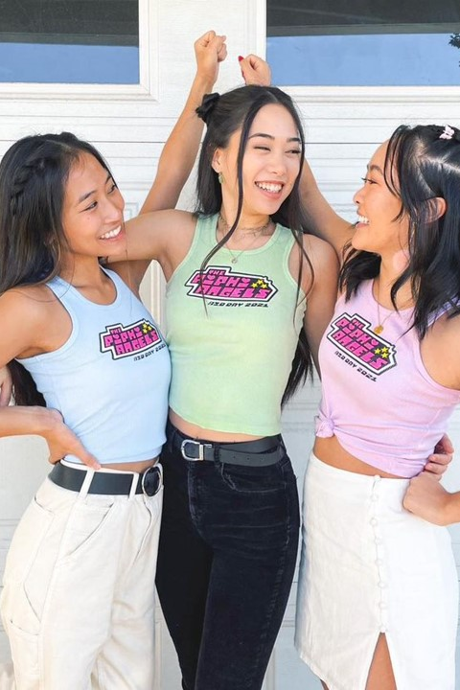
People feel included when they…
Are treated fairly
Feel their uniqueness is appreciated, and they have a sense of belonging
Have a voice in decision making

Slide 67
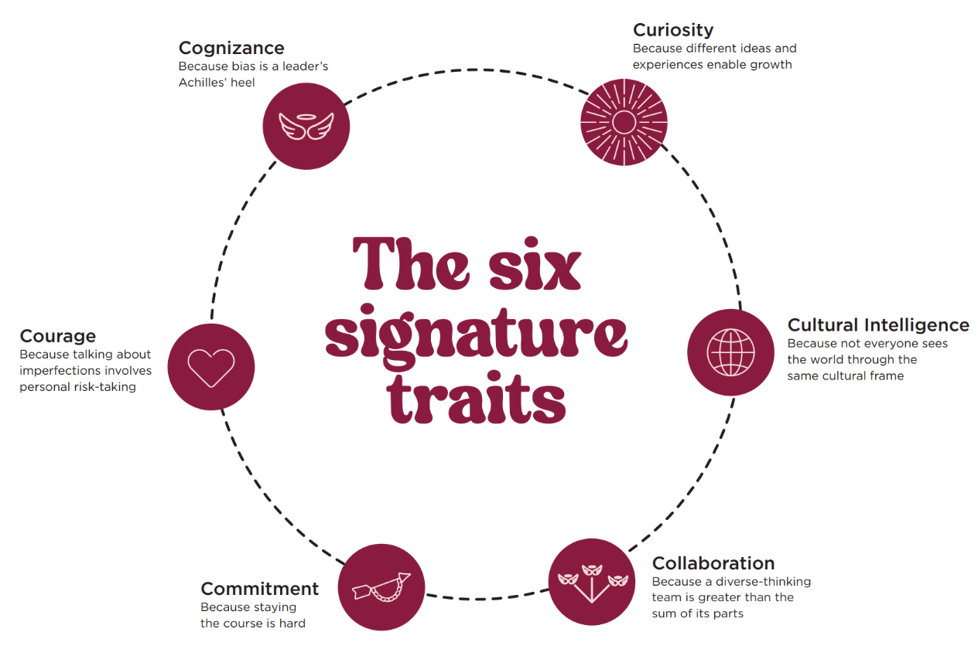
Deloitte’s Six Traits of Inclusive Leadership

Slide 68
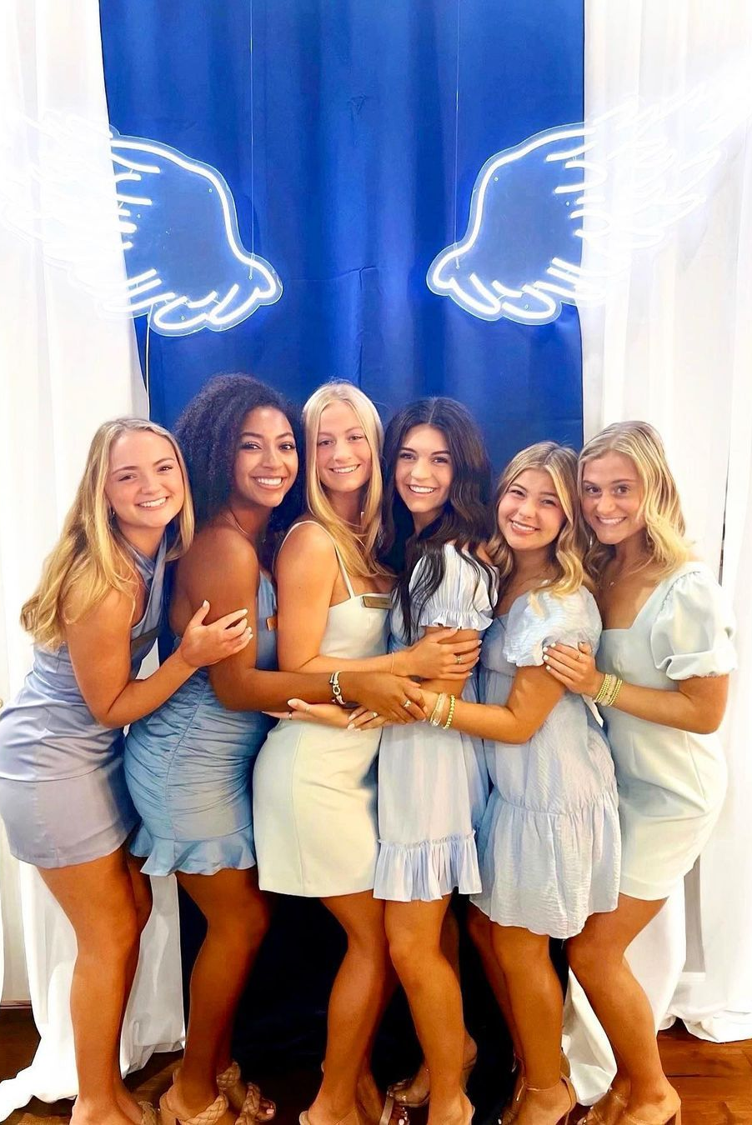
Inclusive Leadership Traits help leaders to:
Operate more effectively within diverse environments
Better connect with a diverse membership
Access a more diverse spectrum of ideas
Enable diverse individuals in the chapter to reach their full potential

Slide 69

People feel included when they…
Are treated fairly
Feel their uniqueness is appreciated, and they have a sense of belonging
Have a voice in decision making
What are three actions you can take as Chapter President to ensure your members feel included?

Slide 70
Member Accountability

Slide 71

Member Accountability in our Sisterhood
Through accountability, we:
  Keep each other safe
  Care enough about each other to point out mistakes so we can learn
  Protect the reputation and “brand” of our sisterhood
  Serve as good stewards of our chapter’s assets

Slide 72
Obstacles to Member Accountability
Lack of respect for the Member Conduct Committee and its function
Lack of belief that anything will happen
Distaste for “turning sisters in”
Attitude: no one can tell me what to do, everyone on campus is doing it, if my parents are ok with it, Pi Phi should be too
Attitude: it’s enough to say I’m sorry
Attitude: what I did was no big deal, I know others who have done the same thing without being referred for accountability

Slide 73
Quick Break!
Take the next five minutes to recharge.

Slide 74

Accountability Approaches
Awareness
Warning
Referral to AAC/Exec for further accountability consideration

Slide 75
Awareness
Non-accusatory way to make member aware or remind them of expectations
Policy education workshops = awareness!
Use when member is unaware of policies (like a New Member)
Do not use for egregious behavior or behavior a reasonable person knows is wrong

Slide 76
Awareness Meetings
Refer member to Member Conduct Committee
Discuss the behavior, listen to the member’s perspective
Reference what policy, expectation or value the behavior is violating
Ask the member to modify their behavior
Document the discussion

Slide 77
Warning
Non-accusatory way to warn a member that their behavior is below Fraternity standards and is placing their membership in jeopardy
Clearly informing them that continuation of poor member conduct may lead to probation, the breaking of a pledge or dismissal
Good option if the member is aware of the policies and there is a clear violation

Slide 78
Warning Meetings
Refer member to Member Conduct Committee.
Discuss the behavior, listen to the member’s perspective.
Reference what policy, expectation or value the behavior is violating.
Let the member know they are responsible for positively changing their behavior.
Discuss what might happen if they do not make positive changes, such as member accountability like probation or dismissal.
Document the discussion.

Slide 79
Referral Process
Final attempt to help a member positively change their behavior
Referring the member to be considered for further accountability by AAC/Exec
May be referred after a meeting with the Member Conduct Committee or immediately upon learning of violation
Good option, even on first occurrence of drug-related violations, alcohol on chapter property, hazing, violence or unlawful use of weapons, racially motivated actions, repeated violations already addressed by the committee, violation of General Probation terms, other escalated situations

Slide 80
Referral Process Activity
As a table, sort the referral step cards in the order you think they are handled in.
There is no pressure to get this perfect—give it your best guess!

Slide 81
Referral Process
Inform and Consult Regional Fraternity Officers
Verify Reported Misconduct
AAC/Exec Meet with Member in Question (MIQ)
Draft Terms of Probation
Terms reviewed and further approval requested
Notify the member of recommended accountability action
Chapter or special notice given
Chapter Meeting to consider the vote
Inform Fraternity Officers of vote outcome
Accountability follow-up
Vote to remove member from probation, extend probation or consider dismissal

Slide 82
Roundtables
Leading Very Large Chapters (350-600)
Leading Large Chapters (200-350)
Leading Medium Chapters (100-200)
Leading Smaller Chapters (100 or less)
Managing the Chapter Leadership Team
Partnering with AAC
Campus and Panhellenic Partnerships
Chapter Elections
Risk Management and Peer Accountability
Primary Recruitment
Continuous Open Bidding (COB)
Chapter Facility Live-In Experience
Diversity, Equity and Inclusion
Philanthropic Efforts and Fundraising
Member Engagement and Morale
New Member Education Program
Senior Programming
What are some challenges you are facing in this area? What advice are you looking to receive?
What ideas do you have, or what have you seen work in this area?
What resources are available to help you in this area?

Slide 84
Roundtables
Leading Very Large Chapters (350-600)
Leading Large Chapters (200-350)
Leading Medium Chapters (100-200)
Leading Smaller Chapters (100 or less)
Managing the Chapter Leadership Team
Partnering with AAC
Campus and Panhellenic Partnerships
Chapter Elections
Risk Management and Peer Accountability
Primary Recruitment
Continuous Open Bidding (COB)
Chapter Facility Live-In Experience
Diversity, Equity and Inclusion
Philanthropic Efforts and Fundraising
Member Engagement and Morale
New Member Education Program
Senior Programming
What are some challenges you are facing in this area? What advice are you looking to receive?
What ideas do you have, or what have you seen work in this area?
What resources are available to help you in this area?

Slide 85
Leading Through Crisis

Slide 86
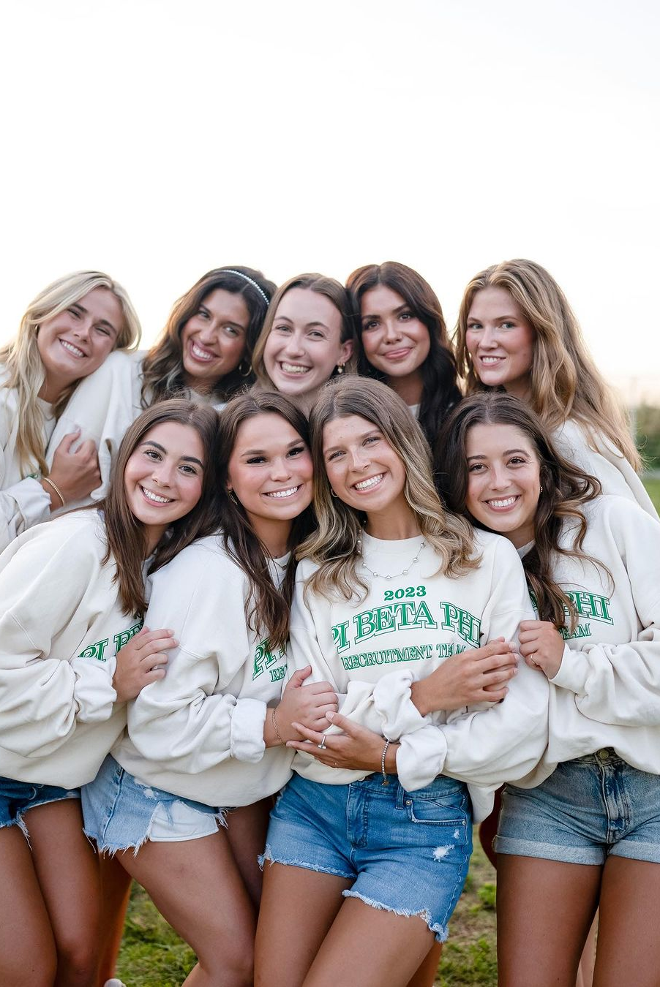
Serving as the Spokesperson
The Chapter President is the spokesperson for the chapter.
If approached by the media, including a student newspaper, all members must refer them to you, the Chapter President.
Only you, as the Chapter President, or Pi Phi Headquarters can make statements to media on behalf of the chapter or Fraternity.
If the chapter is called to an official meeting by the university, you represent your chapter and Pi Phi.
Similarly, if you are called to a meeting by Pi Beta Phi leadership, you represent your chapter.
In your role, you may encounter other times where you vote or speak on behalf of your chapter.

Slide 87
Defining an Emergency
Turn to page 82 in your workbook.
With a partner, you have 1 minute to make a list of as many emergencies you can think of.

Slide 88
Emergencies in Pi Beta Phi
Less Serious Individual Member Issues | Serious Individual Member Issues | Chapter Facility Threats | Campus/Community Threats
Minor injury or illness Other non-life-threatening member issues | Death of a member Drug or alcohol-related medical emergency Life-threatening medical emergency, hospitalization of a member Serious injury Suicide attempt or mental health hospitalization Sexual assault COVID-19 | Fire at the facility A crime takes place at the facility An event/ issue that may prevent members from remaining in the house or meeting there | Active shooter on campus Campus evacuation Severe weather or natural disaster Terrorist attack on or near campus

Slide 89


Emergency Procedures
Calls to be made:
Emergency Services (if needed)
AAC Chair, or other AAC member
Campus Fraternity/Sorority Advisor or point of contact in FSL office
Pi Beta Phi Emergency Hotline
(636) 236-9463

Slide 90
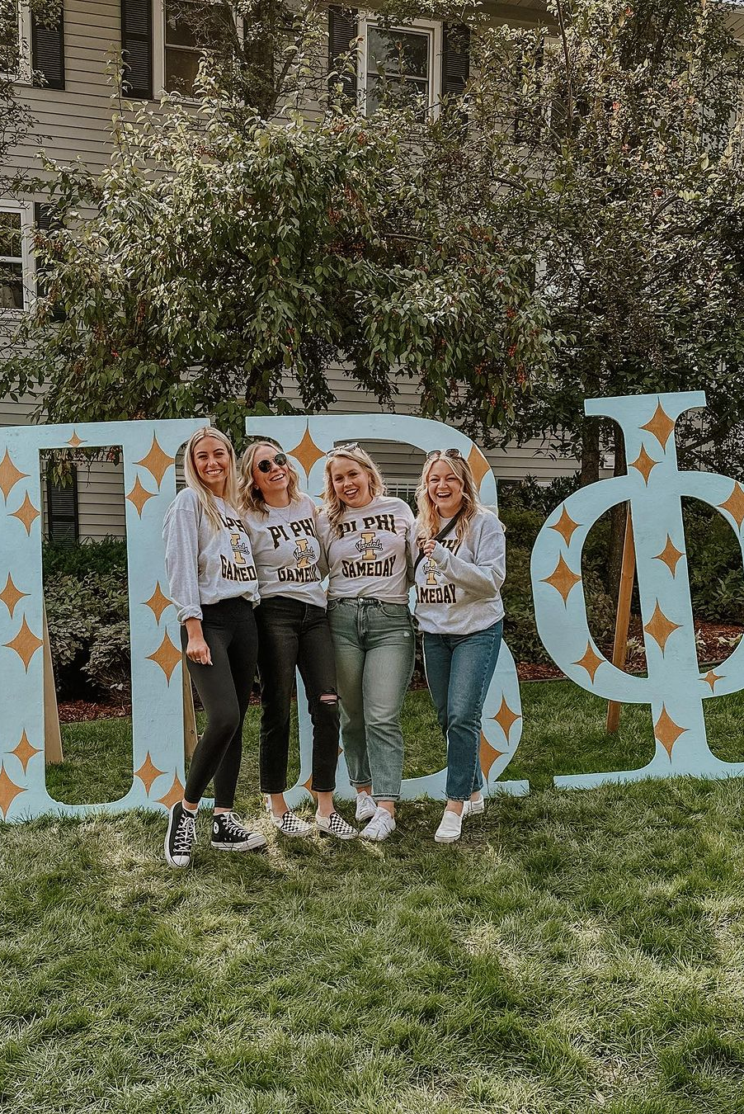
Calling the Emergency Hotline
Monitored after hours and on weekends; may not always be answered 24/7
Leave a voicemail if you don’t receive an answer
The staff member will take down information and distribute to others in Pi Phi
You’ll be asked to share as much as you know (year in school, new or initiated, what is their current condition, what information do you have, were emergency services called, have AAC, CHC or FSA been informed, etc.)
Chapter President should call unless unavailable
Call in a timely manner, immediately or the next morning

Slide 91
Leading Through
Change

Slide 92
Traditions are harmful if…
The tradition is not inclusive, and excludes a group or groups
The tradition could make someone feel uncomfortable
The tradition could be perceived negatively
The tradition is dangerous or illegal
The tradition does not embody Pi Phi’s core values
The tradition does not contribute to the mission or vision of Pi Beta Phi

Slide 93
Examples of Harmful Traditions
Not allowing New Members to use certain parts of the chapter facility
Not allowing New Members to wear Pi Beta Phi letters until initiation, or only allowing them to wear “Pi Phi”
Spirit Week traditions that are centered around the sophomores or seniors, involve alcohol or could be considered a social event
Keeping initiation week activities secretive or surprising New Members with activities throughout the week

Slide 94
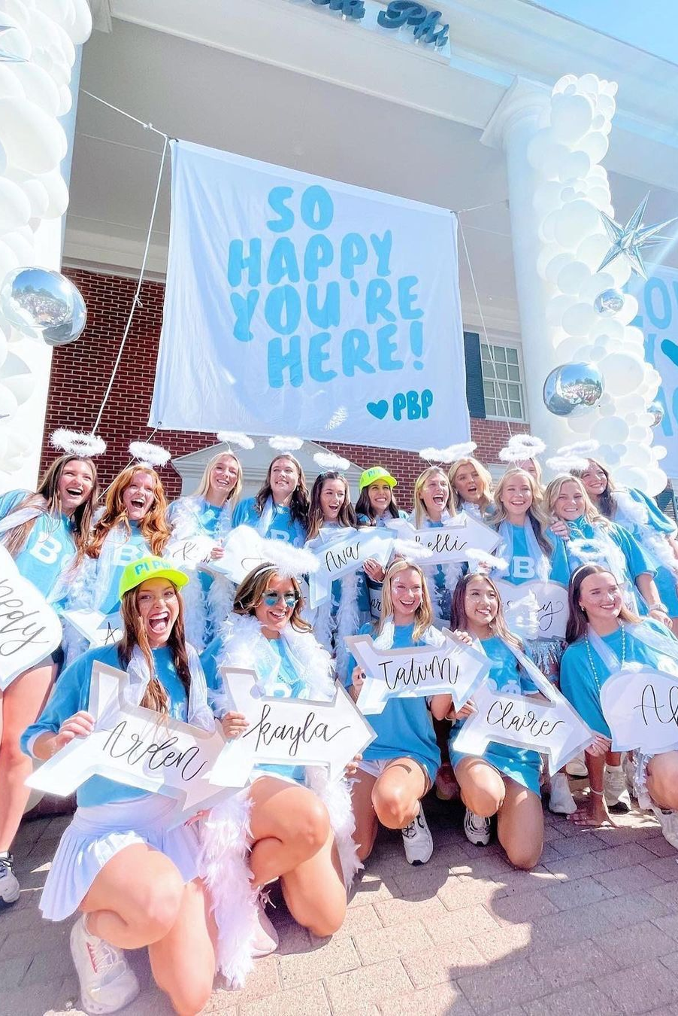
Your Chapter Traditions
On page 83 of your workbook, make a list of activities or practices your chapter considers a tradition.
Examples:
  Big/Little reveal
  Homecoming participation
  Senior expectations
  Recruitment rounds
  Social event themes
  Founders’ Day activities
  Annual philanthropy or sisterhood events

Slide 95
What are some challenges we may encounter when trying to change something in our chapter?

Slide 96
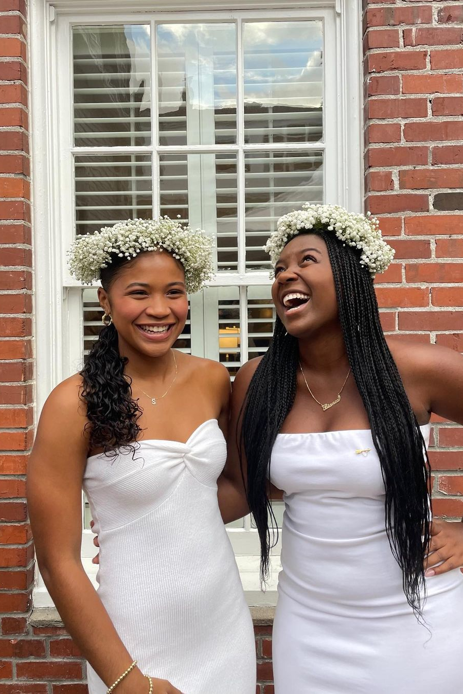
Steps to Creating Change
Recognize a need for change
Identify your team
Share your ideas and gather feedback
Re-evaluate your plan with the feedback you received
Make a plan for implementation with Executive Council
Present the final outcome, explain how feedback was considered and taken into account, and share plan for implementation

Slide 97
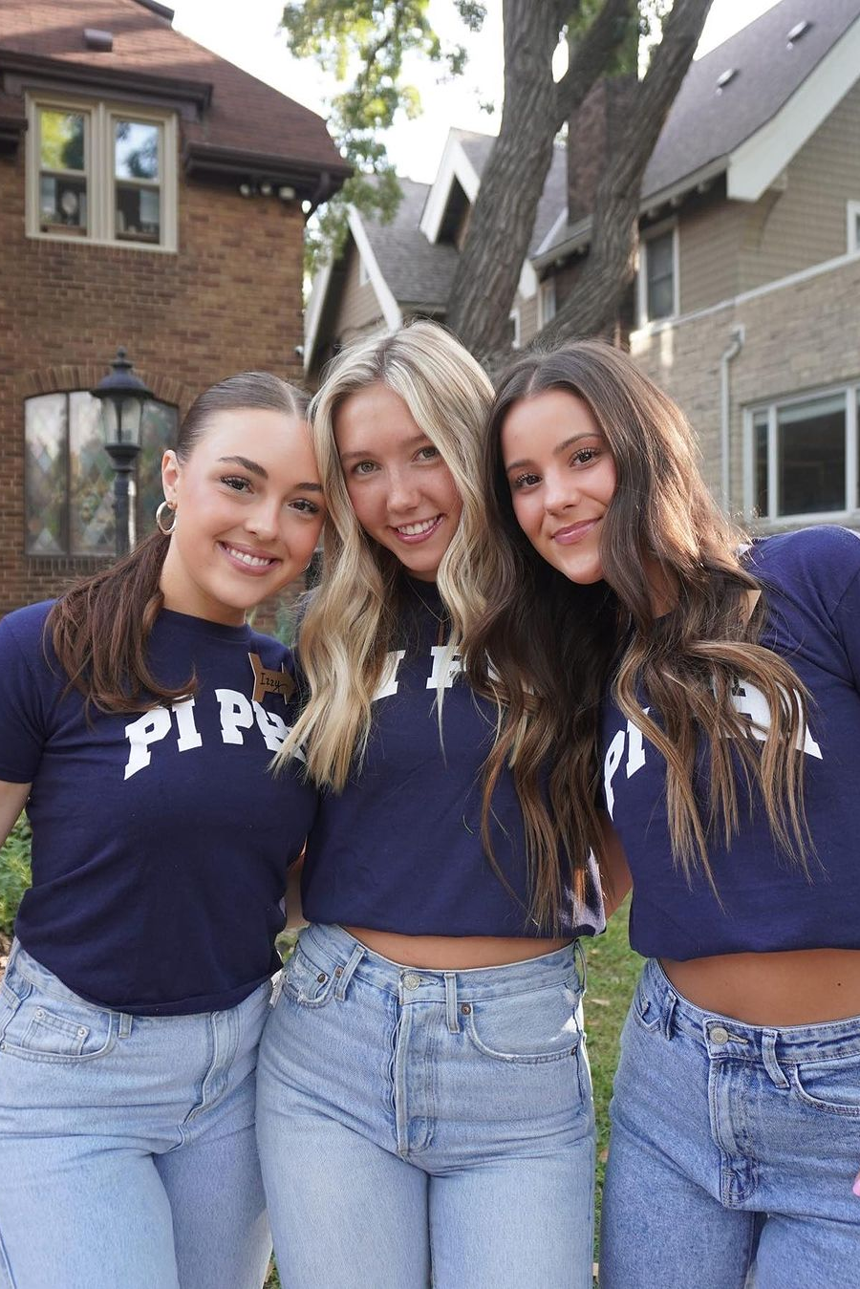
Pair and Share
Turn to a partner and share one thing you are looking to change in your chapter this year
In return, your partner should share one piece of advice or an idea for you to consider
Switch roles and repeat!

Slide 98
Building Your 2025 Roadmap

Slide 99

Monthly Chapter Evaluation
Outlines Pi Beta Phi’s expectations of collegiate chapters and encourages meaningful reflection of chapter accomplishments on a monthly basis in Executive Council meetings
Two levels of standards: Meeting Expectations and Exceeding Expectations
Report submissions from the Chapter President and Vice Presidents are due quarterly on March 1, June 1, September 1 and December 1
Chapter President reports on behalf of themselves and Panhellenic Delegate and ensures completion from Vice Presidents
When submitting a report, check the box to receive a copy of your submission and forward this to your AAC Chair

Slide 100
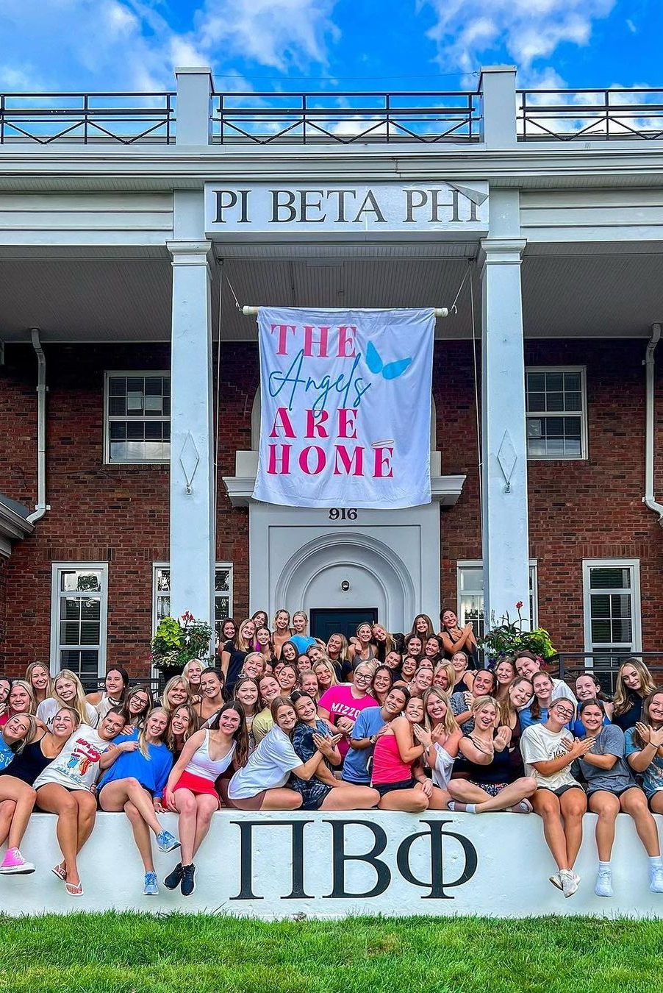
Action Planning
Review 2025 Monthly Chapter Evaluation standards on page 54 of your workbook.
Set goals for your team on pages 86-87.

Slide 101
Wrap-Up

Slide 102
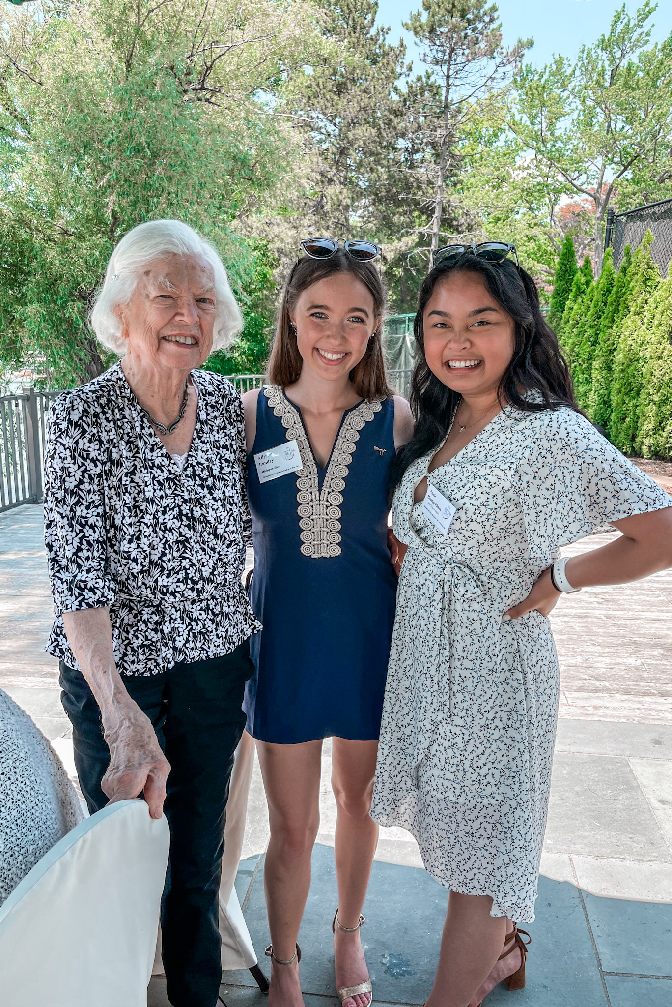
Attitude of Gratitude
Write a thank you note to your AAC counterpart.
A few ideas of what to include:
    Thanking them for the assistance they have and will give you
    Sharing something you’re excited about as it relates to working with them
    Your hope for what you’ll accomplish together
    A quality they have that will help you reach those goals
Write their name and your chapter on a sticky note and stick it on the note so Headquarters can mail it.
  Raise your hand if you don’t know your AAC Chair’s name!

Slide 103

If another Chapter President reached out to you for advice or needed motivation, what would you tell them?
1. Take a blank piece of paper and write it down

Slide 104

If another Chapter President reached out to you for advice or needed motivation, what would you tell them?
1. Take a blank piece of paper and write it down
2. Crumple that piece of paper up and throw it across the room!

Slide 105

Chapter President GroupMe
If you haven’t been added to it yet- join the CP GroupMe!

Slide 106
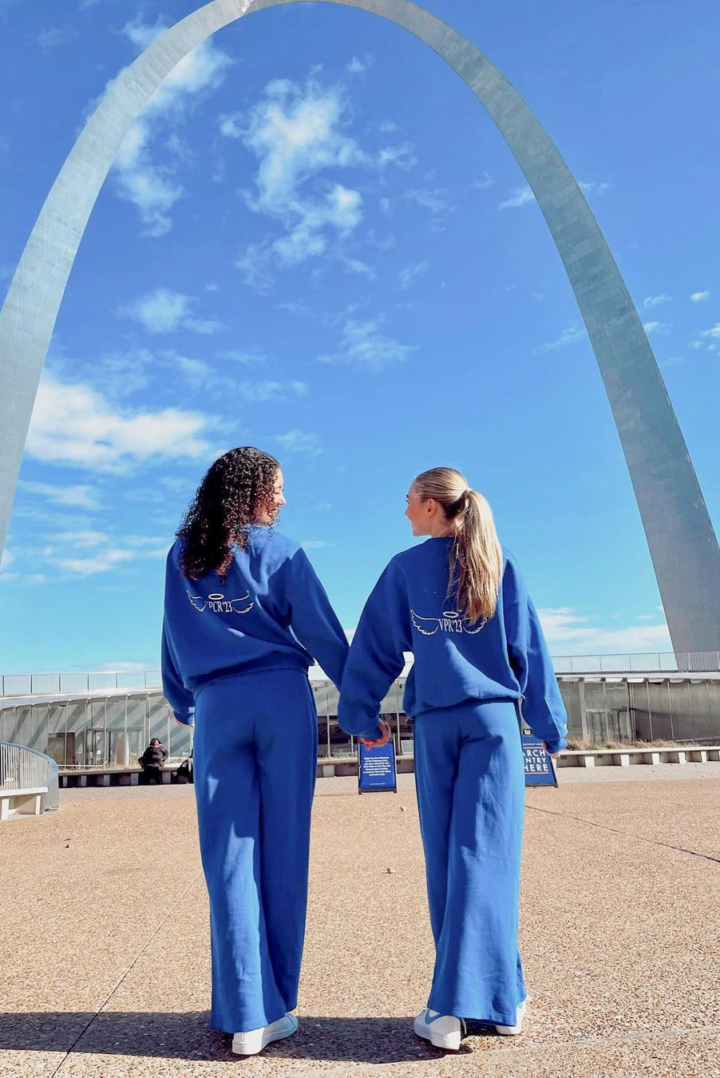
That’s a wrap on the Chapter President College!
Pi Beta Phi College Weekend
January 24-26, 2025

